Slide 1
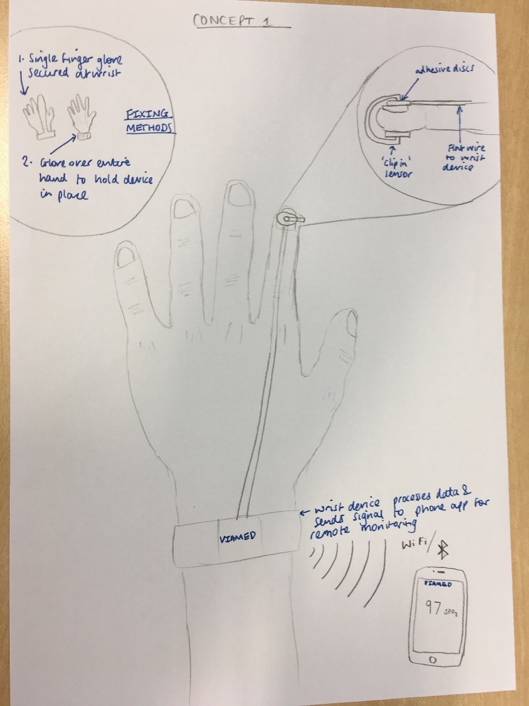
Concept I: The Doughnut
CONFIDENTIAL
Description
An adhesive doughnut based disc that is placed on the digit (finger or toe) . The sensors then clip in to the hole providing a secure fixation. This can be covered by a specially designed finger glove or full glove.
The monitor is a watch like device connected by a short flat wire to sensor
Benefits
Better alignment
Can be worn during activity
Easy attachment
Reduced risk of probe becoming detached
Comfortable, reduced pressure on sensor
Robust
The wrist monitor processes the information and can wirelessly transmit the oximetry reading (and alarms) to the parent or carer who can monitor remotely (e.g. on an app on a mobile phone).

Slide 2
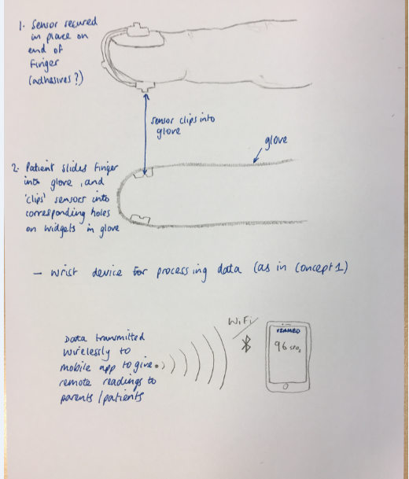
Concept 2: The Glove Clip
CONFIDENTIAL
Description
A bespoke sensor that is secured on the finger by the patient sliding his or her finger into a glove that clips the sensor into corresponding holes or widgets in glove.
A wrist device (watch design) is used to process data (as in concept 1)
Benefits
Better alignment
Can be worn during activity
Easy attachment
Reduced risk of probe becoming detached
Comfortable, reduced pressure on sensor
Robust
The data can then be wirelessly transmitted to the parent or carer to an app on their mobile phone.

Slide 3
Concept 3: Sensor in glove
CONFIDENTIAL
Description
Similar to concept 2, but sensor is within the glove

Slide 4
Concept 4: The leg sensor
CONFIDENTIAL
Description
Need to define?

