Slide 1
EN ISO 14971:2012
Suzanne Halliday
May 2013

Slide 2
Harmonised Standard – EN ISO 14971:2012
EN ISO 14971:2012 published 31 July 2012.
No transition period
On the same day EN ISO 14971:2009 ceased to give presumption of conformity with the ERs of 93/42/EEC, 90/385/EEC and 98/79/EC.
Normative text EN ISO 14971:2012 = EN ISO 14971:2009 = ISO 14971:2007
Annex ZA, ZB and ZC explain “to which requirements, under which conditions and to what extent presumption of conformity can be claimed.”
In general the Directives require more than ISO 14971.

Slide 3
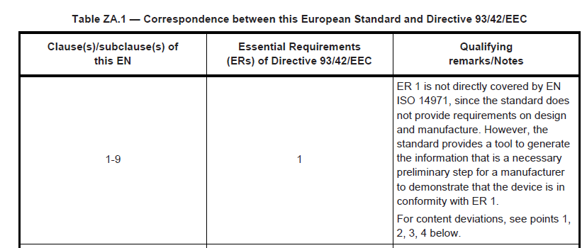
From Annex Z’s

Slide 4
Deviation #1
‘...all risks, regardless of their dimension, need to be reduced as much as possible (and need to be balanced, together with all other risks, against the benefit of the device).’
MDD
(AIMD)
IVD
‘D.8.2 ...the manufacturer may discard negligible risks.’
ISO 14971
Notes:
AIMD deviation does not contain the parenthetical language.

Slide 5
Deviation #3
‘....risks to be reduced "as far as possible" without there being room for economic considerations.’
‘3.4 & D.8 …contains the concept of reducing risks "as low as reasonably practicable.”
The ALARP concept contains an element of economic consideration.’
MDD
AIMD
IVD
ISO 14971

Slide 6
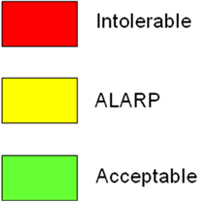
Have all risks been reduced as much as possible?
 | Extend of damage
10 |  |  |  |  |  |  |  |  |  |  | Probability of occurrence
9
8
7
6
5
4
3
2
1
 | 1 | 2 | 3 | 4 | 5 | 6 | 7 | 8 | 9 | 10
There must another step – ALARP & Acceptable do not meet the requirements of the Directives.

Slide 7
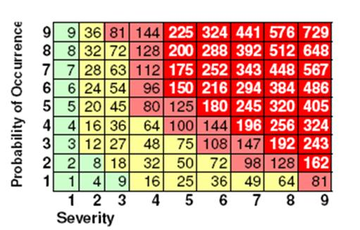
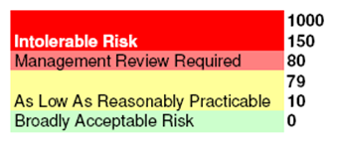
Have all risks been reduced as much as possible?
There must another step – ALARP & Broadly Acceptable do not meet the requirements of the Directives.

Slide 8
Deviation #2
‘....all risks have to be reduced as far as possible (and that all risks combined, regardless of any "acceptability" assessment, need to be balanced, together with all other risks, against the benefit of the device).’
MDD
(AIMD)
IVD
‘5, 6.4, 6.5 & 7 ...manufacturers have the freedom to decide upon the threshold for risk acceptability.’
‘D.6.1 …only non-acceptable risks have to be integrated into the overall risk-benefit analysis.’
ISO 14971
Notes:
AIMD deviation does not contain the parenthetical language.

Slide 9
Deviation #4
‘....an overall risk-benefit analysis must take place in any case, regardless of the application of criteria established in the management plan of the manufacturer....(and requires undesirable side effects to "constitute an acceptable risk when weighed against the performance intended”).’
‘6.5 ...an overall risk-benefit analysis does not need to take place if the overall residual risk is judged acceptable when using the criteria established in the risk management plan.
D.6.1 "A risk/benefit analysis is not required by this International Standard for every risk.”’
MDD
AIMD
(IVD)
ISO 14971
Notes:
IVDD deviation does not contain the parenthetical language.

Slide 10
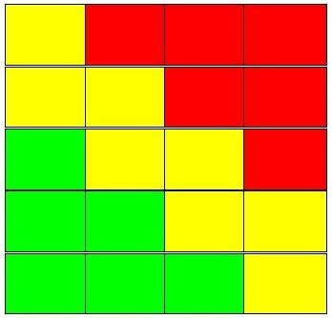
Has a risk benefit analysis been conducted for all risks?
Frequent
2
Conduct Risk v Benefit
Probable
Consider Risk v Benefit
6
4
Occasional
Acceptable
3
Remote
3
Improbable
2
Critical
There must be a risk benefit analysis for all risks.
Insignificant
Inconvenient
Disasterous

Slide 11
Deviation #5
‘...."to select the most appropriate solutions”.....by applying cumulatively what has been called "control options” or "control mechanisms" in the standard.’
MDD
IVD
‘6.2 ...obliges the manufacturer to "use one or more of the following risk control options in the priority order listed.”’
‘6.4 …indicates that further risk control measures do not need to be taken if, after applying one of the options, the risk is judged acceptable according to the criteria of the risk management plan.’
ISO 14971
Notes:
IVDD deviation does not contain the parenthetical language.

Slide 12
Deviation #6
‘..."eliminate or reduce risks as far as possible (inherently safe design and construction)".’
‘6.2.... obliges the manufacturer to "use one or more of the following risk control options in the priority order listed: (a) inherent safety by design (b) protective measures (c) information …" without determining what is meant by this term.’
MDD
IVD
ISO 14971
Notes:
MDD & IVDD Control Options:
Inherent safety by design
Protective measures in the medical device itself or in the manufacturing process
Information for safety

Slide 13
Have risks been designed out if possible?
Part Number | Failure Mode | Cause of Failure | Local Effect | System Effect | Initial Rating |  |  | Risk Reduction Action | Updated Rating
 |  |  |  |  | SEV | PRO | RPN |  | SEV | PRO | RPN
Mesh | Suture pulls out on the edge | Design of mesh / cutting edge | Failed repair | Revision | 7 | 5 | 35 | IFU instructs not to cut mesh and not to place sutures closer than 5mm to edge | 7 | 3 | 21
Risks must be designed out if possible. Risk control options must be applied until risks have been reduced as much as possible.

Slide 14
Deviation #7
‘....users shall be informed about the residual risks. This indicates that....the information given to the users does not reduce the (residual) risk any further.’
MDD
IVD
‘2.15 & 6.4 …residual risk is defined as the risk remaining after application of risk control measures.’
‘6.2 …regards "information for safety" to be a control option.’
ISO 14971
Notes:
MDD & IVDD Control Options:
Inherent safety by design
Protective measures in the medical device itself or in the manufacturing process
Information for safety

Slide 15
Have residual risks been incorrectly reduced?
Device | Failure Mode | Effect | Initial Rating |  |  | Risk Control | Updated Rating
 |  |  | SEV | PRO | RPN |  | SEV | PRO | RPN
Implant | Emboli | Death | 4 | 3 | 12 | IFU warning | 4 | 1 | 4
A warning does not reduce the probability of occurrence of an emboli.

Slide 16
Questions?

