Slide 1
MDSAP Overview
Damon Williams
Business Development Manager - BSI

Slide 2

What is

Slide 3
MDSAP Update
Agenda
What is MDSAP
How MDSAP Works
How does MDSAP fit with other certifications
MDSAP Status

Slide 4
Medical Device Single Audit Program (MDSAP)
History
Result of one of the 6 Working Groups created by the International Medical Device Regulatory Forum (IMDRF)
Global approach to auditing and monitoring the manufacturing of medical devices to ensure safe medical devices
An international coalition to quickly pilot the program
Objective:
  to jointly leverage regulatory resources to manage an efficient, effective, and sustainable single audit program focused on the oversight of medical device manufacturers.
Notes:
WHAT IS MDSAP?
The MDSAP Work Group was created at the inaugural IMDRF meeting Sep 2012.
An international coalition quickly agreed to pilot the program from Jan 2014 to Dec 2016.
4 regulatory bodies: Australia, Brazil, Canada, USA initially, with Japan as observer. June 2015 Japan officially part of coalition

Slide 5
MDSAP
Program Objectives
Develop, manage, and oversee a single audit program that will allow a single regulatory audit to satisfy the needs of multiple regulatory jurisdictions
To promote greater alignment of regulatory approaches and technical requirements
To promote consistency, predictability, and transparency of regulatory programs

Slide 6
MSDAP
Manufacturer Benefits
No additional requirements for manufacturers
Single audit optimizes time and resources
Routine audits are scheduled/planned with AO
Expected to improve predictability
Expected to add additional Regulatory Authorities

Slide 7
MDSAP Program Status
Use of outputs of MDSAP audits
Australia | Brazil | Canada | Japan | USA
Use as part of evidence to assess compliance with MD market authorization requirements | Input for ANVISA’s premarket and post-market assessment procedures | Concurrent with CMDCAS until ends in late Dec 2018 | Report might be utilized for a desk review for class 2,3,4 in lieu of a premarket inspection performed by PMDA or registered certification bodies in Japan | Substitute for Routine Inspections only. Not for PMA, “For Cause” or “Compliance Follow-up”
 | Audits in lieu of ANVISA inspection to grant GMP certs for class 3,4 | Use of certificate for obtaining/maintaining a Class 2,3,4 device license | report might also be utilized for periodic post market inspections | Report review with scrutiny on significance of findings
 | For renewal of ANVISA’s GMP certs bi-annually | From January 2019, Health Canada will only accept MDSAP certificates | Reports will be used in review of on-site inspection for eligible sites so as to obtain a QMS certificate | May use Warning Letters if conclusion of imminent/unreasonable risk to public health

Slide 8
How MDSAP works

Slide 9
MDSAP Structure
Regulatory Authorities
Assessments
Auditing Organizations
Audits NCs/CAPs
Manufacturers
NCs/CAPs
Reports
Notes:
In a nutshell, the RA’s assess and qualify the AO’s,
Qualified AO’s audit the Manufacturers and send the reports to the AO’s.
Procedures have been implemented to ensure consistency across the RA’s and the Assessments that they conduct of the AO’s, as well as the AO’s, and the Audits that they conduct of the Manufacturers.

Slide 10
MDSAP
Audit Cycle
Three Year Audit Cycle
  Initial Audit (Stage One & Stage Two)
  Surveillance Audits (Years 1 and 2)
  Re-audit (Recertification Audit)
    Note that not all Regulatory Authorities require “certificate”
Other Possible Audits
  Special Audits
    changes, nonconformances, suppliers, post-market issue follow-up
  Audits by Regulatory Authorities
  Unannounced Audits (to close major nonconformances)
Notes:
Now for a deeper dive into the audits themselves.

Slide 11
MDSAP
Program Requirements
ISO 13485 plus applicable Country-specific requirements
A separate report is required per site.
To recommend certification to MDSAP all applicable processes and jurisdictions must be audited.
There is no sampling of design and manufacturing sites permitted in the MDSAP program.
All RA’s in the program get copies of submitted reports
  Not subject to US FOI Act
Notes:
Requirements to which manufacturers will be audited to consists of two primary parts:
ISO 13485 requirements, and Country-specific requirements
These are clearly identified in the Audit Model document
If a manufacturer is shipping product to a MDSAP jurisdiction, country-specific requirements WILL apply

Slide 12




Regulations in addition to ISO 13485
 | Requirements
 | Therapeutic Goods Act 1989 Therapeutic Goods (Medical Devices) Regulations 2002
 | ANVISA Pre-Market Approval RDC 185/2001 ANVISA Good Manufacturing Practices RDC 16/2013 ANVISA GMP Certification – Requirement for Product Registration RDC 25/2009 ANVISA PMS RDC 67/2009 and RDC 23/2011
 | Food and Drugs Act R.S.C., 1985, c. F-27 CMDR SOR-98-282
 | Quality System Regulation 21 CFR 820, Medical Device Reporting 21 CFR 803, Reports of Corrections & Removals 21 CF 806, Registration & Listing 21 CFR 807 subparts A to D, Device Tracking 21 CFR 821
 | MHLW Ministerial Ordinance No. 169

Slide 13
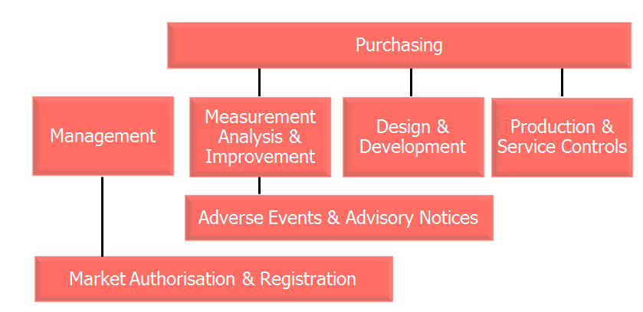
MDSAP Audit Sequence
Notes:
Here is a graphic representation of the sequence. Would basically follow the primary processes, but linkages to the supporting processes could take place as the audit progresses. Parts of Purchasing could be looked at during any of the primary processes. Risk Management would be expected to underlie all processes.
Follows the process approach, top down
Four Primary processes
Management
Measurement, Analysis and Improvement
Design and Development
Production and Service Controls
Three Supporting Processes
Device Marketing Authorization and Facility Registration
Medical Device Adverse Events and Advisory Notices Reporting
Purchasing

Slide 14
MDSAP Audit Process Sequence and Estimated Durations
MDSAP Process | MDSAP Tasks per Process | Minutes per Audit Task
Management | 11 | 36.0
Device Marketing Authorization &Facility Registration (DMA&FR) | 3 | 35.0
Measurement Analysis & Improvement (MA&I) | 16 | 38.0
MD Adverse Events & Advisory Notice Reporting (MDAE&ANR) | 2 | 38.0
Design & Development (D&D) | 17 | 21.0
Production & Servicing Controls (P&SC) | 29 | 44.0
Purchasing | 16 | 15.0

Slide 15
MDSAP Audit Time Calculations SAMPLE
hh:mm
 | Initial Cert. | Surv 1* | Surv 2* | Recert.
Management | 6:36 | X | X | 6:36
DMA&FR | 1:45 | X | X | 1:45
MA&I | 10:08 | X | X | 10:08
MDAE&ANR | 1:16 | X | X | 1:16
D&D | 5:57 | x | X | 5:57
P&SC | 21:16 | X | x | 21:16
Purchasing | 4:00 | x | x | 4:00
On-site Total | 50:58 (6.5d) | ~70% of cert. | ~70% of cert. | 50:58 (6.5d)
* D&D and P&SC can be split between Surv 1&2, Purchasing to follow based on device trail.

Slide 16
MDSAP Audit Program
Considerations for audit time adjustments
Past Nonconformance review adds time to MA&I
D&D tasks adjustments:
  No design then only task 1 & 16
  No active role with new device design or devices prior to regulatory design requirements tasks limited to 1,4 & 13-16
  Devices containing SW may result in duplicate D&D tasks
P&SC task adjustments
  Multiple processes will add time per process
  Limited processes and no changes since last audit may reduce time
Purchasing time will be dependent on number of critical suppliers and will include intra-company entities, where applicable

Slide 17
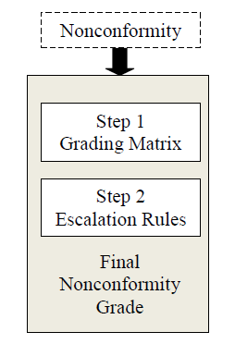
MDSAP
Nonconformity Grading
Uses GHTF Document SG3/N19:2012 - Nonconformity Grading System for Regulatory Purposes and Information Exchange
Definition of nonconformity unchanged – non-fulfillment of requirement
Creates a quantitative grading system
Notes:
Nonconformity grading differs from minor/major used in ISO audits

Slide 18
MDSAP Nonconformity - Initial Grading Matrix
Impact
Occurrence
QMS Impact on safety & performance | Direct Clauses 6.4 thru 8.5 | 3
 | Indirect Clauses 4.1 thru 6.3 | 1
Occurrence in same sub-clause (X.X.X | Repeat during last 2 QMS audits | +1
 | First | 0

Slide 19
MDSAP Nonconformity - Escalation Rules
Escalation
Matrix
Absence of documented process or procedure
Release of a nonconforming medical device
Absence of Process or Procedure | +1
Led to Nonconforming devices on market | +1
Escalation Criteria

Slide 20
MDSAP Nonconformity Grading - Final
QMS Impact | Direct | 3 | 4 | Absence of Process or Procedure | +1
 | Indirect | 1 | 2 | Led to Nonconforming devices on market | +1
 |  | First | Repeat
 |  | Occurrence |  | Escalation Criteria
Maximum grade is a 5.

Slide 21
MDSAP Program Update
Manufacturer’s next steps
Assess markets for the sale of your product now and in the future
If you have are due for recertification to CMDCAS and intend to market in Canada you should consider transition to MDSAP when you are up for recertification.
  Those who have already recertified in 2016 you will need to become certified to MDSAP before your next recertification comes up.
Coordination of MDSAP and ISO 13485:2016 is crucial in your planning process.
Contract for your MDSAP audit - ASAP time is of the essence!!!
Use On-Line survey to provide feedback to the regulators about your experience with the MDSAP program. http://www.fda.gov/MedicalDevices/InternationalPrograms/MDSAPPilot/default.htm

Slide 22
MDSAP Program Update
QUESTIONS ???

