Slide 1
ABINGDON HEALTH
Marsha Leeman
IVDR - Practical company case study
09th July 2019

Slide 2

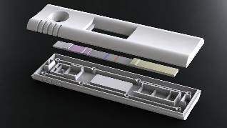


Overview of ABINGDON HEALTH
Rapid diagnostic testing company founded in 2008 by Chris Hand and Chris Yates.
Certified Quality Management System - ISO 9001:2015 & ISO 13485:2016
We support the migration of testing closer to the patient -- in the case of clinical diagnostics or veterinary diagnostics -- or into the field or farm -- in the case of agricultural and food diagnostics.
Our technology focus is lateral flow testing -- which is cost-effective to produce, easy to use, and widely accepted by users and regulatory authorities.

Slide 3
Our Focus is the Growing Lateral Flow Market
We support our customers through offering a complete development and manufacturing service.
We develop our own products such as Seralite® - FLC Serum, the first product we launched is now sold in 70 countries worldwide.
We invest in new technology, particularly reader and app innovation, to support our growth plans.
Own-products
Contract services
Reader platform
Innovation

Slide 4
IVDR Readiness – Case Study
Project Timeline of Implementation of IVDR
Hard deadline
(self – declared IVD’s)
2017
5 year transition period
Period grace
May 2024
NB application
No IVDD CE may be issued
Entry into force
May 2017
Date of application
26th May 2022
All unexpired IVDD certificates now expired
May 2024

Slide 5
IVDR Readiness – Case Study
Impact on Abingdon Health in vitro product range
Seralite® - FLC Serum
Seralite ® - FLC Urine
FLC LFD Controls
ADxLR5® Reader System
ADxLR5® QC Device
Current Classification vs revised IVDR
IVD - Self certification
IVDR – Class C

Slide 6
IVDR Readiness – Case Study
Classification – IVDR (Annex VIII)
D
High Population, High Patient Risk
Low Population, High Patient Risk
C
OEM
Abingdon Health
Medium, low patient Risk
B
Low patient Risk
A
Guidance expected from the CAMD

Slide 7
IVDR Readiness – Case Study
Impact on OEM customer products
OEM Scenario 1
OEM Scenario 2
OEM Scenario 3
OEM customer – collaborative transition
OEM customer – Development, IVDR integrated within the project planning
OEM customer – conducts transition
All three impact Abingdon Health Service Provision

Slide 8
IVDR Readiness – Case Study
Transition Strategy
Conduct Gap Analysis:
Intended use and product classification
Revision of current risk assessments
ERCL vs GSPR
Authorised Persons
Increased Clinical requirements
Note: ERCL replaced by the General Safety and performance requirements summary (GSPRs)
Abingdon Health & OEM

Slide 9
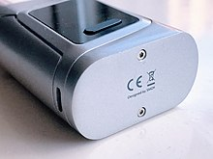
IVDR Readiness – Case Study
Transition Strategy
Conduct Gap Analysis:
Notified body review (Who? )
LRQA withdrawing from the race ‘will not apply to be an NB under the new medical device and in vitro diagnostic regulations (MDR/IVDR)’.
Engagement with NB early to avoid bottle necks…….
Designated NB for authorisations of CE Certificates still to be appointed (May 2019).

Slide 10
IVDR Readiness – Case Study
Clinical Trials – Planning
Abingdon Health:
Identification of clinical test sites
Ethics
Sample availability
Clinical protocols
Cost
Note: Sample availability is a key factor when planning Clinical Trials (rare, limited availability)
‘Capturing any impact in pre-submissions is critical especially for FDA approval’
ISO 14155:2011 - Clinical investigation of medical devices for human subjects -- Good clinical practice (Third Edition in draft)
and,
ISO 20916:2019 - In vitro diagnostic medical devices. Clinical performance studies using specimens from human subjects. Good Study Practice.

Slide 11
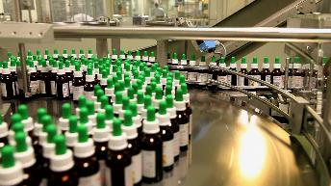


IVDR Readiness – Case Study
Clinical Evidence:
(Gap analysis identified a number of areas for address)
Resource
Active sites (willing and able)
Clinical investigations protocols
Clinical data review
Cost
Current sales sufficient to offset the
higher cost of certification
Operations:
Impact on manufacturing capacity - for clinical requirements

Slide 12

IVDR Readiness – Case Study
Evaluation of performance – product life cycle
Clinical
Scientific
Analytical
Analytical Performance
Clinical Performance
Scientific Validity
ERCL replaced by the General Safety and performance requirements summary (GSPRs)

Slide 13
IVDR Readiness – Case Study
Post Market Performance Follow-up (Post Market Surveillance)
Increased frequency
Post Market clinical follow up
Changes to population demographics
NB site audits (QMS ISO13485): Abingdon Health
Product certificate scope
Product grouping
NB site audits (QMS ISO13485): OEM
Product certificate scope
Product grouping

Slide 14

IVDR Readiness – Case Study
Thank you
Questions and Answers

