Slide 1

Clinical evidence – meeting the new requirements
Tom Wright, Medilink North of England

Slide 2

Contents
What is clinical evidence and why is it important?
New requirements in EU regulatory system
Clinical evaluation
Action plan

Slide 3
Definitions
Clinical evidence: The clinical data and the clinical evaluation report pertaining to a medical device
Clinical evaluation: The assessment and analysis of clinical data pertaining to a medical device to verify the clinical safety and performance of the device when used as intended by the manufacturer

Slide 4
What is clinical evidence and why is it important?

Slide 5
Clinical evidence – what is it?
How much clinical evidence?
Risk
Classification
Claims
Indications
Sufficient clinical data, relatable to use of the device, which provides evidence that the benefits outweigh the risks of use
Generated internally or by external groups
Often peer reviewed – strongest evidence
A range of data sources required depending on:
  Risk profile for device
  Classification
  Claims
  Indications

Slide 6
Clinical evidence
Requirement for all CE marked medical devices
Supports validity of device claims and use in chosen indications
Internationally important (e.g. FDA approvals)
Essential for adoption – proving benefits
This data is essential for regulatory compliance, but also for clinical adoption, underpinning your value proposition to your customers
Notes:
You need clinical evidence in any market you sell into globally
Also need substantially more clinical evidence for adoption compared with CE marking. Incentive is to collect lots of high wuality data to help get your product adopted.

Slide 7
Clinical evidence - types
RCT
At least 2 arms – standard therapy and test device. Your product can be either.
Cohort Study
Prospective cohort study or single group where no comparator was used
Useful for showing the use of device amongst a large population over time - quantitative
Case series/ case study
A collection of patient case studies from an indeterminate period of time
Expert opinion
e.g. clinician notes published
No patient case studies recorded, purely opinion piece
A single patient case study
Useful for illustrating the benefits of a device with detailed descriptions of outcomes
Useful for retrospective PMCF where data is limited
Based on historical data or a control – moves into cohort from case series
Reasonable numbers of patients
Gold standard – gives greatest credibility
Outcomes research
Beginning with patient outcomes and working back to the devices and techniques used from there
Rarely seen in medical device evaluations
No set guidance for how to do this. Based on GHTF document.
Notes:
The various levels of clinical evidence available are best deployed in combination. RCTs provide the greatest confidence, whereas case studies provide useful detail showing how a product brought benefit to a patient.

Slide 8
New requirements in EU regulatory system

Slide 9
Why do I need clinical evidence?
Generation of clinical evidence has been mandatory for some years now
Demonstrate the safety of products used on patients in EU countries
By May 2020, this requirement will become more difficult for companies to satisfy as standards are raised by two key regulatory documents:
MEDDEV 2.7.1. Rev 4
Medical Device Regulation (MDR)

Slide 10
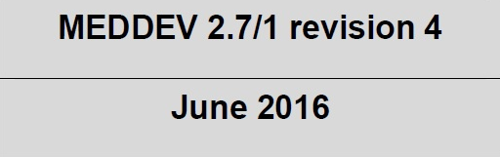
MEDDEV 2.7.1.
Guidance document created to lay down principles of evaluation of clinical evidence
No transition period, but not legally binding
Requirement for CE mark – must demonstrate that there is evidence supporting the safety and benefits of the device
Recent update from Revision 3 to Revision 4 has increased the standard required (June 2016)
Revision 4 is underpinned by the MDR

Slide 11
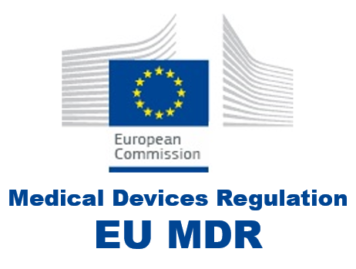
Medical Device Regulation (MDR)
Builds on MEDDEV 2.7.1. in its approach
More clinical evidence required for most devices to satisfy new “General Safety and Performance Requirements”
Some devices have been upregulated – requiring more evidence
Less ability to rely on equivalent products and their clinical evidence
PMCF plans are more detailed

Slide 12
Challenges created by Rev 4 and MDR
No grandfathering of legacy products – everything in your catalogue must be assessed in full
Less ability to use equivalent product data (can use any data in relation to your product, but more difficult to use data for a competitor product)
Upregulation – do you need a notified body for your previously Class I product?
Need to generate clinical data for new devices pre-CE mark
Legacy products – insufficient evidence
New products – need to generate evidence pre-CE mark

Slide 13
Clinical evaluation

Slide 14
Clinical Evaluation
A comprehensive review of evidence supporting the safety of your device
Largely adopted by competent authorities and recognised by notified bodies under MDD via MEDDEV 2.7.1. guidance – already compulsory
Presents an impartial appraisal of all available clinical evidence collected for a particular device…good and bad!
Now transitioned (since July 2016) to Rev 4
Aim: to present sufficient critically appraised data for use of the device with human subjects demonstrating that the claimed benefits of the device outweigh any risks.

Slide 15
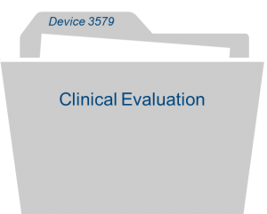
Clinical Evaluation Report (CER)
State of the art review
Clinical, biological and technical review of your device
Equivalence arguments (if using equivalents)
Literature search strategy and results
Clinical evaluation
Safety, sales and complaints (PMS)
Periodic Safety Update Report
General Safety and Performance Requirements
Notes:
Clinical evaluation – this is the bulk of the report, where data collected describing use of your product is critically appraised in the context of your claims and indications.

Slide 16
Clinical Evaluation: MEDDEV 2.7.1. and MDR – key changes
Rev 4
State of the art
Equivalence
PMCF
PMS
Frequency
Safety
Objectives & Clinical Evaluation Plan
Qualification of author
Both mandatory from May 2020
Rev 4 introduces stricter guidance on clinical evaluation
MDR applies legal weight behind future non-compliances
Consider this to be legally enforceable beyond May 2020

Slide 17
Key differences between Rev3 and Rev 4
Item |  | MEDDEV 2.7.1 Rev3 |  | MEDDEV 2.7.1. Rev4
State of the art |  | Description of the device in the context of the problem it solves and why it is considered to be suitable. |  | Establishing safety and performance of device, claimed equivalents and risks/benefits of other available treatment options
Equivalence |  | Show clinical equivalence between devices without access to comparator technical files. Argument laid out in Biological, Technological and Clinical equivalence. Could rely on comparators for bulk of data. |  | All clinical data presented must be in relation to the review device itself where possible. Comparator data is permitted, but only if you have access to the technical file and are able to discuss design differences at a Clinical, Biological and Technical level
Post Market Clinical Follow up |  | No requirement to present a plan – provision of justification necessary if not included |  | Demonstrate that PMCF is planned and there is a process in place to continue to generate further data in support of the ongoing safety of the device. A study may be required to justify long term safety and performance
Post Market Surveillance |  | PMS must be appropriate to the device and intended use. Manufacturer should ‘periodically’ review performance via CER |  | Active surveillance to ensure risk/benefit profile is acceptable and to identify any arising issues which may need to be addressed.

Slide 18
Key differences between Rev3 and Rev 4
Item |  | MEDDEV 2.7.1 Rev3 |  | MEDDEV 2.7.1. Rev4
Safety |  | Reporting of complaints collected through PMS system and other relevant databases |  | Preparation and annual update of Periodic Safety Update Report. Review of EUDAMED database and other relevant databases. UDI compulsory
Objectives |  | Essential requirements – listed in report but no direct requirement to link the content of the report to them |  | General Safety and Performance Requirements – objectives to be linked to specific safety, performance and risk-benefit endpoints.
Qualification of author & Clinical Evaluation Plan |  | Suitably qualified individual with knowledge of the device, its application, research methodology and diagnosis and management of conditions intended to be treated by the device |  | Relevant higher education degree and five years’ related professional experience/ ten years’ professional experience. Requirement to produce a Clinical Evaluation Plan examining evidence gaps (and how you will fill them), equivalence arguments etc.
Frequency of updates |  | Updated every 2-5 years depending on classification and risk |  | Requirement to plan and then justify the frequency of updates – can be challenged by auditor

Slide 19
Action plan

Slide 20
Action plan – what to do before May 2020?
Action | Complete
Gap analysis: Ensure you have a Clinical Evaluation Plan in place (i.e. how are you going to fill gaps in your data? Are you using equivalents and if so, where is the technical file coming from?)
Explore options for data generation – Expert opinion, PMCF, restrospective data review
PMS – ensure you are capturing all sales and complaints data (this can help to prove your product’s safety)
The Clinical Evaluation Report – get it completed before your audit
Consider portfolio – are there any products which aren’t selling enough to justify the increased cost of regulation?
Don’t leave it too late!

Slide 21
Thank you
t.wright@medilink.co.uk

