Slide 1
IVDR Update
MediLink
09 Jul 2019
Dr Erica Conway Global Head – IVD Medical Devices

Slide 2
IVDR update - Overview

Slide 3
Transitional arrangements for IVDR
Time frame for
designation of NBs to IVDR?
Date of Application
Grace period for existing IVDD CE
Entry into force 25 May 2017
26 May 2022
May 2024
NB application 26 Nov 2017
5 Year Transition Mfrs can meet IVDD or IVDR
Date of Application 2021/22 + 2 Yrs
Publication 5 May 2017
Publication + ? months NB designation
Implementing Acts
No IVDD CE may be issued
CE certificates can be renewed by a NB during the transition period, with a maximum expiry of DoA + 2 years
Class A IVDs (non- sterile) under the IVDR can be placed on market under IVDR

Slide 4
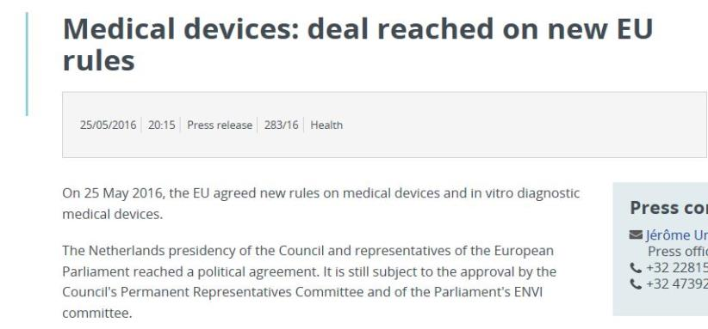
IVDR alignment to MDR
Alignment of the MDR and IVDR
‘…There are specific features of in vitro diagnostic medical devices, in particular in terms of risk classification, conformity assessment procedures and clinical evidence, and of the in vitro diagnostic medical device sector which require the adoption of a specific legislation, distinct from the legislation on other medical devices,
whereas the horizontal aspects common to both sectors should be aligned.’

Slide 5
IVDR specific aspects
Where IVDR diverges from MDR…
Scope
Classification
Conformity Assessment
Devices that need a EU Technical Documentation certificate
Class D devices – role of EU Reference Laboratories
Companion Diagnostics
Clinical Evidence
Huge impact to manufacturers!
And we will also cover…
Opportunity to work with BSI
Examples of devices
Technical documentation

Slide 6
Classification- IVDR

Slide 7
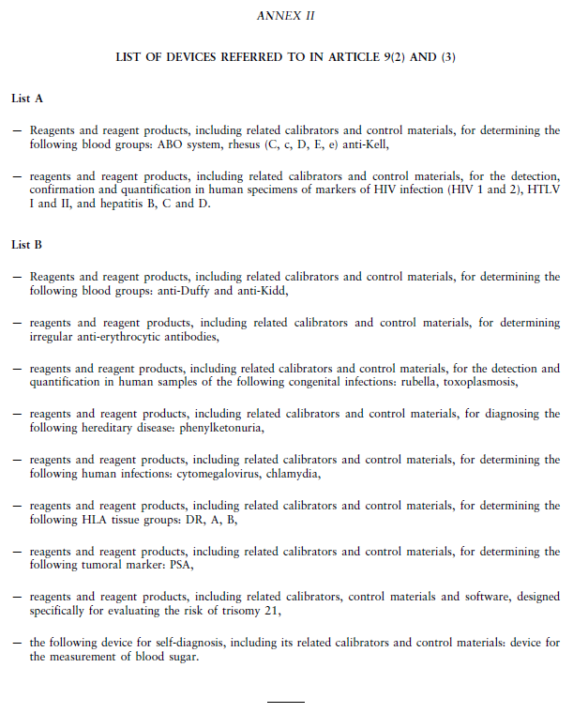
Classification under IVDD…
These devices need a NB
All other devices can self-declare conformity (Annex III), except self-test devices

Slide 8

Classification of IVDs
Re-classification of IVDs will mean 80-90 % will no longer be able to ‘self certify’ conformity
Image of 4 risk groups
High Population, High Patient risk
Medium-low patient
Low patient risk
Low Population, High Patient risk
D
Review of technical documentation will be at the same depth for all devices, but there will be sampling proportionate to risk
More scrutiny on risk, clinical evidence and post-market surveillance
C
B
A

Slide 9
Transitional arrangements for IVDR
Hard deadline for self-declared IVDs
Time frame for
designation of NBs to IVDR?
Date of Application
Grace period for existing IVDD CE
Entry into force 25 May 2017
26 May 2022
May 2024
NB application 26 Nov 2017
5 Year Transition Mfrs can meet IVDD or IVDR
Date of Application 2021/22 + 2 Yrs
Publication 5 May 2017
Publication + ? months NB designation
Implementing Acts
No IVDD CE may be issued
CE certificates can be renewed by a NB during the transition period, with a maximum expiry of DoA + 2 years
Class A IVDs (non- sterile) under the IVDR can be placed on market under IVDR

Slide 10
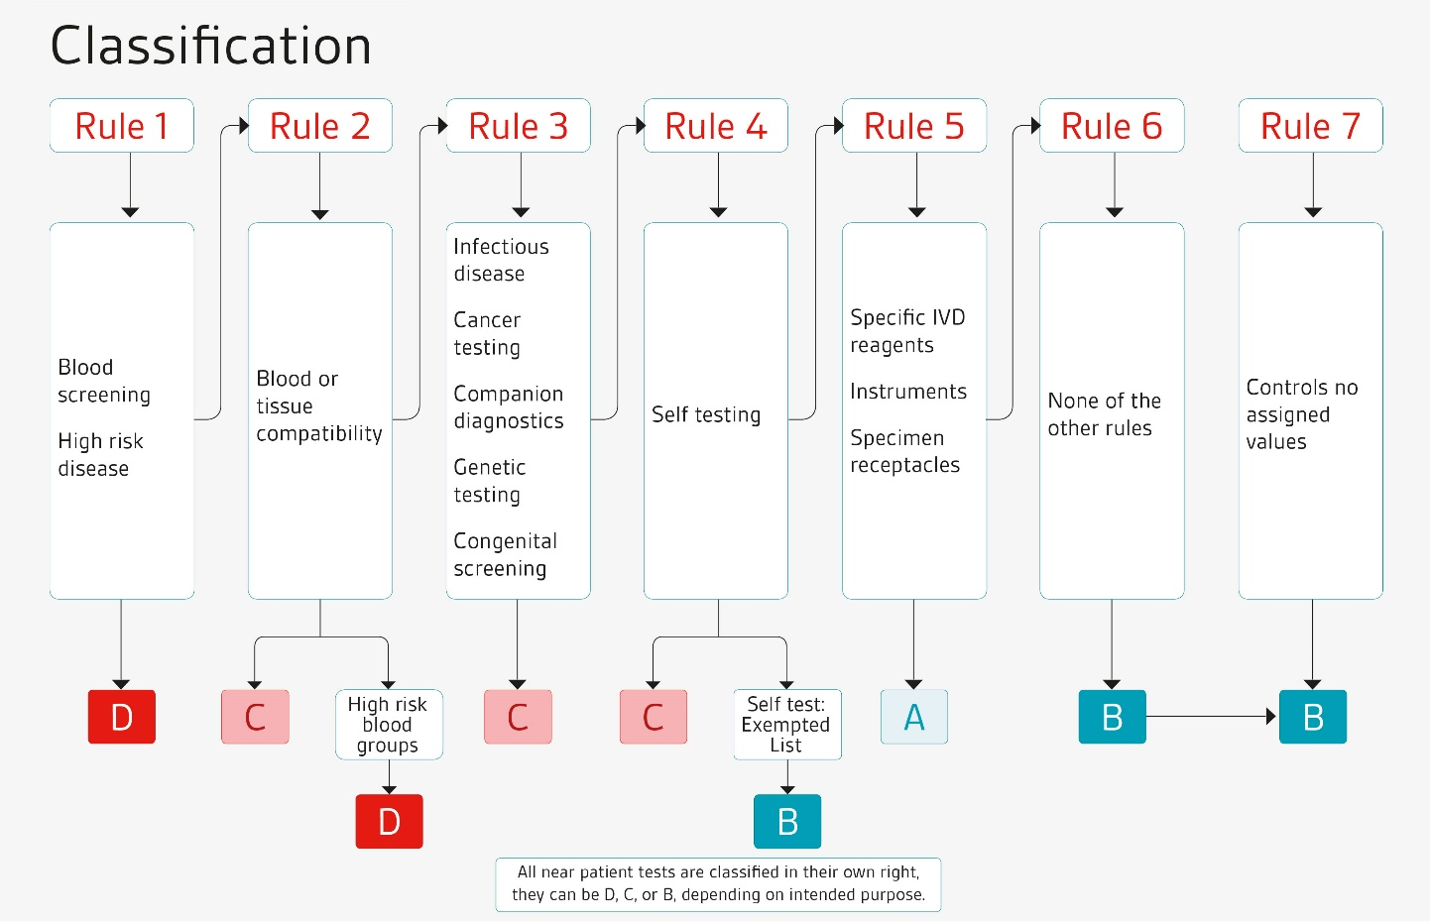
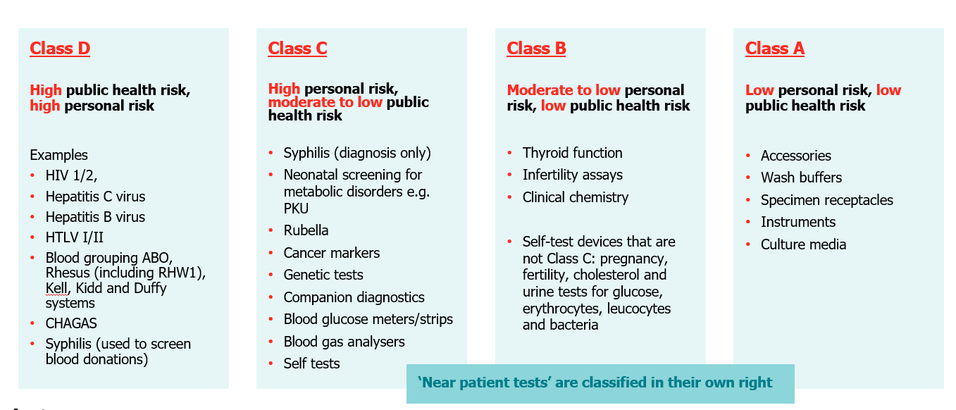
New Classification Rules for IVDs – Annex VIII

Slide 11
Conformity Assessment - IVDR

Slide 12
New classification – means new IVDR (NBOG) codes for IVD NBs
A NB becomes designated against these Technical competence codes (And IVT codes for QMS Auditors)
From 15 (list A) + 7 (List B) specific IVDD device codes
Devices for blood grouping
IVR | Devices intended to be used for blood grouping to ensure the immunological compatibility of blood, blood components, cells, tissue or organs that are intended for transfusion or transplantation or cell administration
IVR 0101 | ABO system [A (ABO1), B (ABO2), AB (ABO3)] | IVD 0101
IVR 0102 | Rhesus system [RH1 (D), RHW1, RH2 (C), RH3 (E), RH4 (c), RH5 (e)] | IVD 0102
IVR 0103 | Kell system [Kel1 (K)] | IVD 0103
IVR 0104 | Kidd system [JK1 (Jka), JK2 (Jkb)] | IVD 0301
IVR 0105 | Duffy system [FY1 (Fya), FY2 (Fyb)] | IVD 0301
IVR | Other devices intended to be used for blood grouping
IVR 0106 | Other devices intended to be used for blood grouping
Devices intended to be used for tissue typing
IVR | Devices intended to be used for tissue typing
IVR 0201 | Devices intended to be used for tissue typing to ensure the immunological compatibility of blood, blood components, cells, tissue or organs that are intended for transfusion or transplantation or cell administration (HLA A, B, DR) | IVD 0306
IVR 0202 | Other devices intended to be used for tissue typing
Devices intended to be used for markers of cancer and non-malignant tumours
IVR | Devices intended to be used for markers of cancer and non-malignant tumours except devices for human genetic testing
IVR 0301 | Devices intended to be used for screening, diagnosis, staging or monitoring of cancer | e.g. 0307
IVR 0302 | Other devices intended to be used for markers of cancer and non-malignant tumours
IVR device groups: 33 codes
Devices for human genetic testing
IVR | Devices intended to be used for human genetic testing
IVR 0401 | Devices intended to be used in screening / confirmation of congenital / inherited disorders | e.g. 0308
IVR 0402 | Devices intended to be used to predict genetic disease/disorder risk and prognosis
IVR 0403 | Other devices intended to be used for human genetic testing
Devices intended to be used to determine markers of infections / immune status
IVR | Devices to be used for the for the screening, confirmation, identification of infectious agents or determination of immune status
IVR 0501 | Devices for pre-natal screening of women in order to determine their immune status towards transmissible agents
IVR 0502 | Devices intended to be used to detect the presence of, or exposure to transmissible agents in blood, blood components, cells, tissues or organs, or in any of their derivatives, to assess their suitability for transfusion, transplantation or cell administration | e.g. 0303
IVR 0503 | Devices intended to be used to detect the presence of, or exposure to an infectious agent including sexually transmitted agents | e.g. 0305
IVR 0504 | Devices intended to be used to determine the infectious load, to determine infective disease status or immune status and devices used for infectious disease staging | e.g. 0201-4
IVR 0505 | Devices intended to be used to grow / isolate / identify and handle infectious agents
IVR 0506 | Other devices intended to be used to determine markers of infections / immune status | e.g. 0201-4
Devices for non-infectious pathologies, physiological markers, and impairments
IVR | Devices intended to be used for a specific disease
IVR 0601 | Devices intended to be used for screening / confirmation of specific disorders / impairments | e.g. 0304 PKU
IVR 0602 | Devices intended to be used for screening, determination or monitoring of physiological markers for a specific disease | e.g. 0309 BGM, 0401-4 self tests
IVR 0603 | Devices intended to be used for screening, confirmation / determination, or monitoring of allergies and intolerances
IVR 0604 | Other devices intended to be used for a specific disease
IVR | Devices intended to be used to define or monitor physiological status and therapeutic measures
IVR 0605 | Devices intended to be used for monitoring of levels of medicinal products, substances or biological components
IVR 0606 | Devices intended to be used for non-infectious disease staging
IVR 0607 | Devices intended to be used for detection of pregnancy or fertility testing | IVD 0405
IVR 0608 | Devices intended to be used for screening, determination or monitoring of physiological markers
IVR 0609 | Other devices intended to be used to define or monitor physiological status and therapeutic measures
IVS specifics: 10 codes
IVP procedure: 14 codes
Laboratory and clinical disciplines where the in vitro diagnostic medical devices can be used (diagnostic use)
IVDD | Diagnostic use codes for IVDs
IVD 4001 | Bacteriology
IVD 4002 | Clinical Chemistry / Biochemistry
IVD 4003 | Detection of transmissible agents (without organisms or viruses)
IVD 4004 | Genetics
IVD 4005 | Haematology / Haemostasis including coagulation disorders
IVD 4006 | Histocompatability and Immunogenetics
IVD 4007 | Immunohistochemistry/ Histology
IVD 4008 | Immunology
IVD 4009 | Molecular Biology / Diagnostics
IVD 4010 | Mycology
IVD 4011 | Parasitology
IVD 4012 | Virology
Devices which are controls without a quantitative or qualitative assigned value
IVR | Controls without a quantitative or qualitative assigned value
IVR 0701 | Devices which are controls without a quantitative assigned value
IVR 0702 | Devices which are controls without a qualitative assigned value
Class A devices in sterile condition
IVR | Class A devices in sterile condition
IVR 0801 | Devices referred to in point 2.5 (rule 5), under a), of Annex VIII to Regulation (EU) 2017/746 | related: MDS 7206
IVR 0802 | Instruments intended specifically to be used for in vitro diagnostic procedures referred to in point 2.5 (rule 5), under b), of Annex VIII to Regulation (EU) 2017/746
IVR 0803 | Specimen receptacles referred to in point 2.5 (rule 5), under c), of Annex VIII to Regulation (EU) 2017/746
IVD Lab discipline: 12 codes

Slide 13
Conformity assessment
A
B
C
D
EU Declaration of Conformity Annex III
Quality Management System Assurance Annex IX
Quality Management System Assurance Annex IX
Type Examination Annex X (includes Technical Documentation)
Quality Management System Assurance Annex IX
Type Examination Annex X (includes Technical Documentation)
Assessment of Technical Documentation per category device *§ - Annex IX sec 4
Assessment of Technical Documentation per generic device § - Annex IX sec 4
Production Quality Assurance
Annex XI
Assessment of Technical Documentation * Annex IX Ch II
Production Quality Assurance
Annex XI
* Annex IX Ch II EU Technical Documentation certificate issued per device - § applicable also to self tests & near patient tests (B & C ) & Companion Diagnostics
For Companion Diagnostics CA consultation Annex IX Ch II *§
For Companion Diagnostics CA consultation Annex X 3
Verification by EU Reference Laboratory
Verification by EU Reference Laboratory

Slide 14
Conformity assessment
A
B
C
D
EU Declaration of Conformity Annex III
Quality Management System Assurance Annex IX
Quality Management System Assurance Annex IX
Type Examination Annex X (includes Technical Documentation)
Quality Management System Assurance Annex IX
Type Examination Annex X (includes Technical Documentation)
Assessment of Technical Documentation per category device *§ - Annex IX sec 4
Assessment of Technical Documentation per generic device *§ - Annex IX sec 4
Production Quality Assurance
Annex XI
Assessment of Technical Documentation * Annex IX Ch II
Production Quality Assurance
Annex XI
* Annex IX Ch II EU Technical Documentation certificate issued per device - § applicable also to self tests & near patient tests (B & C ) & Companion Diagnostics
For Companion Diagnostics CA consultation Annex IX 5.2 §
For Companion Diagnostics CA consultation Annex X 3
Verification by EU Reference Laboratory
Verification by EU Reference Laboratory

Slide 15

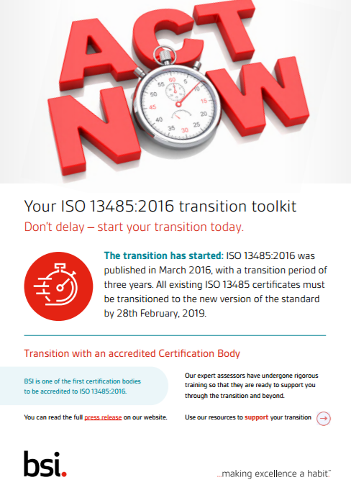
Quality Management System Assurance
QMS Audit
A manufacturer certified to ISO 13485:2016 is in a good position to progress to IVDR
Except an audit will be needed of IVDR Regulatory requirements from your IVDR NB
Certification to ISO 13485:2016 from an EU NB will be needed

Slide 16

Quality Management System Assurance
Assessment of Technical Documentation on a sampling basis (Class C & B)
Annex IX (I & III); Chapter II, Sec 4
Review of Technical documentation – Annex II & XIII
File sampling per Generic device groups (C) or Device subcategory groups (B)
Performance Evaluation Plan & Report needed
Adequacy of technical documentation to support all claims
Possible post-market NB follow up
Performance Evaluation Assessment Report will be issued by NB
EU Quality Management Certificate will be issued (with each group listed under the scope of audit)
Content dependent on device

Slide 17
Quality Management System Assurance
Assessment of Technical Documentation
Class D, Self-Tests (all), and Near Patient Tests (all)
Annex IX (I & III) + Chapter II
Review of Technical documentation – Annex II & XIII
No sampling of files
Performance Evaluation Plan & Report needed
Adequacy of technical documentation to support all claims
Possible post-market NB follow up
Performance Evaluation Assessment Report
EU Technical Documentation certificate will be issued (Product specific), in addition to the EU Quality Management Certificate
Content dependent on device

Slide 18
Companion Diagnostics
Definition…
means a device which is essential for the safe and effective use of a corresponding medicinal product to:
- identify, before and/or during treatment, patients who are most likely to benefit from the corresponding medicinal product; or
- identify, before and/or during treatment, patients likely to be at increased risk for serious adverse reactions as a result of treatment with the corresponding medicinal product;
Conformity assessment of companion diagnostics will require consultation by the NB with the European Medicines Agency (EMA) or country competent authority (CA)
Process and expectations from European Commission not yet defined

Slide 19
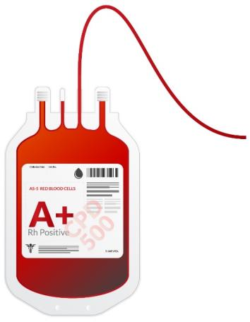
EU Reference Laboratories & Class D devices
In addition to QMS and Technical Documentation audit – part of conformity assessment:
Compliance with the Common Specification
Query on transition arrangements to current Common Technical Specification
Consultation with MDCG where no Common Specification
EU Reference laboratory will verify claimed performance of the device and compliance with Common Specification or other solutions
Scientific opinion within 60 days
Ref Lab will also be involved in review of device changes post-market
EU Reference laboratories will need to be designated
Time frame dependent on implementing provisions
Current estimate start 2021

Slide 20
EU Reference Laboratories & Class D devices
Batch release – differences compared to IVD Directive:
All batches will have to be tested and released by the EURL
IVDD allows testing to take place in the manufacturer’s laboratory with a panel of samples supplied by the NB
It is assumed that the Reference Lab for testing of the batches will be the same at the Reference Lab that reviews the performance data

Slide 21
Certificates issued under Annex IX
Class B & C devices
EU Quality Management System certificate (Annex IX, I & III)
Accompanied by assessment of technical documentation on representative basis for each generic device group (C) or device category (B)
Ref Article 48

Slide 22
Certificates issued under Annex IX
Class B & C devices
Class D & Others specified*
EU Quality Management System certificate (Annex IX, I & III)
Accompanied by assessment of technical documentation on representative basis for each generic device group (C) or device category (B)
Ref Article 48
EU Quality Management System certificate (Annex IX, I & III)
EU Technical Documentation Assessment certificate (Annex IX, II exclu sec 5)
For each Class D device to be placed on the market
Reference laboratory will verify claimed performance and Common Specification requirements – needs to be positive outcome
MDCG consultation if no Common Specification
Verification of manufactured batches (Class D)
*Self-test and near patient tests, Classed B-D; Companion Diagnostics

Slide 23
Certificates issued under Annex IX
Class B & C devices
Class D & Others specified*
EU Quality Management System certificate (Annex IX, I & III)
Accompanied by assessment of technical documentation on representative basis for each generic device group (C) or device category (B)
Ref Article 48
EU Quality Management System certificate (Annex IX, I & III)
EU Technical Documentation Assessment certificate (Annex IX, II)
For each Class D device to be placed on the market
Reference laboratory will verify claimed performance and Common Specification requirements – needs to be positive outcome
MDCG consultation if no Common Specification
Verification of manufactured batches (Class D)
OR EU Technical Documentation Assessment certificate (Annex IX, II)
For each device* to be placed on the market (to be confirmed)
Drug consultation for Companion Diagnostics
*Self-test and near patient tests, Classed B-D; Companion Diagnostics

Slide 24
QMS Assurance conformity assessment process
Quality Management System Assurance under the IVDR
What will be needed…
Application to a NB
QMS certification with a scope to cover the processes / technologies / devices
QMS assessment by a NB for the purposes of CE marking
ISO 13485 + On-site ’upgrade’ to IVDR requirements
Submission of technical documentation for review
Dependent on the device risk and scope
Additional processes for Class D devices, Companion diagnostics

Slide 25
IVDR – Clinicial Evidence & Performance Evaluation

Slide 26
‘Clinical benefit’ consideration
=
Accurate medical information
=
Final clinical outcome
Clinical benefit of an IVD

Slide 27
Clinical Evidence
New requirement for Clinical Evidence
Clinical evidence = clinical data and performance evaluation results, pertaining to a device of sufficient amount and quality to allow a qualified assessment of whether the device achieves the intended clinical benefit and safety, when used as intended by the manufacturer
Based on harmonised guidance
GHTF documents (IMDRF archive):
Clinical Performance Studies for In Vitro Diagnostic Medical Devices
Clinical Evidence for IVD Medical Devices – Key Definitions and Concepts
Clinical Evidence for IVD Medical Devices – Scientific Validity Determination and Performance Evaluation

Slide 28
Clinical Evidence
New requirement for Clinical Evidence
Clinical evidence = clinical data and performance evaluation results, pertaining to a device of sufficient amount and quality to allow a qualified assessment of whether the device achieves the intended clinical benefit and safety, when used as intended by the manufacturer
Based on harmonised guidance
GHTF documents (IMDRF archive):
Clinical Performance Studies for In Vitro Diagnostic Medical Devices
Clinical Evidence for IVD Medical Devices – Key Definitions and Concepts
Clinical Evidence for IVD Medical Devices – Scientific Validity Determination and Performance Evaluation
Scientific validity
CLINICAL EVIDENCE
CLINICAL UTILITY
Clinical performance
Analytical performance

Slide 29
Performance Evaluation
Sum total = Clinical Evidence
Process of Performance Evaluation
Done according to a Performance Evaluation Plan
Collated as a Performance Evaluation Report
Continuous during life-time of the device

Slide 30
Scientific Validity
Refers to the association of an analyte to a clinical condition or physiological state
For established analytes, this may be from literature; but for novel analytes or companion diagnostics this would need to be established

Slide 31
Scientific Validity
Refers to the association of an analyte to a clinical condition or physiological state
For established analytes, this may be from literature; but for novel analytes or companion diagnostics this would need to be established
Analytical Performance
Refers to the ability of an IVD medical device to correctly detect and measure a particular analyte
Performance requirements similar to IVD Directive essential requirements

Slide 32
Clinical Performance
Ability to yield results that relate to a particular clinical condition or physiological state for the intended use and in accordance with target population, and where applicable to the intended user
Data to support diagnostic accuracy compared to reference test; information related to expected values
Scientific Validity
Refers to the association of an analyte to a clinical condition or physiological state
For established analytes, this may be from literature; but for novel analytes or companion diagnostics this would need to be established
Analytical Performance
Refers to the ability of an IVD medical device to correctly detect and measure a particular analyte
Performance requirements similar to IVD Directive essential requirements

Slide 33
Expectations for Performance & Technical documentation
Performance Evaluation Plan, as well as a file of Clinical Evidence will form part of the Technical Documentation, as a Performance Evaluation Report
Clinical Performance studies may be required, unless justified
Interventional performance studies – new requirements
In line with clinical trial expectations for clinical trials of medicinal products
Clinical Evidence will be an on-going process
Performance Evaluation Report should be updated throughout the device life cycle
Plan for Post-market Surveillance and Plan for Post-market Performance Follow-up (PMPF) will be reviewed at time of CE marking
For Class C & D devices, updates to the Summary of Safety and Performance
Updated at least annually
Will be publicly available

Slide 34

What now…
Huge leap in requirements for IVDs
This will be felt hardest for ‘legacy’ or currently self-declared CE devices (non-Annex II IVDD)
And those that have been up-classified to Class D
Hard deadline of 26 May 2022 (for most devices)
Our message: “ Start your transition activities now!”
Please approach the IVD Team (via Erica) if you need support!

Slide 35
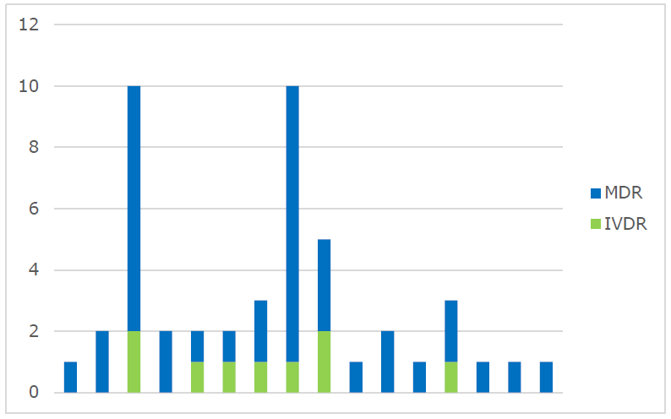
DG Sante – April 2019
38 MDR Applications
9 IVDR Applications
26 MDR Preliminary Assessment Reports
6 IVDR Preliminary Assessment Reports

Slide 36
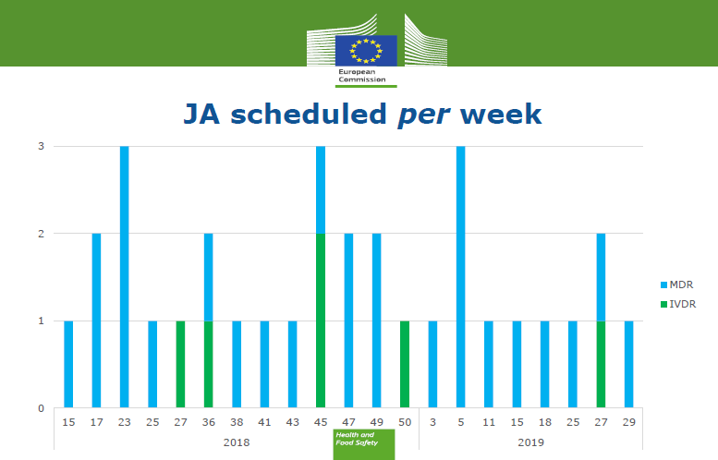
DG Sante – April 2019
26 MDR Joint Assessments
6 IVDR Joint Assessments
GMed
DEKRA
BSI UK
?
TuV Sud
BSI NL – wk 27 2019
1 MDR Notified Body
0 IVDR Notified Body

Slide 37


Name: | Erica Conway
Title: | Global Head – IVD Medical Devices
m: | +44 (0)7795 043922
email: | erica.conway@bsigroup.com
 | www.bsigroup.com/IVDR-revisions

