Slide 1
MDR Introduction, Structure, Timelines and Implementation
Damon Williams
Business Development Manager - BSI

Slide 2
MDR/IVDR - Goals of the Commission*
Wider scope of medical devices / updated classifications
Stronger supervision of independent assessment bodies by national authorities
More powers for assessment bodies for a thorough assessment
Clearer rights & responsibilities for various economic operators
Extended Eudamed database on medical devices
Better traceability of medical devices
Stricter requirements for clinical evidence
Better coordination between various entities
MDR/IVDR are a major revision to MDD+AIMDD/IVDD
Significant Impact on
Manufacturers
Notified Bodies
Competent Authorities
EU commission

Slide 3
Structure of the Regulations
MDR – (EU) 2017/745
Recitals – 101 ‘Whereas’ statements which justify the adoption of the Regulation
Chapter I – Scope and definitions (Articles 1 – 4)
Chapter II – Making available on market, Economic Operators (Articles 5 – 24)
Chapter III – Identification, Traceability and Registration of devices and Economic Operators (Articles 25 – 34)
Chapter IV – Notified Bodies (Articles 35 – 50)
Chapter V – Classification & Conformity Assessment (Articles 51 – 60)
Chapter VI – Clinical Evaluation & Clinical Investigations (Articles 61 – 82)
Chapter VII – PMS, Vigilance and Market Surveillance (Articles 83 – 100)
Chapter VIII – Co-operation (Articles 101 – 108)
Chapter IX – Confidentiality, Data Protection, Funding and Penalties (Articles 109 – 113)
Chapter X – Final Provisions (Articles 114 – 123)
Annex I – General Safety and Performance Requirements
Annex II – Technical Documentation
Annex III – Technical Documentation on PMS
Annex IV – EU DoC
Annex V – CE marking of conformity
Annex VI – Information for registration of devices and Economic Operators
Annex VII – Requirements to be met by NBs
Annex VIII – Classification Rules
Annex IX – Conformity Assessment – QMS and Technical
Annex X – Conformity Assessment – Type examination
Annex XI – Conformity Assessment – Product conformity verification
Annex XII – Certificates issued by a NB
Annex XIII – Custom-made Devices
Annex XIV – Clinical Evaluation and PMCF
Annex XV – Clinical Investigations
Annex XVI – Products without an intended Medical Purpose
Annex XVII – Correlation table

Slide 4
Transition Timelines
MDR & IVDR

Slide 5
MDR Transition (Article 120)
MDD/AIMDD certificates void
27 May 2024
Entry in to Force
25 May 2017
Date of Application
26 May 2020
Transition period
3 years
MDD/AIMDD certificate validity
(4 years )
27 May 2025
Adoption of MDR
05 May 2017
MDD/AIMDD Annex IV certificates void on 27 May 2022
MDD/AIMDD certificates can be issued/re-issued/renewed
No more « making available or putting into service » of devices covered by MDD/AIMDD certificates
NBs can apply for designation
26 Nov 2017
MDR certificates
NBs designation
under MDR
Notes:
Exception: Annex 4 (no validíty dates – void on 27th of may 2022)

Slide 6
Transition timelines
Important points
After 26 May 2020, devices certified under MDD/AIMDD (26 May 2022 for devices certified under IVDD) can only be placed on market if:
  They continue to comply with applicable Directives
  There are no significant changes in the design and intended purpose
  However, following MDR/IVDR requirements will apply
    post-market surveillance,
    market surveillance,
    vigilance,
    registration of economic operators
    registration of devices

Slide 7
Delegated & Implementing Acts: MDR & IVDR

Slide 8
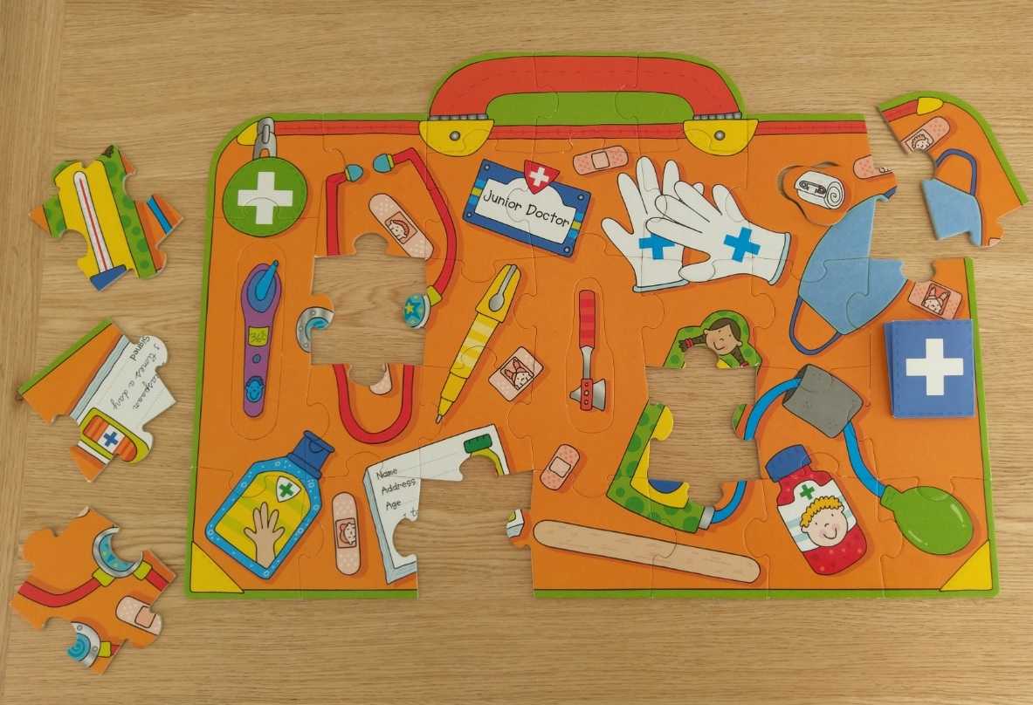
Why adopt Delegated and Implementing Acts?
Allows focus on policy and direction without getting lost in the detail
Faster to agree and publish legislation
Allows to learn from experience
There is legal precedent – Treaty on the functioning of the EU (TFEU or 2012/C 326/01)

Slide 9
What do they mean (in normal English)…
Delegated Acts
Acts used to modify/amend the ‘What’ of a legislation, but limited to the non-essential elements of that legislation.
Implementing Acts
Acts which are used to clarify/implement the ‘How’ of a legislation
Additional References:
http://eur-lex.europa.eu/legal-content/EN/TXT/?uri=uriserv%3Aai0032
http://eur-lex.europa.eu/summary/glossary/norms_hierarchy.html
http://eur-lex.europa.eu/summary/glossary/norms_hierarchy.html
http://www.eipa.eu/files/repository/product/20130904094203_Comitology_Brochure5EN_web.pdf
http://www.clientearth.org/reports/introduction-to-delegated-and-implementing-acts.pdf

Slide 10
MDR Scope

Slide 11
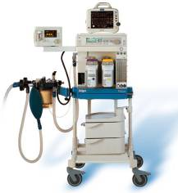
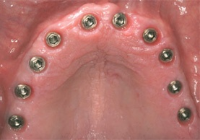

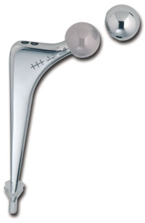
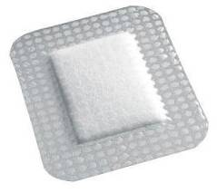
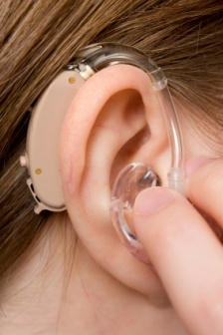
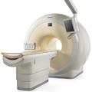
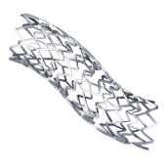
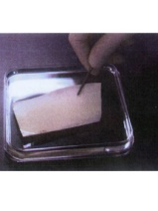
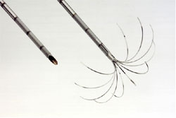
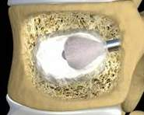
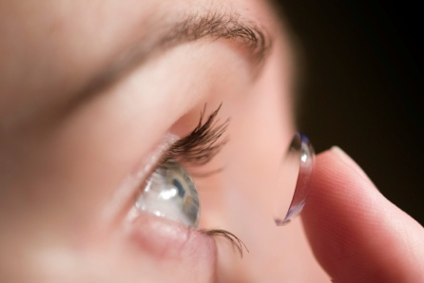
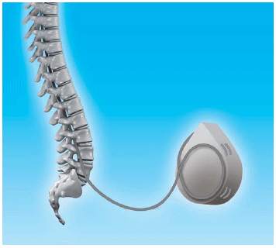
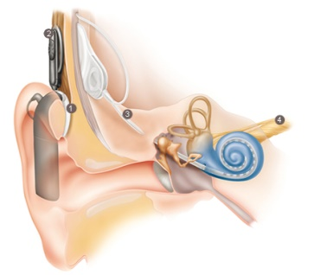

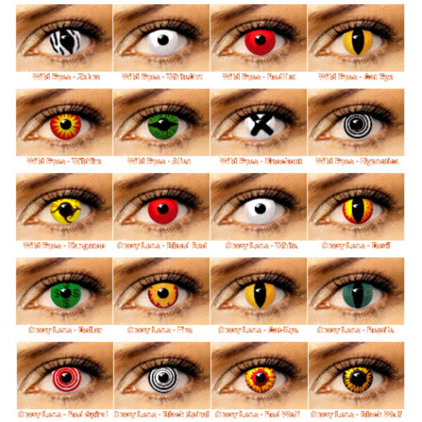

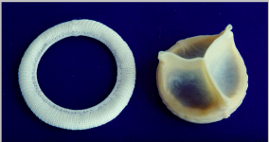
European Medical Device Regulations 2017/745 Scope
In:
Medical Devices from 93/42/EEC (Recital 6)
Active Implantable Medical Devices from 90/385/EEC (Recital 6)
medical devices incorporating (non-viable) human tissues (Recital 11)
devices similar to medical devices, but without a medical purpose (Recital 12)
Notes:
All devices covered by mdd / aimd, meddev with human tissue (non-viable), close to meddevs without medical purpose (contact lenses)

Slide 12
European Medical Device Regulations 2017/745 Scope
In:
Out (largely unchanged):
Medical Devices from 93/42/EEC (Recital 6)
Active Implantable Medical Devices from 90/385/EEC (Recital 6)
medical devices incorporating (non-viable) human tissues (Recital 11)
devices similar to medical devices, but without a medical purpose (Recital 12)
in vitro diagnostics
medicinal products
cosmetics
food
products containing viable tissues or cells of human or animal origin (Recital 13)
(Recital 7)
Clarification – Article 1(6h):
Devices incorporating viable biological materials or organisms (including bacteria, fungi, viruses) are excluded

Slide 13
European Medical Device Regulations 2017/745 Scope
In:
Out (largely unchanged):
Medical Devices from 93/42/EEC (Recital 6)
Active Implantable Medical Devices from 90/385/EEC (Recital 6)
medical devices incorporating (non-viable) human tissues (Recital 11)
devices similar to medical devices, but without a medical purpose (Recital 12)
in vitro diagnostics
medicinal products
cosmetics
food
products containing viable tissues or cells of human or animal origin (Recital 13)
(Recital 7)
Clarification - Recitals 8, 9:
MS to decide on case by base basis for borderline products, including those incorporating biological substances, medicinal products, and those which could be considered cosmetics, food products or biocides. Commission may intervene to ensure consistency, in coordination with MDCG, EMA, European Chemicals Agency or European Food Safety Authority

Slide 14
European Medical Device Regulations 2017/745 Scope
In:
Medical Devices from 93/42/EEC (Recital 6)
Active Implantable Medical Devices from 90/385/EEC (Recital 6)
medical devices incorporating (non-viable) human tissues (Recital 11)
devices similar to medical devices, but without a medical purpose (Recital 12)
Clarification - Article 1(10):
Devices incorporating human derived substances are not within the scope of the Regulation if the action of these substances is principal and not ancillary to that of the device. These products will be governed by Directive 2004/23/EC EU Tissues and Cells Directive)

Slide 15
European Medical Device Regulations 2017/745 Scope
In:
Medical Devices from 93/42/EEC (Recital 6)
Active Implantable Medical Devices from 90/385/EEC (Recital 6)
medical devices incorporating (non-viable) human tissues (Recital 11)
devices similar to medical devices, but without a medical purpose (Recital 12)
Clarifications - Article 1(3):
For devices without a medical purpose, Commission should develop common specifications, at least regarding risk management and (where necessary) clinical evaluations for safety (Article 1(2))
If devices have both medical and non-medical purpose, they must meet requirements for both

Slide 16
European Medical Device Regulations 2017/745 Scope
In:
Medical Devices from 93/42/EEC (Recital 6)
Active Implantable Medical Devices from 90/385/EEC (Recital 6)
medical devices incorporating (non-viable) human tissues (Recital 11)
devices similar to medical devices, but without a medical purpose (Recital 12)
Clarifications – Recital 19:
Software with a medical purpose is a medical device
Software with lifestyle or well-being purposes is not a medical device – even if used in a healthcare setting

Slide 17
Overview, Annex I General Safety and Performance Requirements

Slide 18
Differences: Regulation GSPRs vs Directive ERs
MDD : 13 Essential requirements
  Overall Structure and Trends:
    Some numbering and organizational changes
    Overall similar content and topics (some title changes: i.e. construction → manufacturing)
    Expanded requirements (Labeling, Risk)
    New areas of emphasis (from standards and guidances, etc.)
    Some additional requirements because of merging of MDD with AIMDD
    Some topics move out of the SPR list into Articles/Annexes (Clinical, medicinal consultation)
  Some new topics introduced (devices without medical purpose, lay person use, etc.)
MDR :
23 Safety &
Performance requirements
AIMD : 16 Essential requirements

Slide 19
MDR Annex I: General Safety and Performance Requirements
Chapter 1: General Requirements
(SPRs 1-9)
Chapter 2: Design and Manufacture
(SPRs 10-22)
Chapter 3: Information Supplied with the Device
(SPR 23)

Slide 20


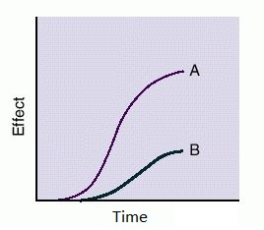





Annex I – Safety & Performance Requirements
Safe, Perform as Intended, State of the Art
Risk Reduction as far as possible
Risk Management
Risk Control
Risk of Use Error
Lifetime
Packaging, Transport, Storage
Undesirable Side-effects Minimised & Risks<Benefits
20

Slide 21
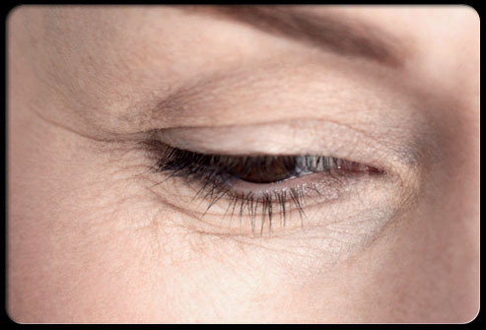
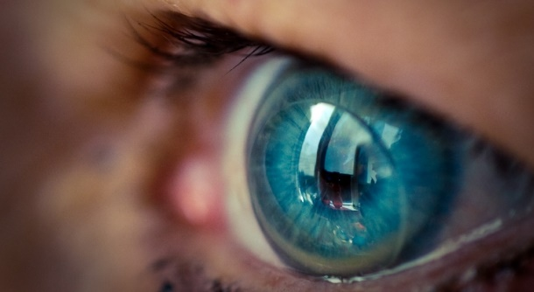
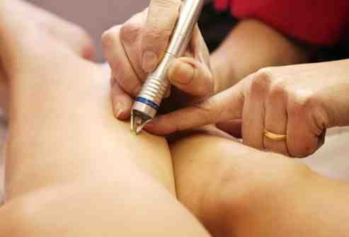
Annex I – Safety & Performance Requirements
For the devices referred to in Annex XVI, the general safety requirements set out in Sections 1 and 8 shall be understood to mean that the device, when used under the conditions and for the purposes intended, does not present a risk at all or presents a risk that is no more than the maximum acceptable risk related to the product's use which is consistent with a high level of protection for the safety and health of persons.
Common Specification
21

Slide 22








Annex I – Safety & Performance Requirements
Chemical, Physical & Biological Properties
Infection & Microbial Contamination
Devices incorporating a medicinal product and devices composed of substances that are absorbed by or locally dispersed in the human body
Devices incorporating materials of biological origin
Construction and interaction with the environment
Devices with a diagnostic or measuring function
Protection against radiation
22

Slide 23






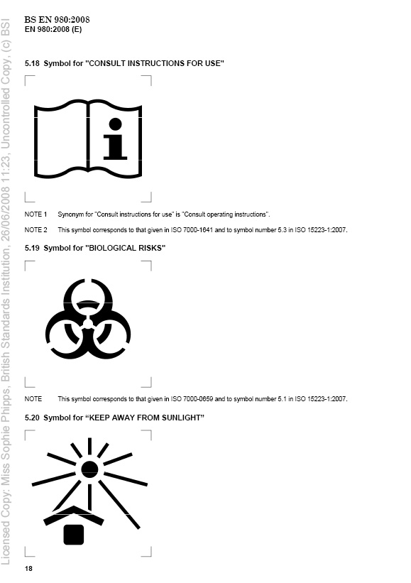
Annex I – Safety & Performance Requirements
Electronic programmable systems
Active devices and devices connected to them
Requirements for Active Implantable Devices
Protection against mechanical and thermal risks
Protection against the risks posed to the patient or user by supplied energy or substances
Protection against the risks posed by medical devices intended by the manufacturer for use by lay persons
23

Slide 24
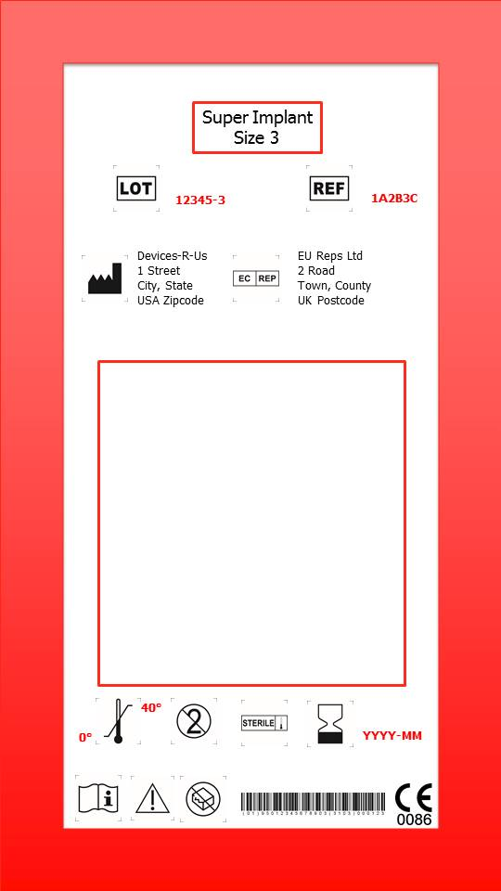

Annex I – Safety & Performance Requirements
Labels and Instructions for Use
(a)
(e) medicine, human, animal
(g)
(s)
(f) CMR + ED >0.1%
(c)
(d)
(j)
Article 18 – Implant Card
(o) reprocessing cycles
(p) custom made
(b)
(q) clinical investigation
(l)
(r) quantity of constituents – achieving principal intended action
(k)
(i)
(n)
(h)
(m)
24
Article 20

Slide 25
Clinical Evaluation
Snapshot of changes

Slide 26

Snapshot of changes
Consultation and Scrutiny procedures for Class III implantable and Class IIb active drug delivery / removal devices (Articles 54 and 55 – more detail on next slides)
NB to document requirements for interim review of PMCF outputs throughout certification period (Article 52; Annex IX or X)
Product certificates required for Class IIb implantable devices (except sutures, staples, dental fillings, dental braces, tooth crowns, screws, wedges, plates, wires, pins, clips and connectors) (Article 52(4))
Greater emphasis on use of clinical experts in clinical evaluation assessments (Article 52; Annex IX or X; Annex VII)
Depth of technical documentation assessment (including clinical evaluation) no longer based on device risk classification? (Article 52; Annex IX or X)
Clinical Evaluation Assessment Report (CEAR) to be provided to manufacturer as part of the technical documentation assessment for all device classifications (Article 52; Annex IX or X)

Slide 27
Snapshot of changes
Clinical evaluation consultation procedure (Chapter V, Article 54)
Applies to Class III implantable devices and Class IIb active device intended to administer or remove a medicinal product
Does not apply to:
  Certificate renewals
  Design modifications where manufacturer satisfactorily demonstrates to NB that risk-benefit ratio is unaffected
  Clinical evaluation CS exists for that device type, and NB confirms that the CER meets CS requirements
Article 54(3):
NBs must notify CAs and Commission through EUDAMED of decision of whether or not this consultation is to be applied
Notification shall be accompanied by CEAR

Slide 28
Clinical evaluation consultation procedure (Article 55)
21 days
Notified Body Review
Notified Body Review
39 days
Restrict indications
Limit duration of certificate
Undertake specific PMCF studies
Adapt IFU or Summary of Safety and Clinical Performance
Impose other restrictions
NB must justify if expert panel advice not followed
Class III Implant or Iib active drug delivery
Manufacturer’s Clinical Evaluation
NB Clinical Evaluation Assessment Report
PMCF Plan
Benefit:Risk Determination
Consistency with indications
PMCF Plan
Complete Conformity Assessment
EU Commission
No ‘scientific opinion’
NB Further Review
Notified Body Certificate
Notified Body Certificate

Slide 29
Requirements for SSCP
Requirements defined:
SSCP required for Class III and implantable devices
Draft submitted as part of the application for certification to NB
Identifies device, intended use, safety and performance characteristics and summary of technical and clinical evidence of conformity
Updated whenever PMS data affects conclusions (Article 62(11))
Validated by NB and made available to the public via Eudamed
Requirements for content may be amended by implementing acts
Article 32 (Summary of safety and clinical performance)
Notes:
For IVD: SSP – Summary of Safety Performance (class D + C compaignion Diagnostics) ?

Slide 30
Overview of Key Technical Documentation Requirements

Slide 31
MDR/IVDR Requirements for technical documentation
Highlights:
General requirements similar to Directives, but content more explicitly defined in Annex II
Dedicated Annex (III) for Technical Documentation on Post-market surveillance
Periodic Safety Update Reports and Summary of Safety and Clinical Performance (or Summary of Safety and Performance for IVDs) specified as part of the Technical Documentation
Annexes II and III of the Regulations do not follow IMDRF suggested Table of Contents for technical documentation

Slide 32
MDR/IVDR Requirements for technical documentation
Annex II: Technical Documentation
1: Device description
2: Information to be supplied by the manufacturer
+ PSUR (MDR & IVDR)
3: Design and manufacturing information
+ SSCP (MDR)
4: General safety and performance requirements
+ SSP (IVDR)
5: Benefit-risk analysis and risk management
6: Product verification and validation
Annex III: Technical Documentation on Post-Market Surveillance

Slide 33
MDR/IVDR Requirements for technical documentation
Annex II: Technical Documentation
1: Device description
Postmarket Surveillance, PSUR and vigilance
Chapter VII
Safety and Performance
Annex I
2: Information to be supplied by the manufacturer
3: Design and manufacturing information
Technical Documentation
Annexes II and III
Traceability
Chapter III
4: General safety and performance requirements
5: Benefit-risk analysis and risk management
Clinical Evaluation
Chapter VI, Annex XIV
6: Product verification and validation
Conformity routes
Annexes IX - XI
Annex III: Technical Documentation on Post-Market Surveillance
Clinical Investigation
Chapter VI, Annex XV
Notes:
Intention here is to say that, although the requirements for Technical Documentation are outlined in Annexes II and III of the MDR and IVDR, lots of other Chapters and Annexes feed into this (the ones listed on this example are from the MDR rather than IVDR)

Slide 34
Conformity Assessment – EU Regulation
Year 1
Year 2
Year 3
Year 4
Year 5
Unannounced Audit
Microbiology
Unannounced Audit
Initial (Stage 1 & 2)
Continuing Assessment
Re-assessment
Continuing Assessment
Continuing Assessment
Microbiology
Microbiology
Technical Documentation
Technical Documentation
Continuing Assessment
PSUR – Implantable, Class III
PSUR – Implantable, Class III
PSUR – Implantable, Class III
PSUR – Implantable, Class III
34

Slide 35
Existing client MDR Transitions

Slide 36
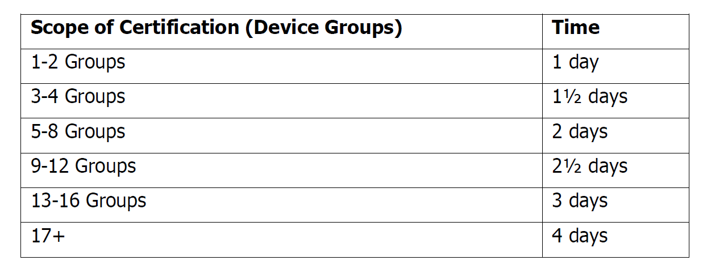
Existing Client Transitions (Proposed as per MDP4200 draft)
All manufacturers currently certified by BSI have to lodge a new application to the Regulations
QMS Transition
Initial Assessments can be combined with any scheduled audit plus any additional time as shown below.
Technical Documentation
Review durations to range from 2-7 days. Sampling allowed for IIa and IIb non-implantable devices.
Microbiology Transition
QMS certification: No additional time for manufacturers who received an M audit in the last 3 year
Product Specific certification: Class IIb implants may require Microbiologist review of Technical Documentation
36

Slide 37
New Manufacturer - MDR Applications

Slide 38
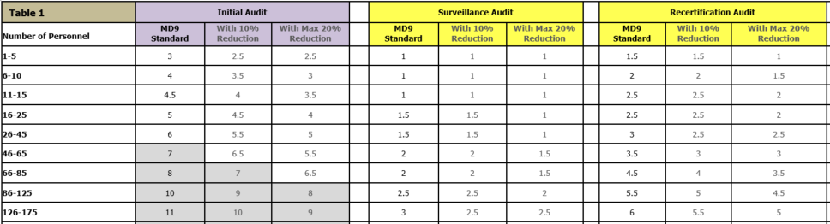
Initial applications – New Manufacturers – QMS & Micro
QMS & Micro audits: Same principles as before
38

Slide 39
Initial applications – New Manufacturers – Technical
(Draft MDP4200)
Classification MDR | Technical Documentation Review MDR | Guidance on Duration* (per file)
Class III custom made implantable | None | None
Class Is, Im | None | None
Class Ir | None | None
Class IIa | One sample from each category | 2-3 days
Class IIb | One sample from each generic device group | 3 days
Class IIb, active intended to administer medicines | One sample from each generic device group + Clinical evaluation consultation | 3 days
Class IIb implantable | All | 3-4 days
Class III | All | 8-10 days
Class III – Rule 14 and/or 18 | All + Med/AT consultation | 8-10 days (excluding consultation)
Class III implantable | All + Med/AT consultation (if applicable – Rule 14 and/or 18) + Clinical evaluation consultation | 8-10 days (excluding consultation + clinical evaluation consultation)
39

Slide 40
Regulation EU 2017/745 – Conformity Assessment
 | Quality Management System | Microbiology | Technical Documentation | Unannounced Audit | Clinical Evaluation Consultation Procedure (CECP) (Article 54) | 2001/83/EC EC/726/2004 2004/23/EC EU 722/2012 | PSUR (Article 86) (*Annual) | SSCP (Article 32)
Class III Implants | ✓ | ✓ | ✓ | ✓ 5 years | ✓ | ✓ | ✓* | ✓
Class III | ✓ | ✓ | ✓ | ✓ 5 years |  | ✓ | ✓* | ✓
Class IIb Active Intended to administer and/or remove Medicines from the body | ✓ | ✓ | Sample per group | ✓ 5 years | ✓ |  | ✓* not submitted to NB
Class IIb Implants | ✓ | ✓ | ✓ | ✓ 5 years |  |  | ✓* | ✓
Sutures, staples, dental fillings, dental braces, tooth crowns, screws, wedges, plates, wires, pins clips, connectors | ✓ | ✓ | Sample per group | ✓ 5 years |  |  | ✓ | ✓
Class IIb | ✓ | ✓ | Sample per group | ✓ 5 years |  |  | ✓* not submitted to NB
Class IIa | ✓ | ✓ | Sample per category | ✓ 5 years |  |  | ✓ not submitted to NB

Slide 41
Regulation EU 2017/745 – Conformity Assessment
 | Quality Management System | Microbiology | Technical Documentation | Unannounced Audit | Clinical Evaluation Consultation Procedure (CECP) (Article 54) | 2001/83/EC EC/726/2004 2004/23/EC EU 722/2012 | PSUR (Article 86) (*Annual) | SSCP (Article 32)
Class Is, Im, Ir | ✓ | ✓ |  | ✓ 5 years
Class I
Class III Custom Made Implants | ✓ | ✓ |  | ✓ 5 years |  |  | ✓
Custom Made
Procedure Packs (Article 22) | ✓ | ✓ |  | ✓ 5 years
Suppliers, Subcontractors | ✓ *depends on certification held | ✓ *depends on certification held |  | ✓ 5 years
EU Authorised Representatives, Importers, Distributors (Article 16) | ✓*impact sterile barrier, translate, repackage | ✓*impact sterile barrier, translate, repackage |  | ✓ 5 years
Drug Delivery Products (Article 117) |  |  | *conformity with SPRs

Slide 42
Any questions?
Q&A Session later

