Slide 1
Medical Ventilator
Application Overview
Mixing and monitoring the fresh gas:
Mixer
Monitor
0,1 bar
0,1 bar
Valve
Valve
PATIENT
Prop.
Valve
Prop.
Valve
Prop.
Valve
P, Flow, …
Anaesthesia only
O₂
Air
N₂O
2 bar
2 bar
2 bar
Notes:
Note: This an simplified scheme for Intensive care ventilators; Emergency or home care ventilators do have a different layout.

Slide 2
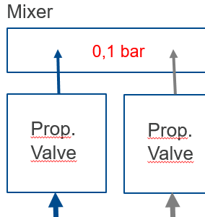
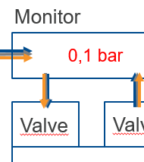
Medical Ventilator
Critical Application Attributes
Prop-Valves
Use of 100% Oxigen
Biological compatibility
Low energy consumption
(esp. for emergency ventilators)
High flow rates = High dynamic for quick regulation
High accuracy
Switch-Valves
Use of 100% Oxigen
Biological compatibility
Low energy consumption
(esp. for emergency ventilators)
Notes:
Prop.-Valves : IPC is a technology designend especially for this application, the only disadvantage (P-out must be less then 10% of P-in) is no problem at all.
Switch-Valves : series 188 is ideal for this usage, we have many references

Slide 3
Medical Ventilator
Key Terms
Gas-mixer : Part of a ventilator to provide always the right mix of fresh gas
Proportional valve : a solenoid valve inside the gas-mixer that controls the pressure of a gas. Goal is to control and change the gas-mix according to the patients needs
Why high flow demands for the Prop. Valves? : the change the gas-mix e.g. from 10% O₂ to 80% O₂ quickly, a high flow of oxygen is essential.
Switch valves : gas flow in and out of patient must be monitored all times.
For calibration, the sensors must we separated from the system
Biological compatibility : A ventilators is providing gas to be pressed in a patient. Therefore all chemical and physical interactions must be avoided.

Slide 4
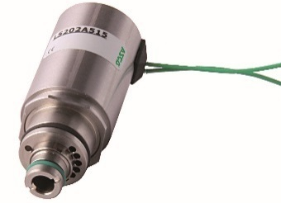
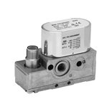
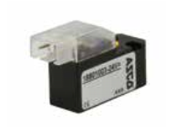
ASCO Product Solutions
Preciflow IPC
Preciflow HF-IPC
Low hysteresis (<5%), excellent repeatability (<1%), and high sensitivity (<1%)
IPC (Inlet Pressure Compensated) reduces spring wear and tear and creates more precise control
Perfect for gas-mixers
Low hysteresis (<5%), excellent repeatability (<1%), and high sensitivity (<1%)
Inlet Pressure Compensated and optimized for high flow up to 200 L/min @2bar
Perfect for gas-mixers
188 – micro10 Valve
ED02 – Pressure Regulator
Tested for Oygen
Small and powerful
Perfect for switching on/off
bypasses in measurement-blocks
Flow up to 120 L/min Pressure range from 0-10bar Input 4-20mA or 0-10V
High performance with small footprint. Excellent hysteresis for precise performance
Gas regulation

