Slide 1
SLE5000 HFO Ventilation

Slide 2
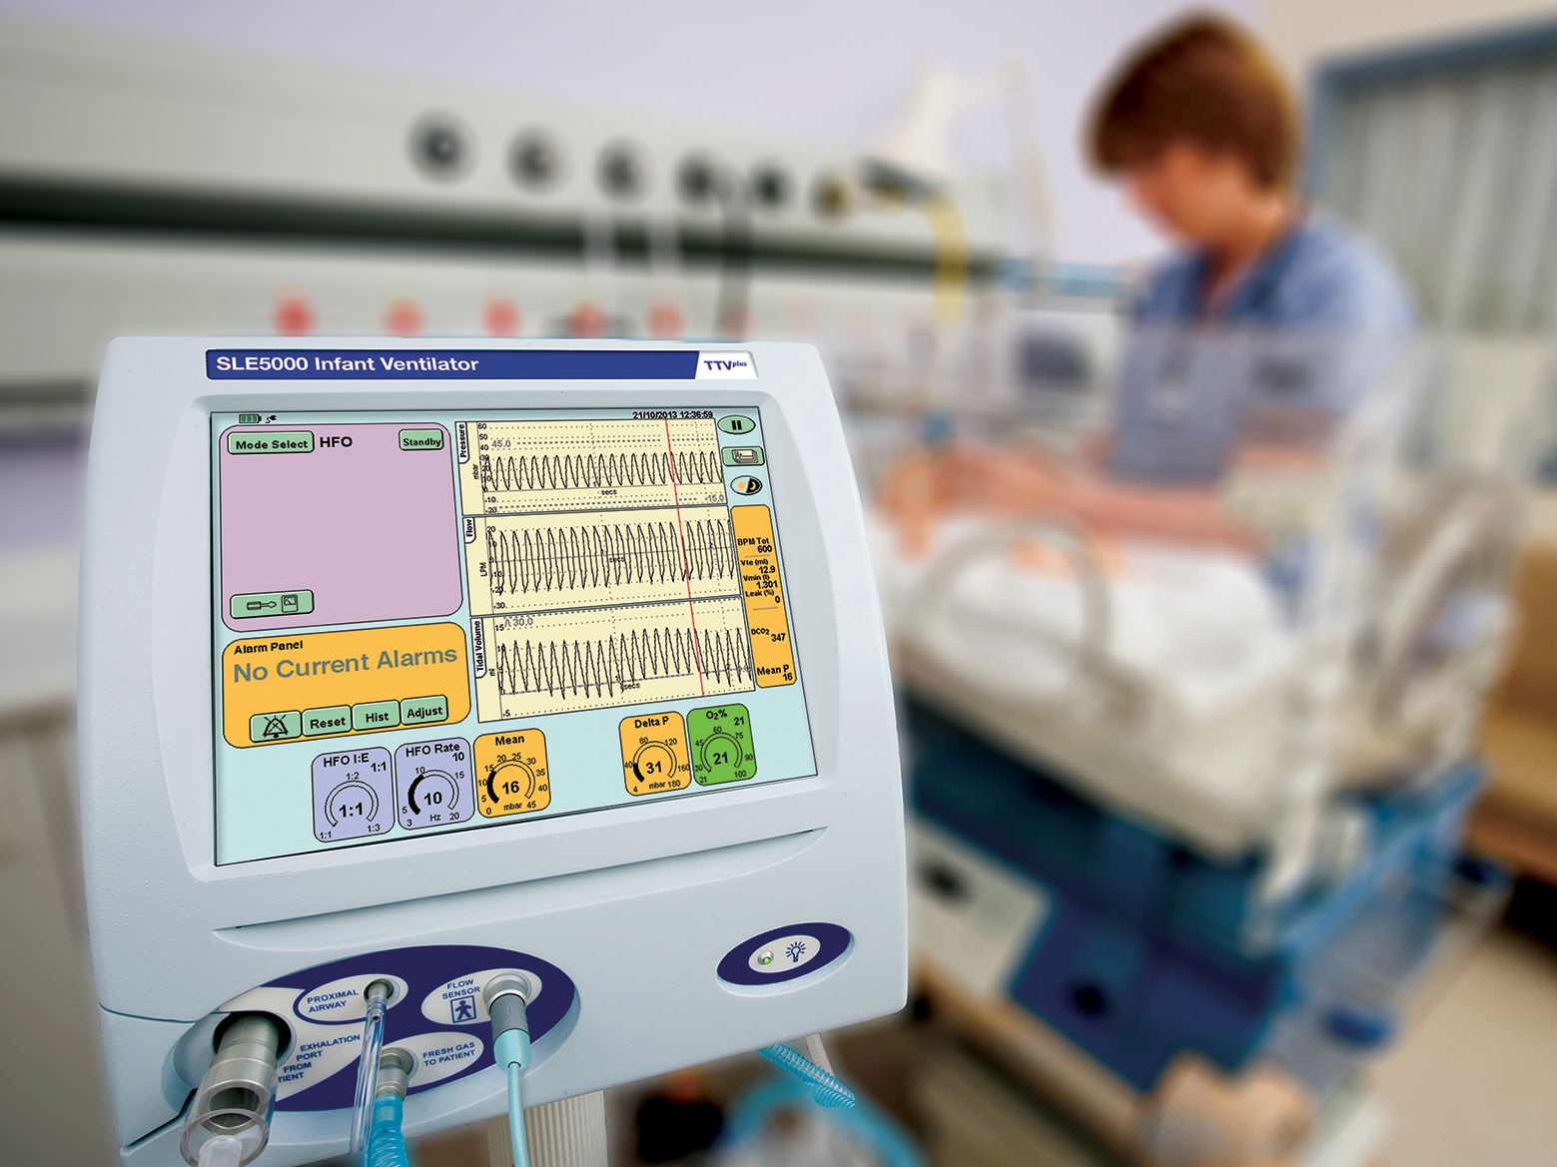

SLE5000 HFO Ventilation

Slide 3
HFO Studies – 2014-15
The SLE5000 was the most powerful neonatal HFO ventilator in terms of volume delivery with performance similar to that of the Sensormedics 3100A
New Generation Neonatal High Frequency Ventilators: Effect of Oscillatory Frequency and Working Principles on Performance
Serge Grazioli MD, Oliver Karam MSc MD, and Peter C Rimensberger MD; Respir. Care 2015
The Sensormedics A and B and the SLE5000 delivered square waves; all the other oscillators generated sine waves
Pressure and Flow Waveform Characteristics of Eight High-Frequency Oscillators
Edward R. Harcourt, BSc; Jubal John, MD; Peter A. Dargaville, MD; Emanuela Zannin, PhD; Peter G. Davis, MD; David G. Tingay, PhD; PCCM 2014

Slide 4
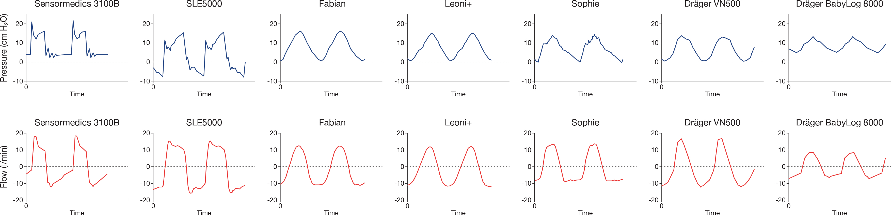
Pressure and flow waveform characteristics of seven high frequency ventilators
Figure 1. Representative P_{ao} and V’_{ao} waveforms during two oscillatory cycles for each HFV tested. Unique incisurae patterns were noted within the waveforms of the SM3100B and SLE5000.
“The Sensormedics A and B and the SLE5000 delivered square waves; all the other oscillators generated sine waves.”
Pressure and Flow Waveform Characteristics of Eight High-Frequency Oscillators
Edward R. Harcourt, BSc; Jubal John, MD; Peter A. Dargaville, MD; Emanuela Zannin, PhD; Peter G. Davis, MD; David G. Tingay, PhD; PCCM 2014

Slide 5
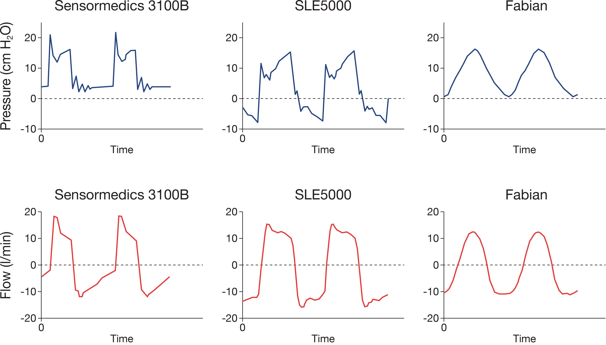
Pressure and flow waveform characteristics (cont.)

Slide 6
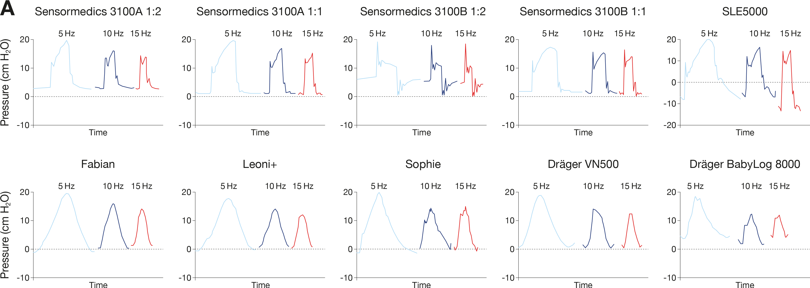
8 Ventilators
Pressure waveforms at
5Hz 10Hz 15Hz

Slide 7
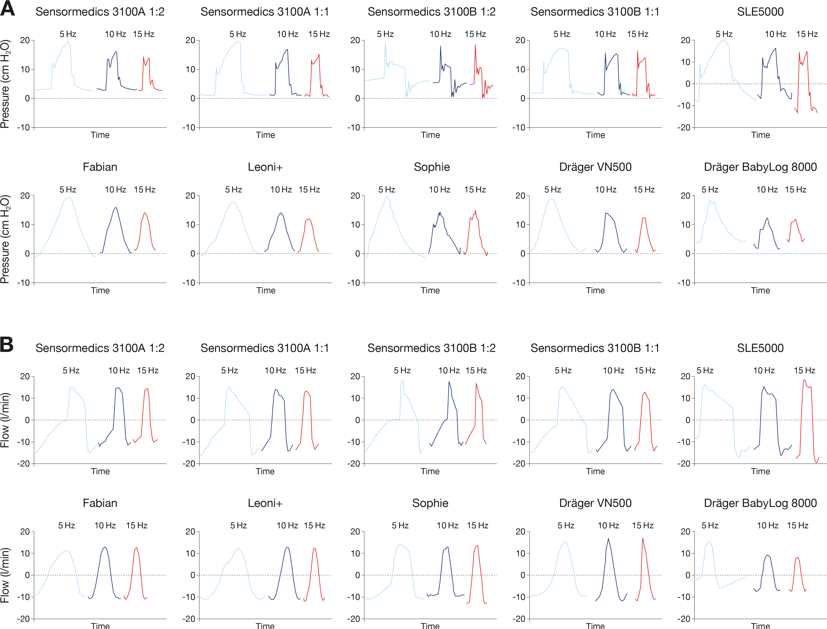
Pressure and Flow Waveforms

Slide 8
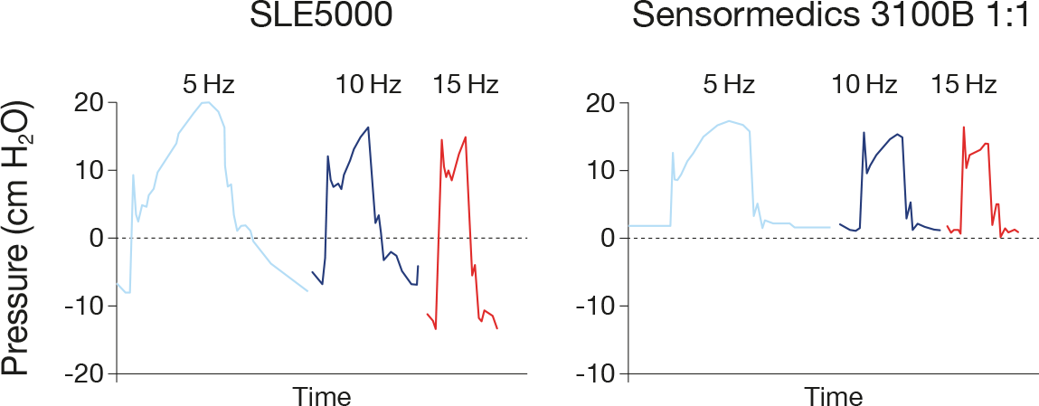
Rapid rise in pressure (approx. 1/100 s) from the SLE5000 and Sensormedics.
Greater amplitude achieved by SLE5000 on same settings.

Slide 9
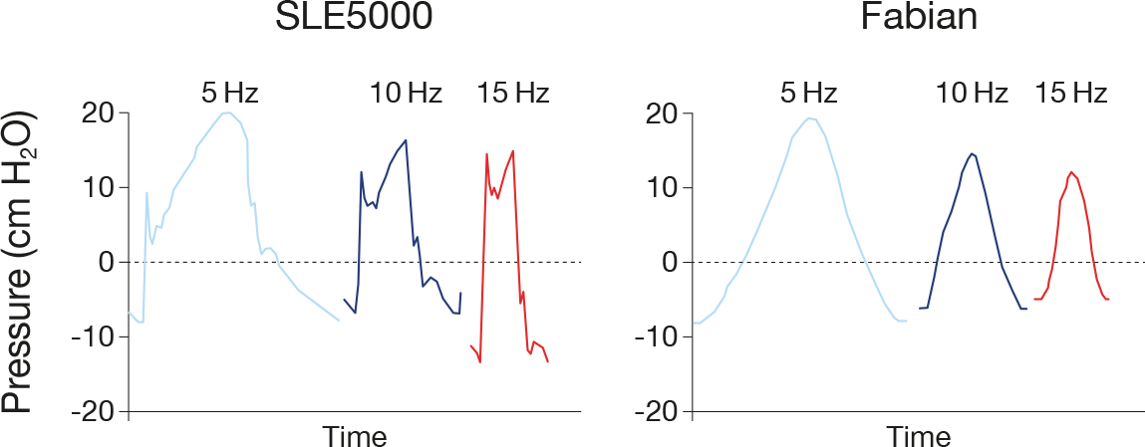
Period:
0.1s at 10Hz
Period:
0.1s at 10Hz
Rapid rise in pressure in approx. 1/100 s
Slower rise in pressure in approx. 1/20 s
The pressure wave created by the rapid rise in pressure from the SLE5000 contains much more energy than the slow rise in pressure from the other ventilators.

Slide 10
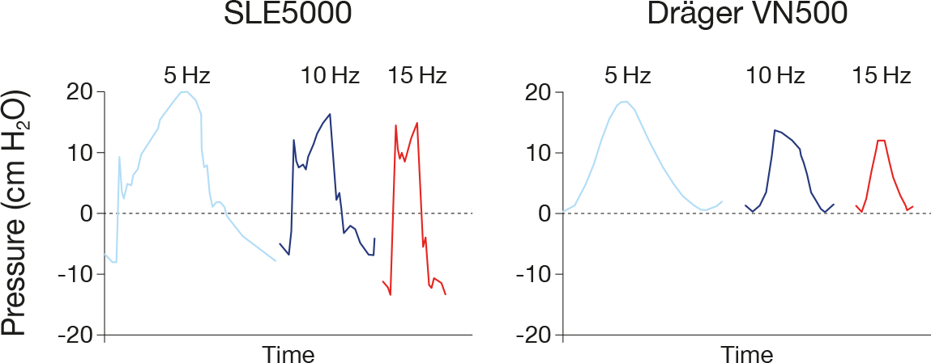
0.1s
0.1s
Rapid rise in pressure in approx. 1/100 s
Slower rise in pressure in approx. 1/30 s

Slide 11
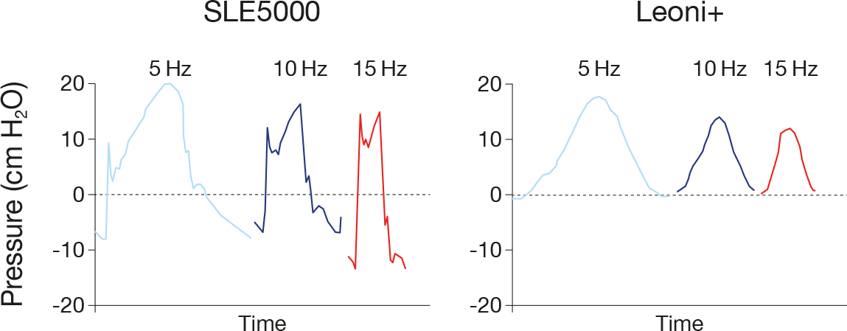
0.1s
0.1s
Rapid rise in pressure in approx. 1/100 s
Slower rise in pressure in approx. 1/20 s

Slide 12
The settings for all ventilators were:
  Mean pressure: 10mbar; Amplitude: 30mbar (+/-15mbar)
  …thus, target pressures: -5mbar to +25mbar.
Target Amplitude
-5 to +25mb
Only the SLE achieved the target negative pressure of -5mbar
(-7.2mbar at 10Hz).
Even the Sensormedics 3100B failed to achieve a negative pressure.
Amplitude 21.4 (21.7 to 0.3) in 1:2 i:e ratio
15.9 (17.0 to 1.1) in 1:1 i:e ratio

Slide 13
Ventilator | I:E Ratio | Peak Pressure | Trough Pressure | Amplitude | % Target Amplitude
Target Ventilator Settings |  | 25.0 | -5.0 | 30.0
Sensormedics 3100A | 1:2 | 16.3 | 3.0 | 13.3 | 44%
Sensormedics 3100A | 1:1 | 16.5 | 0.7 | 15.8 | 53%
Sensormedics 3100B | 1:2 | 21.7 | 0.3 | 21.4 | 71%
Sensormedics 3100B | 1:1 | 17.0 | 1.1 | 15.9 | 53%
SLE5000 | 1:1 | 16.2 | -7.2 | 23.4 | 78%
Fabian | 1:2 | 15.6 | 0.3 | 15.3 | 51%
Leonie+ | 1:2 | 13.9 | 0.8 | 13.1 | 44%
Sophiea | 1:2 | 14.3 | -0.3 | 14.6 | 49%
VN500 | 1:2 | 13.1 | 0.3 | 12.8 | 43%
BL8000b | 1:2 | 10.7 | 2.2 | 8.5 | 28%
Data from Table 1, Harcourt et al, PCCM 2014
Greatest amplitude was achieved by the SLE5000 at 23.4 mbar.

Slide 15
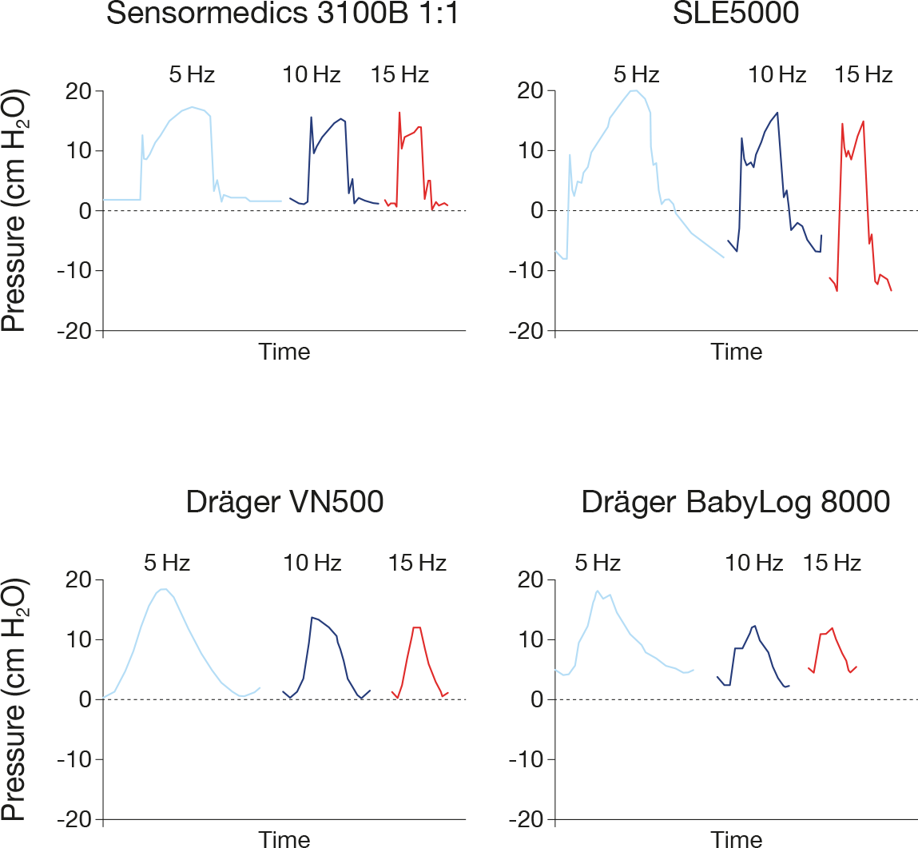
Amplitude maintained at higher frequencies
Amplitude reduces at higher frequencies

Slide 16
Reducing the frequency to achieve greater amplitude (slower oscillation) risks over-distending the lung (according to Dr Peter Rimensberger speaking on HFO at EAPS 2014).
At higher frequencies, the lung does not have time to stretch even at high amplitude oscillation around the appropriate mean pressure.

Slide 17
All the ventilators capable of conventional ventilation and HFO, except for the SLE5000, lost amplitude in the pressure waveform at 10 Hz and lost more pressure at 15Hz.

Slide 18
Rimensberger, Resp. Care 2015
Simulated Term infant 4kg:
resistance 70cmH2O/L/s
compliance 4mL/cmH2O
Mean airway pressure 15 cm H2O , :E 1:1.
“Note that, at a frequency of 15 Hz under full-term infant settings, the Babylog VN500 was not able to increase the pressure amplitude beyond 36 cm H2O (white marker)”

Slide 19
Rimensberger, Resp. Care 2015
“The SLE5000 was the most powerful neonatal HFO ventilator in terms of volume delivery with a performance similar to that of the Sensormedics 3100A.”

