Slide 1
Training

Slide 2
Preparation
Make sure to have the TOF3D Simulator installed on your computer.
In addition to that training you should read the user manual. Contact MIPM if you have any questions.

Slide 3
Agenda
How muscles contract (brief reminder)
Why relaxation of the muscles?
Neuromuscular Transmission Monitoring (NMTM) in Clinical Practice
TOF3D
Trouble shooting
Hands on
Q&A

Slide 4
Terms
Acetylcholine (ACh): Neurotransmitter responsible for stimulus transfer in the synaptic cleft at the neuromuscular end plate
NMBA: Neuromuscular Blocking Agent
Paralysis: relaxation of muscles due to application of NMBA
TOF: Train of Four
PTC: Post Tetanic Count
AMG: Acceleromyography
MMG: Mechanomyography
EMG: Electromyography

Slide 5
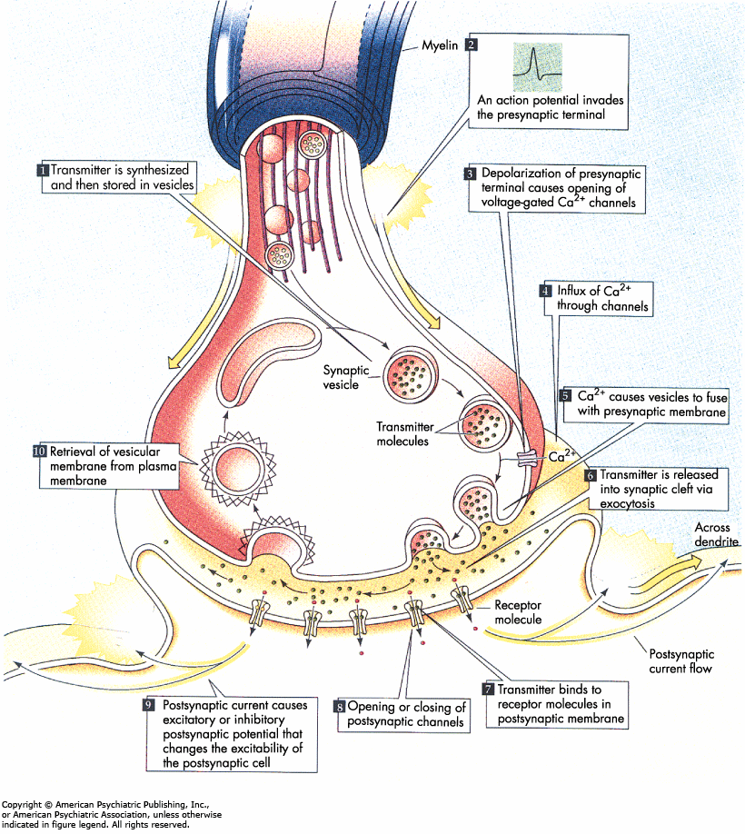
How muscles contract
a nerve is stimulated by impulses coming from the brain (or "artificial" electrical impulse)
At the motor end plate Acetylcholine is emitted from the neuron in the synaptic cleft. ACh attaches to receptors at the muscle cell and enables contraction of the muscle

Slide 6
How muscles contract
ACh is consumed and must be reproduced in the nerve
If receptor is blocked (by NMBA) Acetylcholine cannot attach to receptor
muscle cannot contract
muscle is relaxed
NMBA concentration in the synaptic cleft fades over time
relaxation of the muscle decreases until complete recovery
Time to full recovery varies between different patients and NMBA used!
Only after a complete recovery the muscle is fully functional !!

Slide 7
Why Relaxation?
Intubation
Required condition during surgery
  During several surgery procedures surgeon needs the patient's muscles to be paralyzed to optimize surgical conditions.
3. Improve compliance during ventilation on the ICU

Slide 8
Why NMTM?
Residual paralysis may lead to severe complications for the patient.
  pharyngeal dysfunction
  increased risk for aspiration and pneumonia
  Acute respiratory events
  Residual paralysis increases patient’s discomfort in general.
NMT Monitoring is used to determine the level of neuro muscular blockade.
Save tracheal extubation only if TOF Ratio >0.9 (90%)
Effective management of NMBA administration
      Economic reason for NMTM
      Maintain muscle relaxation to ensure proper surgical condition

Slide 9
Methods
Electromyography - EMG
Mechanomyography (Clinical reference) – MMG
Acceleromyography (Clinical practicability) - AMG

Slide 10
NMT Monitoring in clinical practice
TOF (Train Of Four) as reference for muscular paralysis and recovery condition of the patient
PTC (Post Tetanic Count) for monitoring of deep muscular blockade
Subjective neuromuscular monitoring with peripheral nerve stimulator (Subjective!! Based on personal perception)

Slide 11
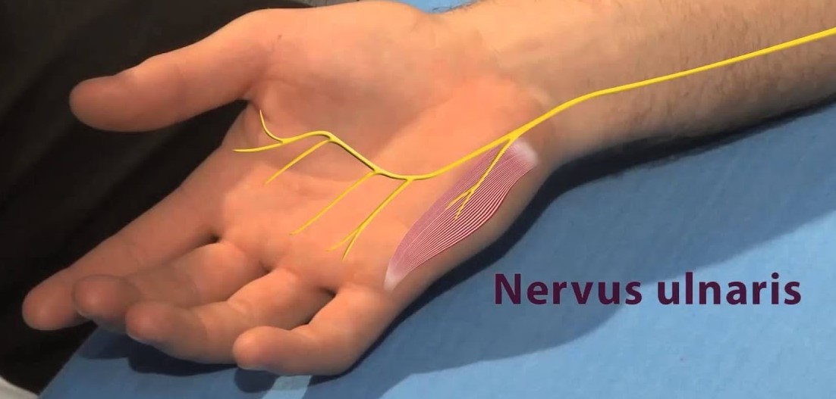
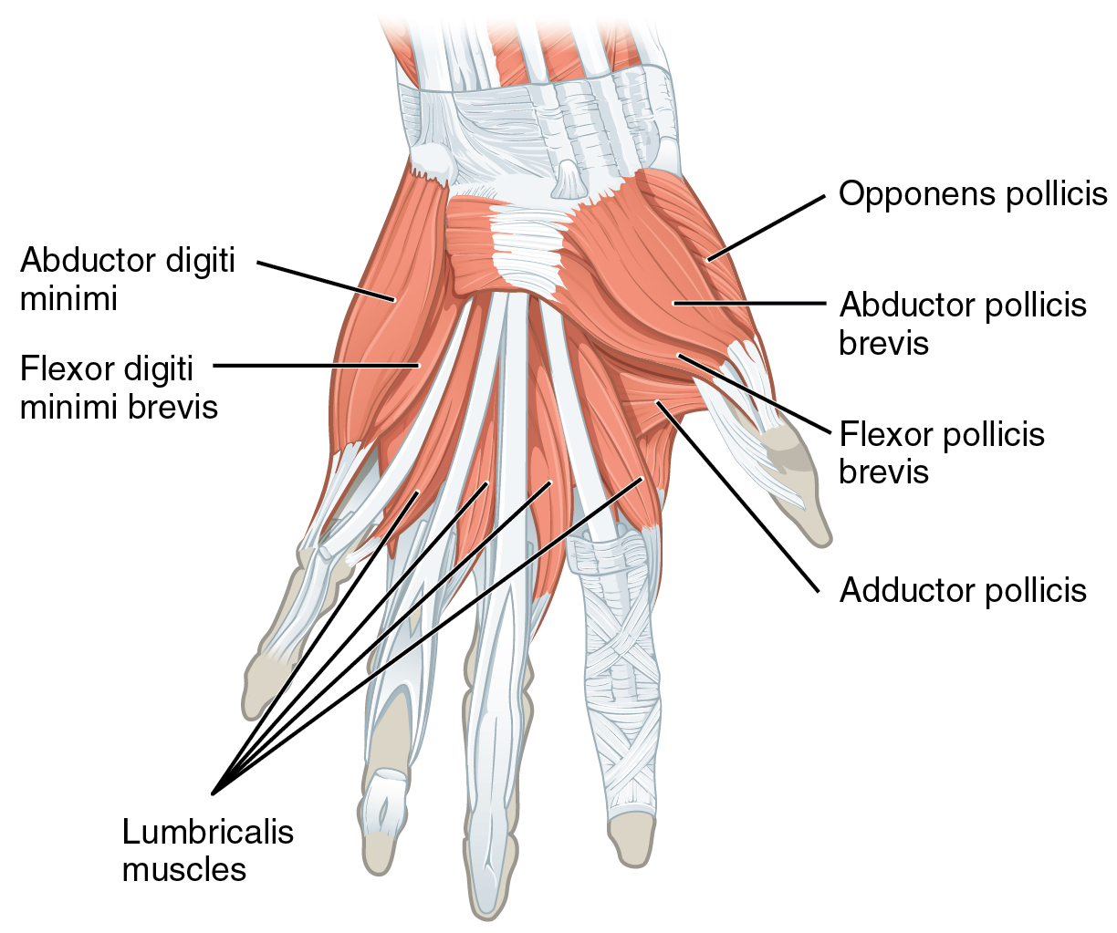
TOF Stimulation - TOF Count/Ratio
Nervus ulnaris is innervated with 4 impulses
Depending on neuromuscular block, 0-4 responses of Musculus Adductor Pollicis are received by TOF Monitor
TOF Ratio = T4/T1
TOF Ratio can only be calculated if 4 responses are detected.
  T1 must be >20% compared to base line (Individual 100% answer)
  T2, T3, T4 must be >3%
Otherwise TOF Count 0 – 4
If 4 responses are detected TOF Ratio is shown as “percentage of recovery”

Slide 12


TOF Count / Ratio - Examples
Excurse - Fade of ACh
Impulse
Response
Non relaxed patient / full recovery
Full neuromuscular block
Recovery: early stadium - (e.g. TOF count 2)
Recovery: medium stadium - (e.g. TOF ratio 50%)

Slide 13
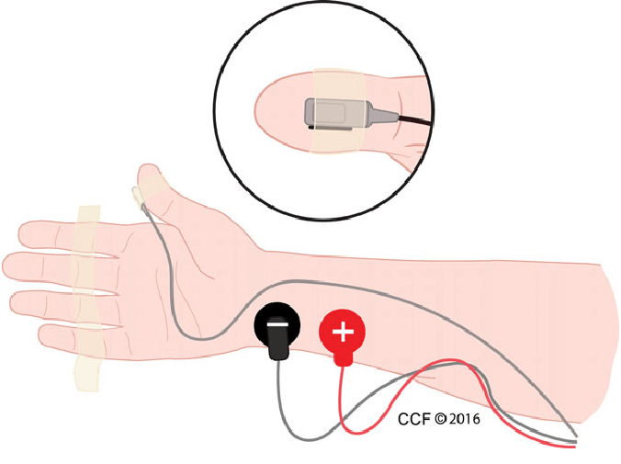
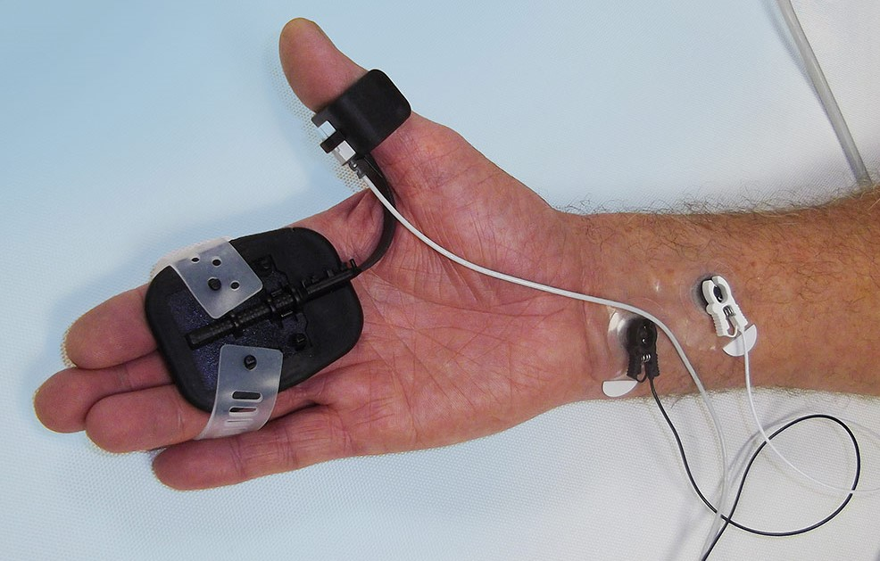
NMT Monitoring - Basics
It all starts with the correct setup of stimulation electrodes and acceleration sensor! The hand should be fixed to the OR table or the hand adapter should be used.
Use small (pediatric) electrodes to ensure proper placement and skin contact.
Observe polarization of the stimulation cables.
- Positive (White) cable: Proximal
- Negative (Black) cable: Distal

Slide 14
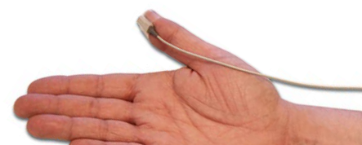
NMT Monitoring - Basics
The more distal the acceleration sensor is placed on the thumb, the stronger the acceleration signal. This effect can be used to adjust the signal strength.

Slide 15
NMT Monitoring - Basics
The shortcoming of AMG technology is that the observed muscle (e.g. adductor pollicis) requires space to move.
Only the movement (acceleration) of the muscles can be picked up by the sensor.
If hands are tucked to the body in an unfavorable way or if the free movement of the muscle is blocked by blankets or surgical drapes AMG will not work!
Using the hand adapter improves the performance by holding up the thumb providing space to move.
If the monitor cannot be used on adductor pollicis (thumb) you may try different setups:

Slide 16
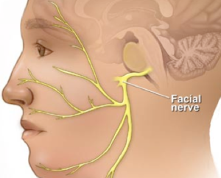
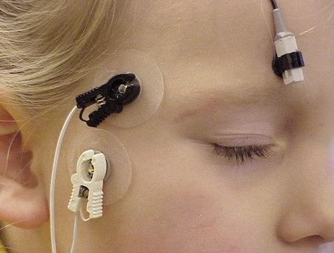
NMT Monitoring - Basics
Stimulation: Facial nerve
place positive electrode (white) near ear lobe and the negative electrode (black) 2 cm’s from the eyebrow (along facial nerve inferior and lateral to the eye)
Response:
Orbicularis occuli muscle – Eyebrow twitching
Use the Eye adapters to fix the acceleration sensor to the eyebrow

Slide 17
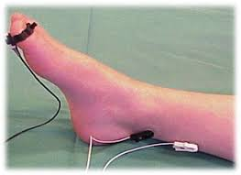
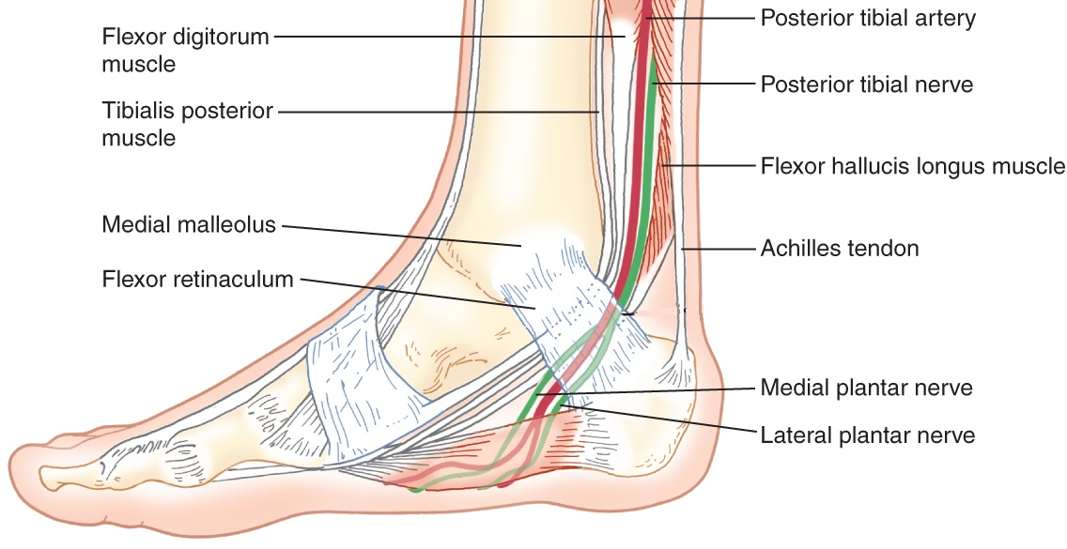
NMT Monitoring - Basics
Stimulation: Posterior tibial nerve
place the negative electrode (black) over inferolateral aspect of medial malleolus (palpate posterior tibial pulse and place electrode there) and positive electrode (white)
2 – 3 cm proximal to the negative electrode.
Response:
Flexor hallucis brevis muscle – planter flexion of big toe
Flexor hallucis brevis muscle
Use the thumb adapter or plaster to fix the acceleration sensor to the toe.

Slide 18
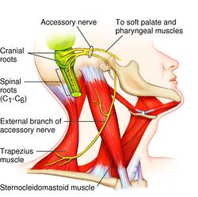
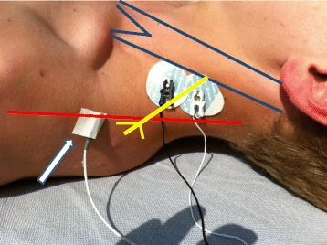
NMT Monitoring - Basics
A study conducted by Dormagen hospital in Germany showed a good correlation between using a setup at the trapezius muscle and using the adductor pollicis setup.
In this setup the Accessory nerve is stimulated provoking a shrug.
Fix the acceleration sensor with tape to the patient’s shoulder.
There is no known literature or different studies available about this method.
It should not be recommended as a standard method

Slide 19
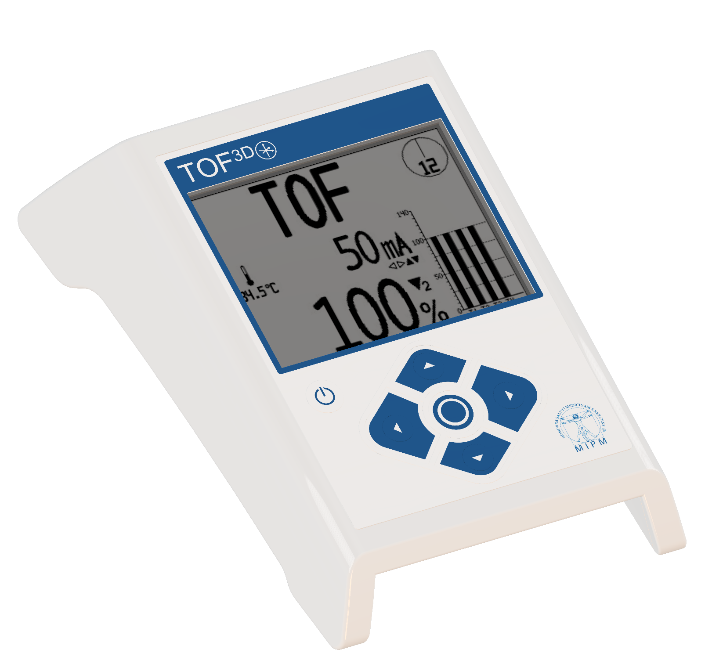
TOF^{3D}
Compact design
Various stimulation modes
  TOF, PTC, Tet, DBS, Single Twitch
Big clearly arranged display
Adjustable continuous measurement
Calibration Mode

Slide 20
NMT Monitoring in clinical practice
TOF3D
Using TOF3D is an easy method to monitor the degree of neuromuscular blockade
AMG: a piezo crystal produces an impulse if accelerated by contraction of the Musculus adductor pollicis (thumb). Impulses are processed and displayed as TOF ratio or single impulse response

Slide 21
NMT Monitoring in clinical practice
TOF3D
More reliable than subjective monitoring!
  Reproducible!
  Objective!
  Calibration function normalizes signal amplification and electric stimulus to the respective patient.

Slide 22
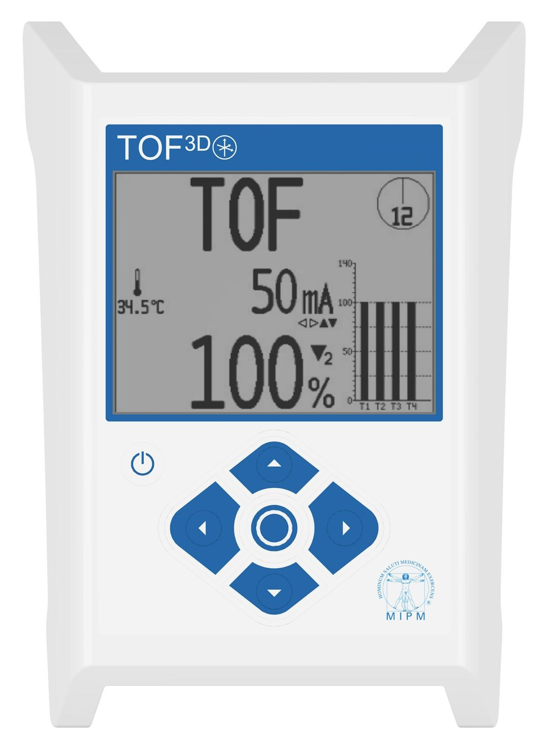
TOF^{3D} - In Detail
Front View
Display
On / Off key
Center Key
Up / Down keys
Right / Left keys
1
2
4
5
3
5
4

Slide 23
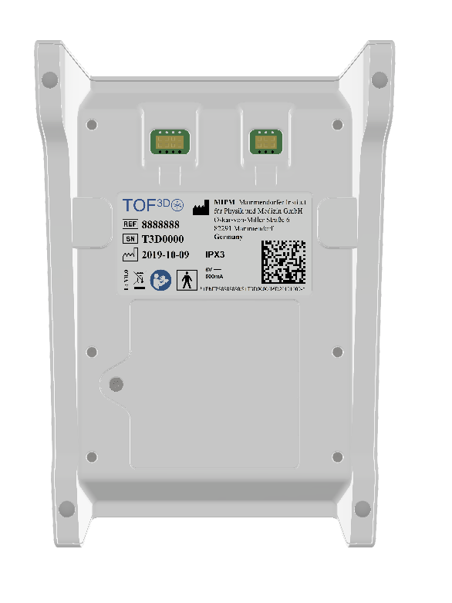
TOF^{3D} - In Detail
Back
2
4
Adapter for IV pole holder
Socket for Patient cable
Battery Compartment
USB Interface
1
3

Slide 24
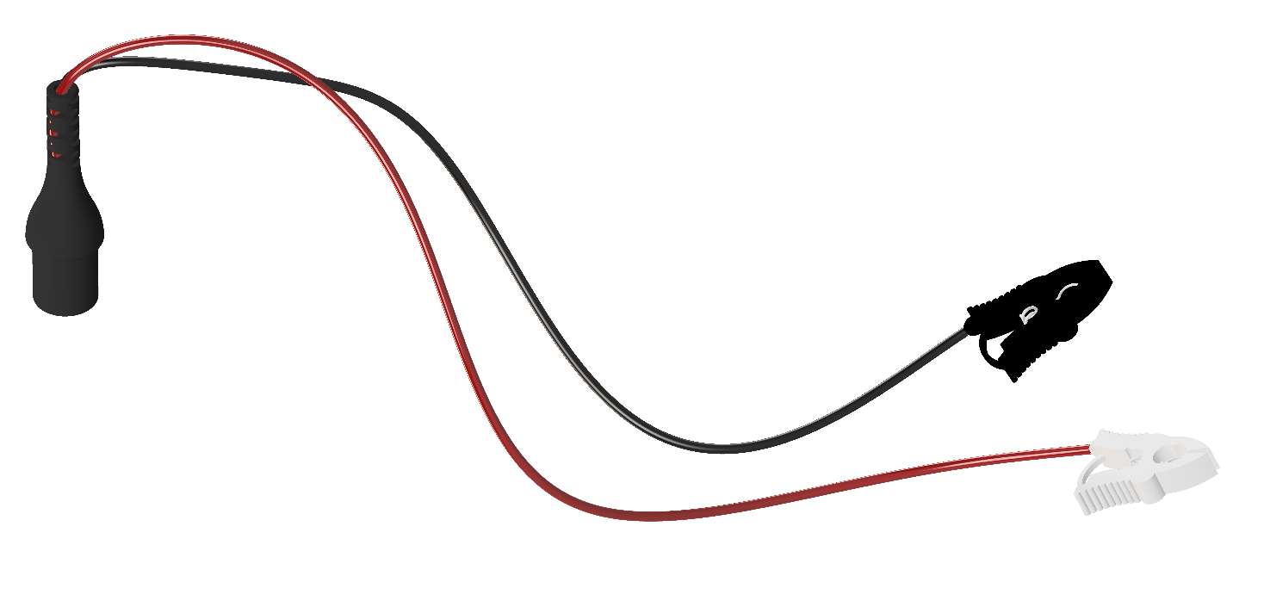
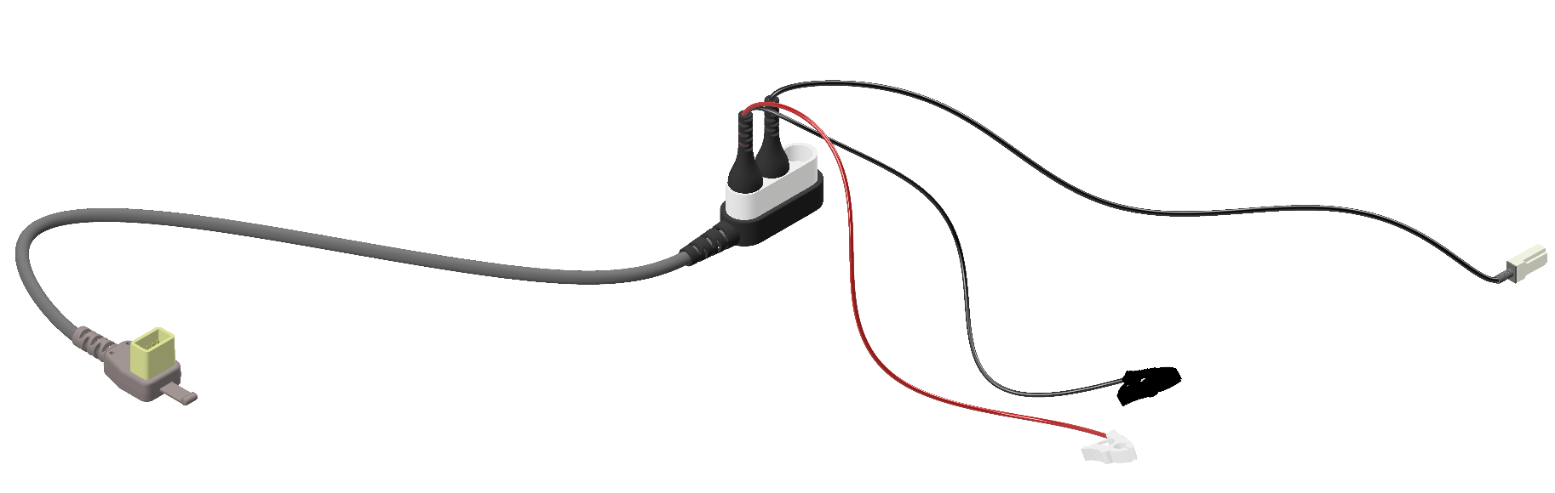
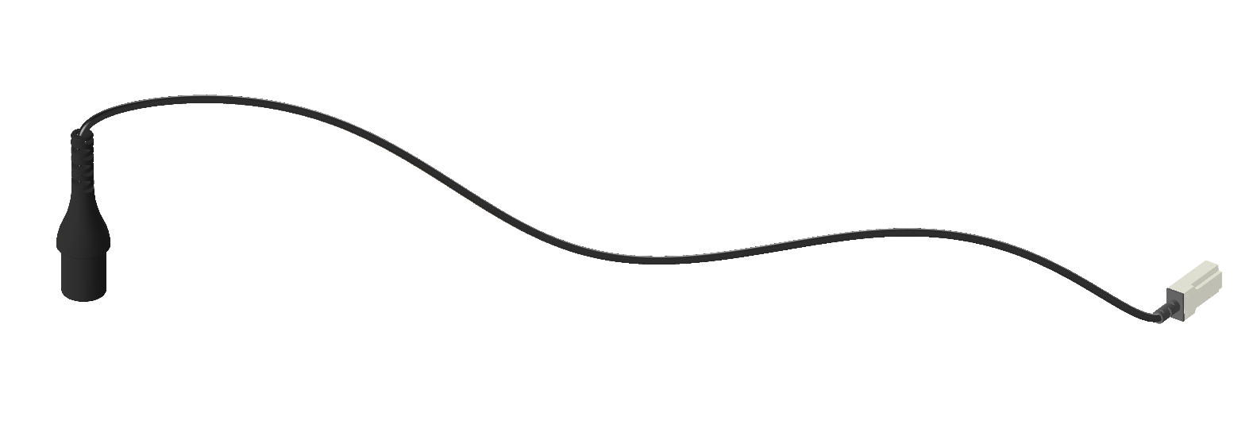
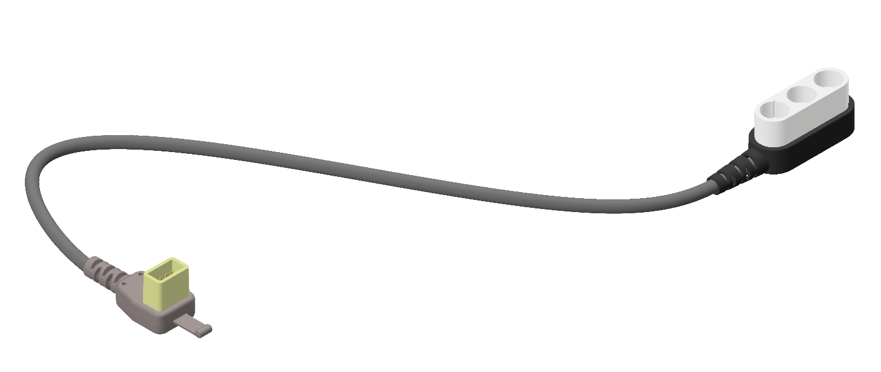
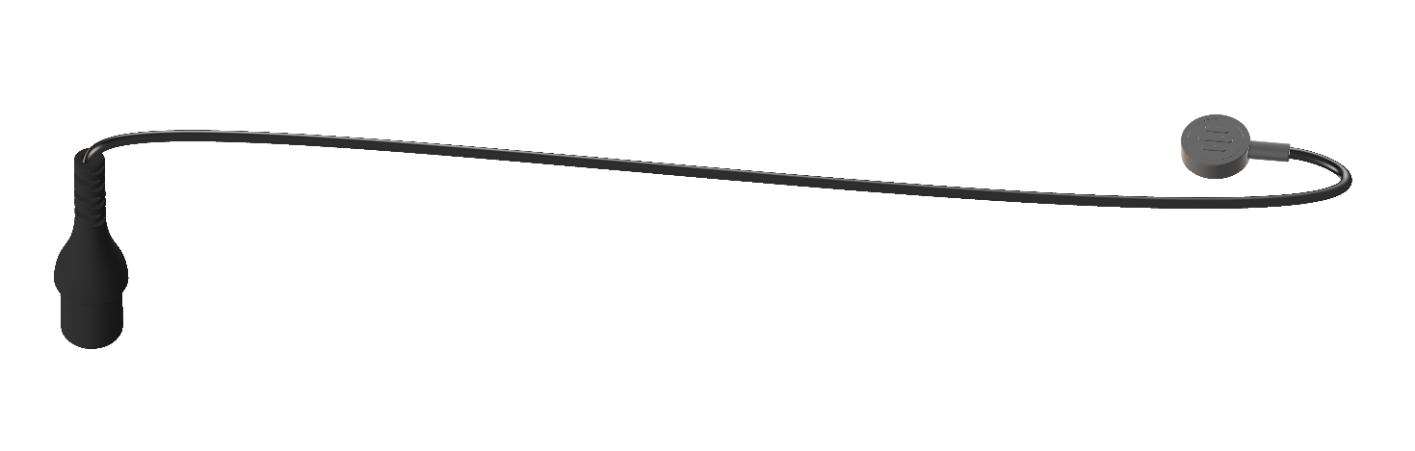
TOF^{3D} - In Detail
Accessories
Stimulation Cable – Item Number: 5750107
Including:
Positive and Negative cable
Complete Patient Cable – Item Number: 5750104
Including:
Main cable
Acceleration Transducer
Stimulation cable
Acceleration Sensor TOF3D – Item Number: 5750105
Main Cable – Item Number: 5750108
Temperature Sensor TOF3D – Item Number: 5750106

Slide 25
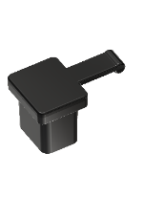
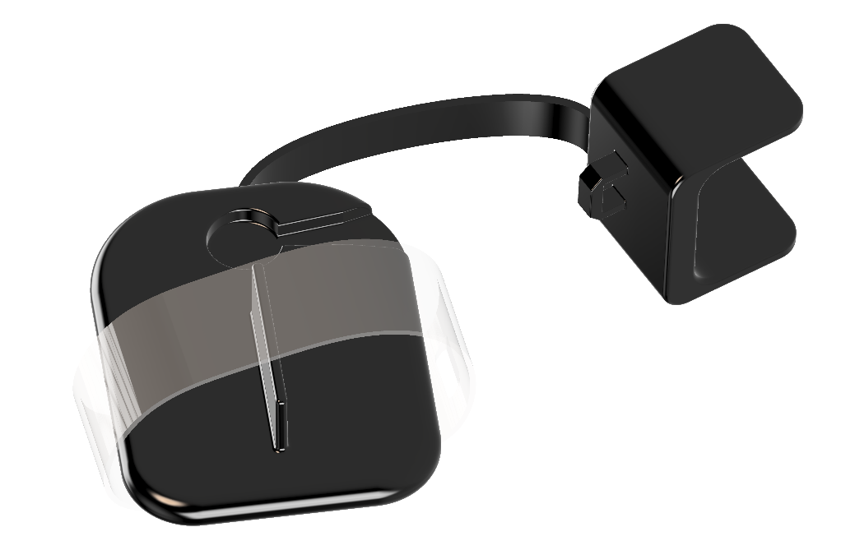
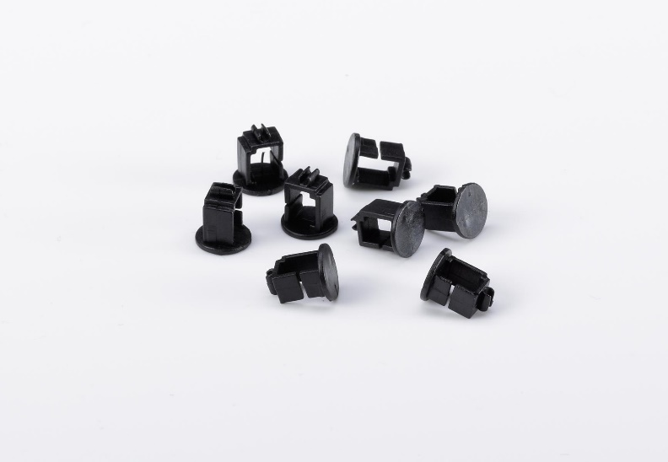
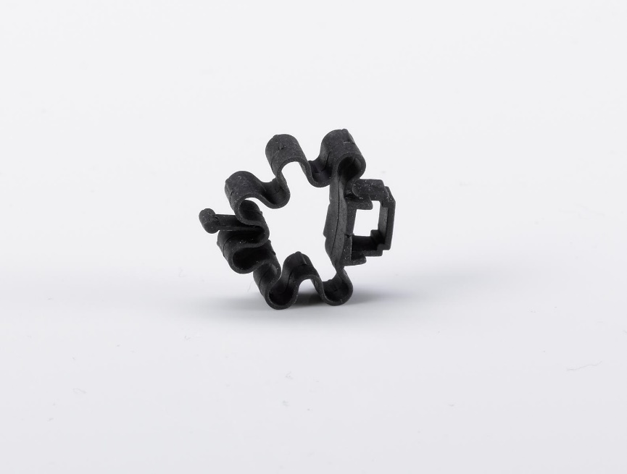
TOF^{3D} - In Detail
Accessories
Data Interface Plug TOF3D – Item Number: 5750109
Hand Adapter TOF3D – Item Number: 5750100
Eye Adapter TOF3D – Item Number: 5750102
Thumb Adapter TOF3D – Item Number: 5750101

Slide 26
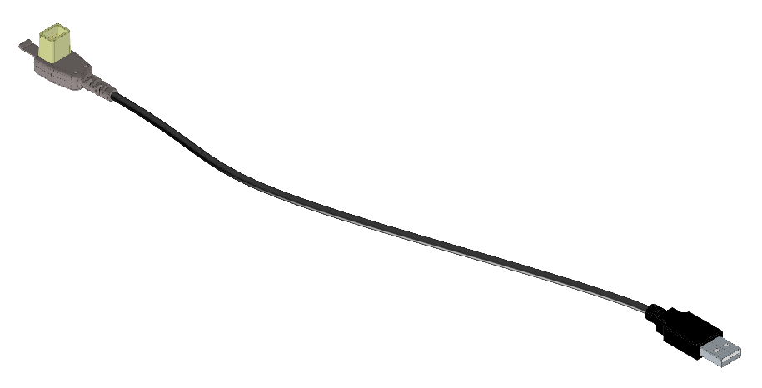
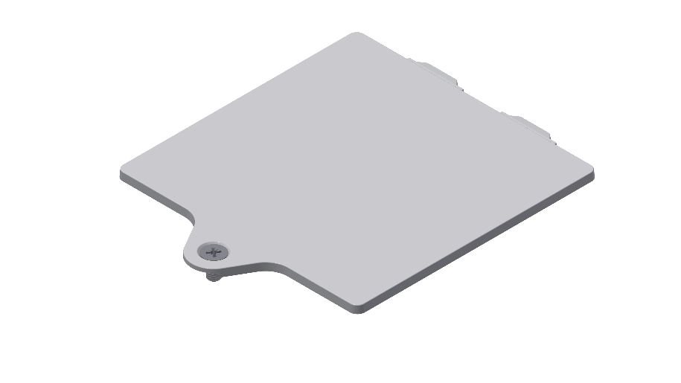

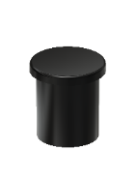
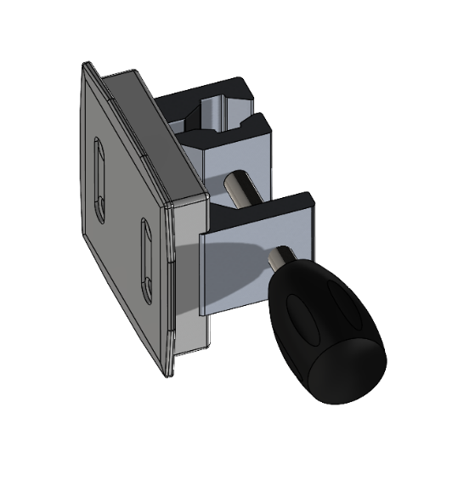
TOF^{3D} - In Detail
USB Interface Cable TOF3D – Item number: 5750103
Battery Lid TOF3D– Item number: 5750111
TOF3D Link Interface– Item number: 5750117
Split connector sealing plug TOF3D– Item number: 5750116
IV-pole holder TOF3D – Item number: 5750110

Slide 27
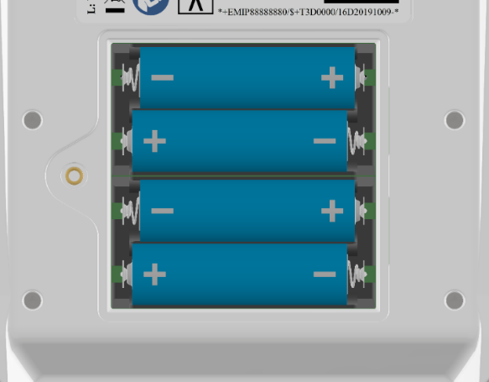
TOF^{3D} - In Detail
The TOF3D is battery powered.
Open the battery lid using a cross tip screwdriver.
Insert 4 AA batteries as shown on the picture.
Fully charged batteries will give you up to 1500 hours of continuous stimulation.

Slide 28
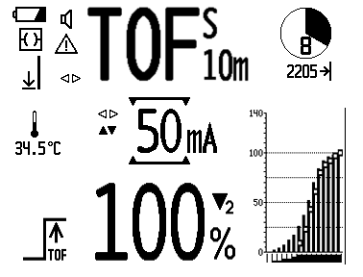
TOF^{3D} - In Detail
The Display
Stimulation Mode
Timer Status
Technical Status
Recordings in Memory
Surface Temperature
Parameter Settings
Trend Graph
Alarms
Status Results and Calibration

Slide 29
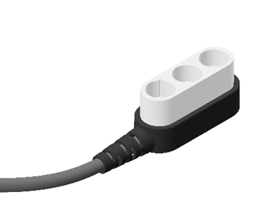
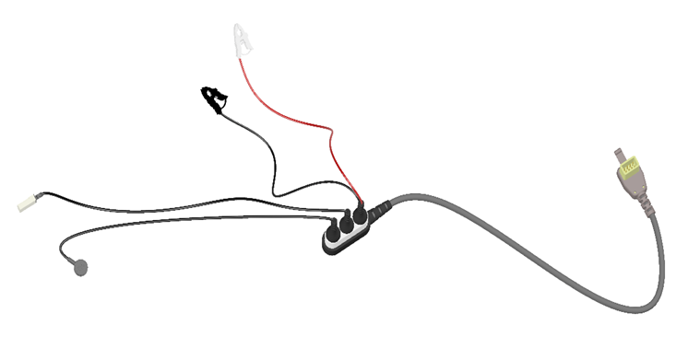
TOF^{3D} - In Detail
Cable connection
Acceleration Transducer, Stimulation cables and temperature sensors need to be connected to the split connector.
Each connector port is mechanically coded to make sure that the cables only fit in their respective position.
Main Patient cable
Split Connector
Socket for
stimulation cables
Socket for
Acceleration
Transducer
Socket for
Temperature sensor

Slide 30
TOF^{3D} - In Detail
Cable connection
Connect the patient cable to the patient cable socket on the back side of the monitor.

Slide 31
TOF^{3D} - Quick Guide - Calibration
Calibration
The monitor should always be calibrated before application of NMBA!
The calibration procedure determines the individual patient’s muscle response.
This ensures accurate measurements.
CAL 1: The monitor determines the base line (muscle response in the absence of NMBA) for the respective patient.
CAL 2: The monitor determines the base line (muscle response in the absence of NMBA) for the respective patient as well as the supra-maximal stimulation current.
Select CAL1 or CAL2 in the Settings menu.

Slide 32
TOF^{3D} - Quick Guide - Calibration
If patient is already relaxed do not calibrate device as this leads to wrong results!
Use TOF3D without calibration. Keep in mind that the results may not be exact.
Since amplification of the signal and stimulus strength haven't been normalized by calibration process TOF ratio may be above 100%.

Slide 33
TOF^{3D} - Quick Guide
Place the stimulation electrodes and acceleration sensor to the patient as explained before.
Turn ON the monitor.
After a completed self test the monitor automatically goes to CAL Mode.
Inject sedative (wait for appropriate sedation)
Calibrate TOF3D.
Press and hold the center key for at least 1 second to initiate Calibration.
Wait until monitor returns to TOF mode and
“calibration successful” is displayed
3. Inject blocking agent (NMBA)
4. Start single TOF stimulation by pressing the Center Key once
(Start continuous TOF stimulation by pressing the Center Key for more than one second)

Slide 34
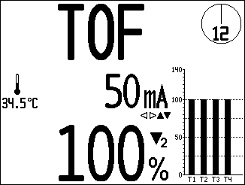
TOF^{3D} - Quick Guide
After a successful TOF measurement you will see:
TOF Ratio or TOF Count
After 15 seconds the TOF value is faded out and the trend graph is shown.
Applied stimulation current
Number and height of twitches

Slide 35
TOF^{3D} - Quick Guide - PTC
If TOF count = 0
Use PTC to monitor deep muscular blockade.
Select PTC Mode using the Right – Left Keys
Press and hold (>1 sec) Center Key to activate PTC
  The monitor performs a response test (PrePTC - 15 impulses at 1 Hz)
    If more than 5 impulses > 3% are detected PTC is not carried out
  If PrePTC is successful tetanic stimulus starts (5 seconds)
  After tetanic stimulus – 15 impulses (1 Hz)
TOF 3D displays number of responses (max. 15)
Monitor goes back to TOF mode
PTC may only be used every 2 minutes!

Slide 36
Additional functions
TOF3D offers a variety of functions.
TOF3D can be used for single twitch stimulus and different other stimulation modes.
However the most common function is TOF stimulation. TOF has biggest practical evidence.

Slide 37

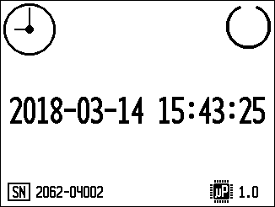
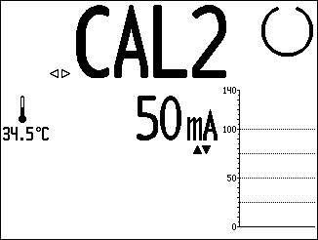
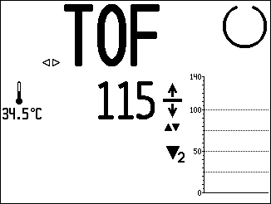
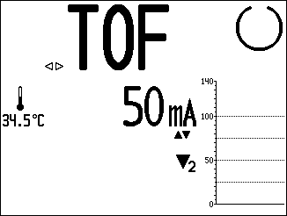
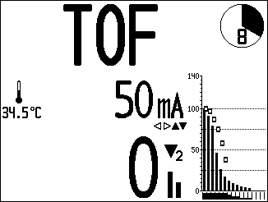
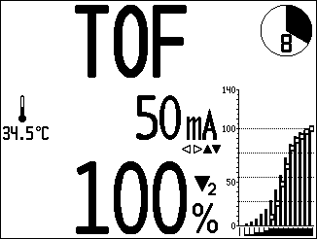

TOF^{3D} - In Detail
A typical TOF Session
Self Test
Verify Date/Time
Initiate Calibration with Center Key >1 sec.
Base line adjustment and CAL confirmation are displayed
Stimulation current is displayed
Start continuous TOF Measurement using Center Key > 1 sec.
If unit is turned on again within two hours (from last measurement) you can add new data to the patient. If more than two hours have elapsed the patient has to be released and stored data must be transmitted via interface or deleted.
Observe effect of NMBA Bolus
Observe recovery until FULL recovery
Stop TOF measurement using Center Key
Turn Off Device

Slide 38
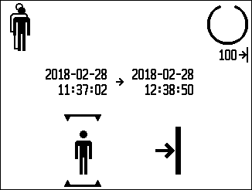
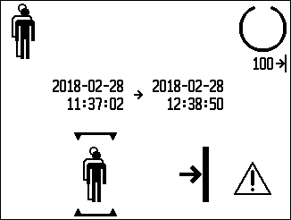
TOF^{3D} - In Detail
Data Management
The TOF3D has an integrated memory. If data logging is active the start up procedure may be different depending on if there is still data in the memory.
If the monitor was calibrated
and the existing patient was selected
TOF3D goes to TOF mode
If the data is less than 2 hours old,
you may add new data to the existing patient
There are 100 logs in the memory.
If the data is older than 2 hours,
or you want to clear the memory
the old patient will be replaced by a new one
If new patient was selected
or the monitor wasn’t calibrated
TOF3D goes to CAL mode

Slide 39
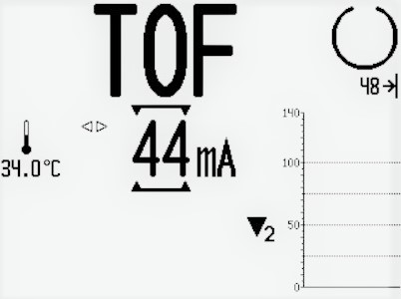
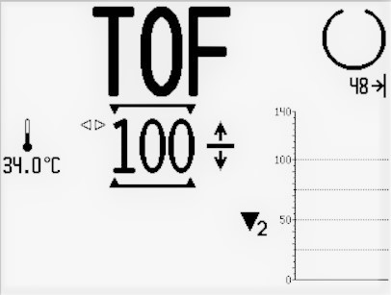
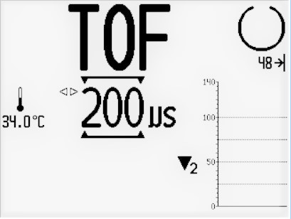
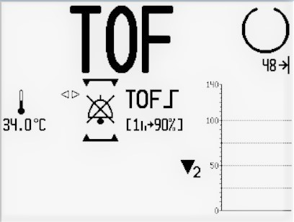
TOF^{3D} - In Detail
Parameter Settings in the main screen
During normal operation you can always have a look at or change certain parameter settings.
Be aware; if the monitor was calibrated and parameter settings are changed manually, the calibration patterns are lost.
Use the Up or Down key in main screen to activate parameter settings.
(If there is no user input within 3 seconds the monitor goes back to normal mode.)
The cursor will be displayed.
Use the Left – Right keys to navigate through the settings.
Use the Up or Down key to change:
Stimulation current
Base Line
Impulse Width
Alarm Sound

Slide 40
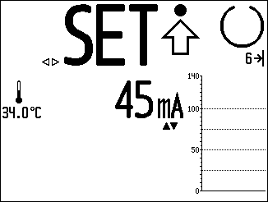
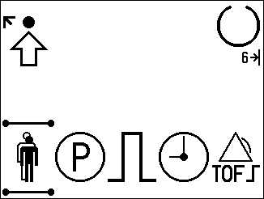
TOF^{3D} - In Detail
Setup Menu
6
Data Management
Parameter Menu
Stimulation settings
Date / Time Settings
TOF Alarm Settings
Exit Setup Menu
Go to Setup Menu using the Left – Right Keys
1
2
3
4
5
Use Left – Right Keys to navigate in the menu and Up – Down Keys to change settings. Use Center Key to enter or exit menus.

Slide 41
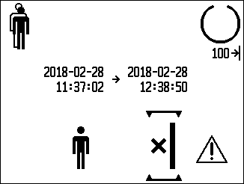
TOF^{3D} - In Detail
Data Management
New Data will be added to data in memory
Existing Data will be erased – New Patient
Activate / Deactivate data logging

Slide 42
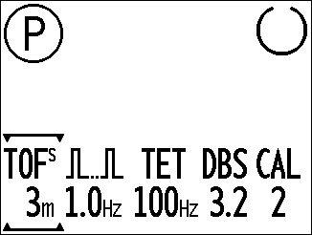
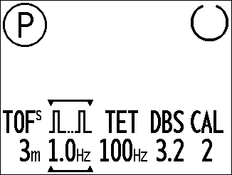



TOF^{3D} - In Detail
Parameter Menu
Select interval for continuous TOF Measurement in minutes.
Select frequency for single twitch stimulation
Select frequency for tetanic stimulation
Select between Double Burst 3.2 and 3.3
Select CAL 1 or CAL2

Slide 43



TOF^{3D} - In Detail
Parameter Menu
It is possible to eliminate stimulation modes from the menu. This will customize the monitor if stimulation modes are not used by customers.
If you want to eliminate a stimulation mode from the menu use the Left – Right Key to select the stimulation mode. Then use the Down key until -- is shown. Repeat this for all stimulation modes you want to eliminate.
To reactivate eliminated stimulation modes go to the parameter menu again and use the Up Key.

Slide 44




TOF^{3D} - In Detail
Stimulation Settings
Activate or deactivate stimulation Beep.
Change default stimulation current
Change measurement unit for stimulation current. mA / µC
Chose stimulation pulse width. 200/300 µs.

Slide 45



TOF^{3D} - In Detail
TOF Alarm Settings
Set Lower Alarm Limit
Set Upper Alarm Limit
Activate / Deactivate TOF Alarm sound.

Slide 46
TOF^{3D} - Specs
Technical Specifications
Device Dimensions | Height : 198 mm Width : 141 mm Depth : 65 mm
Display | Size: 4,4‘‘ – 90 x 67 mm Type: LCD Resolution: 240 x 320
Battery | Technology: Alkaline, NiCd/NiMH Type: 4 x 1,5V AA Operating Time: ≈ 1500 hours of constant TOF monitoring
Electrical Specification | Internally powered handheld device Continous operation IPX3 Operating Voltage: 4 – 6 Volt Max. current: 500 mA Power consumption: max. 2,5 Watt
Stimulation | Waveform: Monophasic rectangular wave Pulse width: 200 µs or 300 µs Constant Current: 0 – 60 mA Load: 100 Ω – 5kΩ
Data Storage | Online Data dump: Yes Data storage in device: Yes Memory capacity: ≈ 45,000 records (e.g. 180 hours of TOF recording)

Slide 47


Competitors - AMG
StimPod
Xavant
TOFscan
idmed

Slide 48
Competitors
Both competitors offer all available stimulation modes.
TOF 3D offers highest resolution display – better readability from greater distances
Alarm Management - Set Alarm Limits for upper and lower TOF Rates.
Competitors claim: No calibration needed.
This is not true!
Modern sensors can compensate variations in the sensitivity (connected to acceleration sensor placement). However the major part of variations in measurement comes from the different patient responses (patient variation). To overcome the variation in patients' responses and ensure correct measurement TOF monitors should always be calibrated.

Slide 49


Competitors - EMG
There are 2 EMG based handheld systems on the market.
TetraGraph
Senzime
TwitchView
Blink DC
EMG devices offer one big advantage compared to AMG based devices.
EMG technology does not depend on free moving muscles as they pick up the muscle's electric potential that is generated independent of the muscle's movements.
However EMG is linked to extremely high cost since the monitors can only be used with a special single use electrode.
A comparison between cost of AMG based monitoring and EMG based monitoring showed that using EMG increases cost for neuromuscular monitoring up to 2.000% p.a. depending on the number of cases.
Moreover EMG is susceptive to RF noise coming from various devices used in the OR.

Slide 50
Trouble shooting
Calibration didn't work.
Check placement of acceleration sensor and stimulation electrodes
      Maybe the acceleration sensor isn't placed correctly
      Maybe the electrodes are not placed over Nervus ulnaris
Maybe the skin resistance is too high
      Observe messages in display
      Clean skin with an abrasive gel or isopropyl alcohol solution

Slide 51
Trouble shooting
PTC doesn't start
    Before TOF3D starts the Post Tetanic Count an additional check for muscle relaxation is performed.
    If the check gives a stimulus response the PTC is
    not carried out.
    Has PTC been performed within the last 2 minutes?

Slide 52
Trouble shooting
Calibration worked but TOF is not displayed.
  check if patients' hand is still fixed
  check if the thumb is free to move
  check if stimulation cables are still connected to the electrodes
  check if transducer is still positioned correctly

Slide 53
Hands On
To get more familiar with the TOF3D you should use the simulator or a monitor to perform the following tasks.
Consult the user manual if you cannot fulfill a task.

Slide 54
Hands On
Setup TOF3D for monitoring at Adductor pollicis muscle. Use the hand adapter.
Make TOF3D ready for Use. Initiate continuous TOF measurement
Set TOF Time Interval to 5 minutes and upper TOF alarm level to 90%.
  Initiate TOF interval measurement
Delete Patient Memory

Slide 55
Hands On
Set Calibration mode to CAL2
Set Stimulation pulse width to 300 µs
Initiate PTC
Connect patient cable with all necessary components.
Customize the monitor. Remove Single Twitch, TET and DB from the menu.
Replace batteries of the unit.

Slide 56
Service

Slide 57

Repair Procedure
C
B
C
Remove Battery lid (marker A)
Remove the four batteries
Remove the sealing plug (marker B)
Remove the silicone plugs and the screws below (marker C)
Remove lower shell
C
C
A
C
C

Slide 58

Repair Procedure
B
B
B
Unplug flat ribbon cable (marker A)
Remove the screws (marker B)
Carefully slide out PCB
To reassamble the device do the previous steps backwards.
B
A
B
B
B

Slide 59


Spareparts
Housing TOF3D top shell
Partnumber: 5750114
Housing TOF3D lower shell
Partnumber: 5750115

Slide 60


Spareparts
Battery lid
Partnumber: 5750111
Interface Sealing Plug
Partnumber: 5750109

Slide 61
Technical Safety Check
Visual Inspection
  Check overall condition of TOF3D (Housing / Display / Keys) and Accessories
Functional Check
  Measure Voltage of Batteries
  Check Peak to Peak Voltage on Oscilloscope for correct measurement
  Check Transducer functionality

Slide 62
Further Information
Technical Safety check needs to be performed on annual basis
Batteries only need to be replaced if indicated
Detailed Information are provided in the Service Manual and the Technical Safety check protocol
In case of any technical questions, please get in contact with service@mipm.com

Slide 63


Slide 64
Fade of Acetylcholine - An explanation for the decreasing response strength
ACh is "consumed" in the synaptic cleft.
It has to be reproduced in the pre synaptic end of the motor neuron.
The TOF stimulus takes 2 seconds to complete.
Within the 2 seconds the ACh concentration in the synaptic cleft decreases as it cannot be reproduced quick enough.

Slide 65


Back to Slide 11
Fade of Acetylcholine - An explanation for the decreasing response strength
In the same time the concentration of NMBA in the synaptic cleft remains constant
From the first to the fourth impulse the relative concentration of NMBA increases.
      More muscle cells are blocked due to relative higher concentration of NMBA in every response.
      Strength of the responses fades from first to fourth response.

