Slide 1
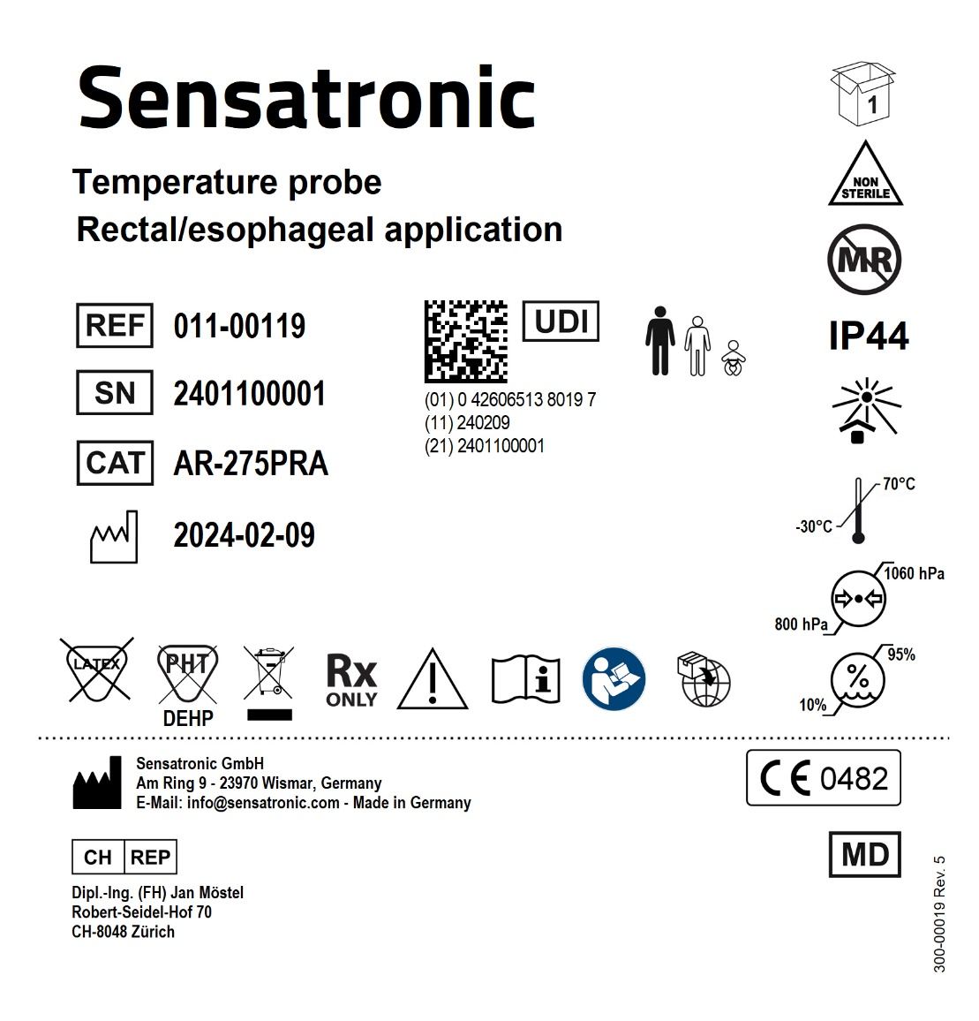
REF number/type | Description | Labelling
REF: 011-00119 Type: AR-275PRA | Reusable rectal/esophageal temperature probe, Adult, phone plug right-angled | Box label:

Slide 2
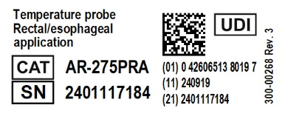
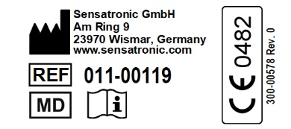
REF number/type | Description | Labelling
REF: 011-00119 Type: AR-275PRA | Reusable rectal/esophageal temperature probe, Adult, phone plug right-angled | Flag label (front): Flag label (back):

Slide 3
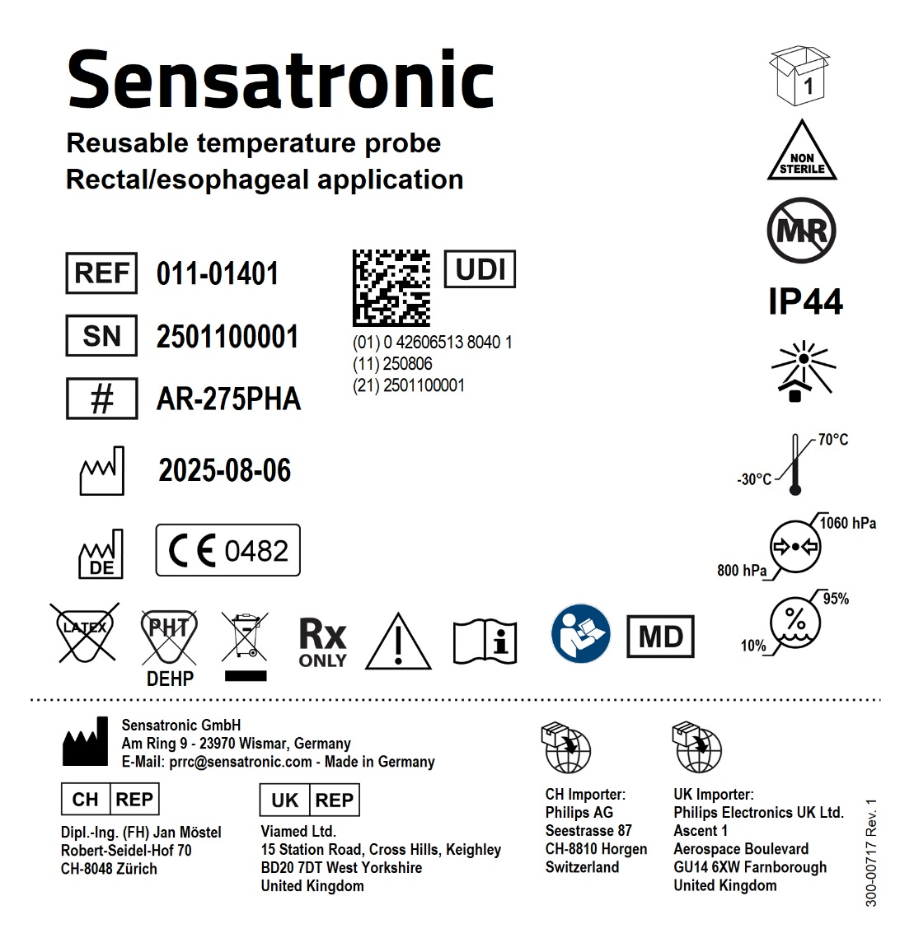
REF number/type | Description | Labelling
REF: 011-01401 Type: AR-275PHA | Reusable rectal/esophageal temperature probe, Philips compatible connector | Box label:

Slide 4
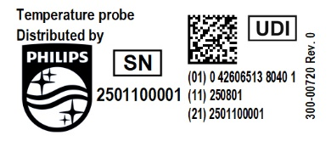
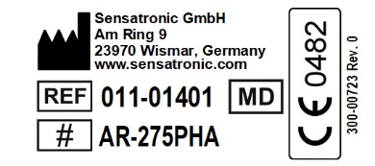
REF number/type | Description | Labelling
REF: 011-01401 Type: AR-275PHA | Reusable rectal/esophageal temperature probe, Philips compatible connector | Product label (front side): Product label (back side):

Slide 5

REF number/type | Description | Labelling
REF: 011-01402 Type: PR-275PHA | Reusable rectal/esophageal temperature probe, Philips compatible connector | Box label:

Slide 6
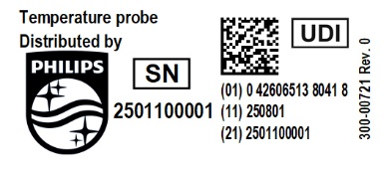
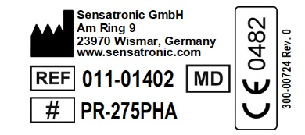
REF number/type | Description | Labelling
REF: 011-01402 Type: PR-275PHA | Reusable rectal/esophageal temperature probe, Philips compatible connector | Product label (front side): Product label (back side):

Slide 7
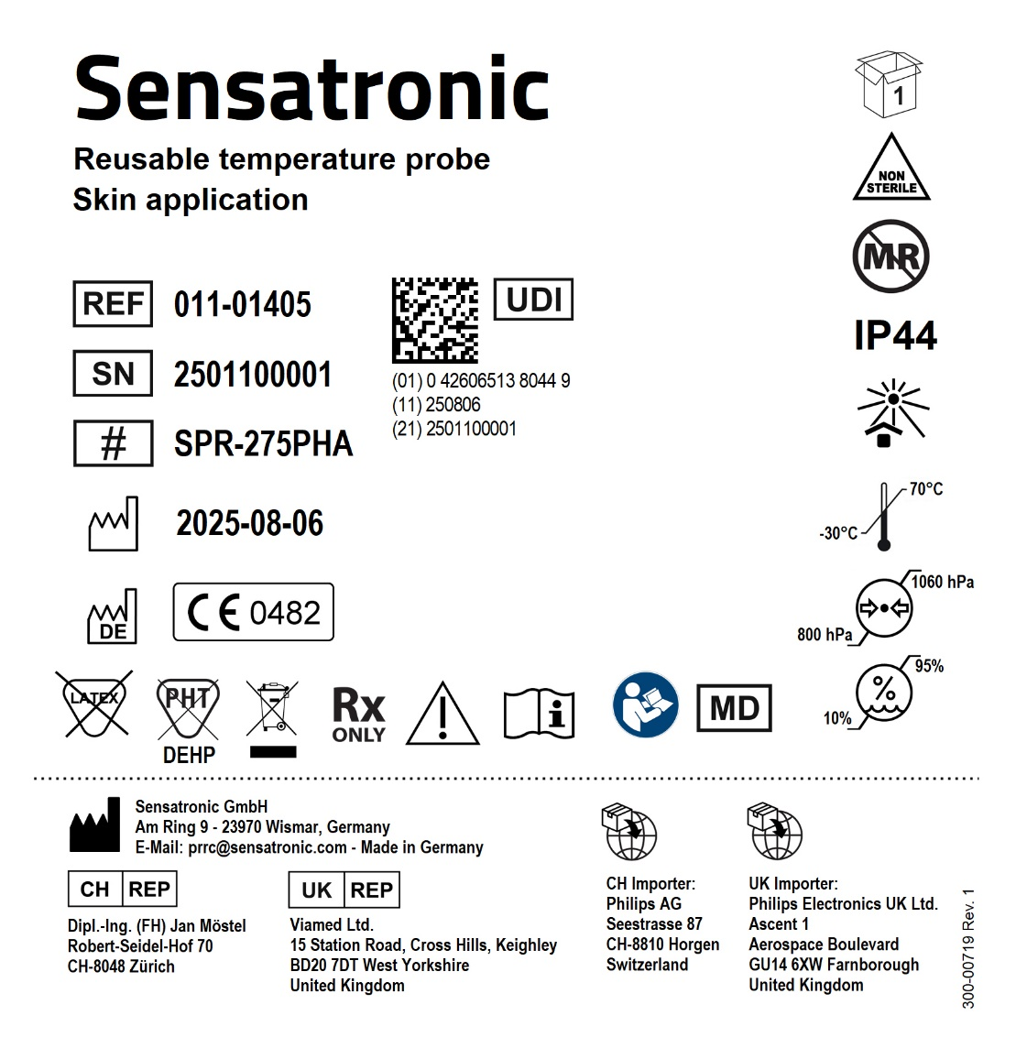
REF number/type | Description | Labelling
REF: 011-01405 Type: SPR-275PHA | Reusable Skin temperature probe, Philips compatible connector | Box label:

Slide 8
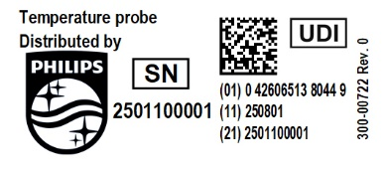
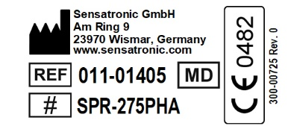
REF number/type | Description | Labelling
REF: 011-01405 Type: SPR-275PHA | Reusable Skin temperature probe, Philips compatible connector | Product label (front side): Product label (back side):

Slide 9
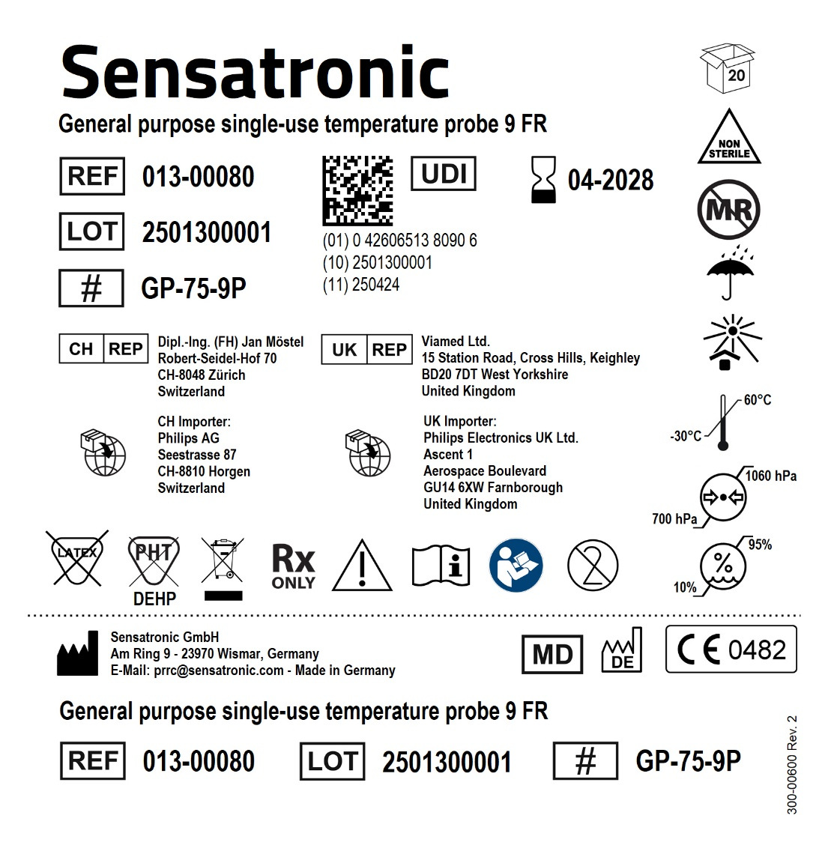
REF number/type | Description | Labelling
REF: 013-00080 Type: GP-75-9P | General purpose probe, single-use, non-sterile, 9 FR, Molex connector | Box label:

Slide 10
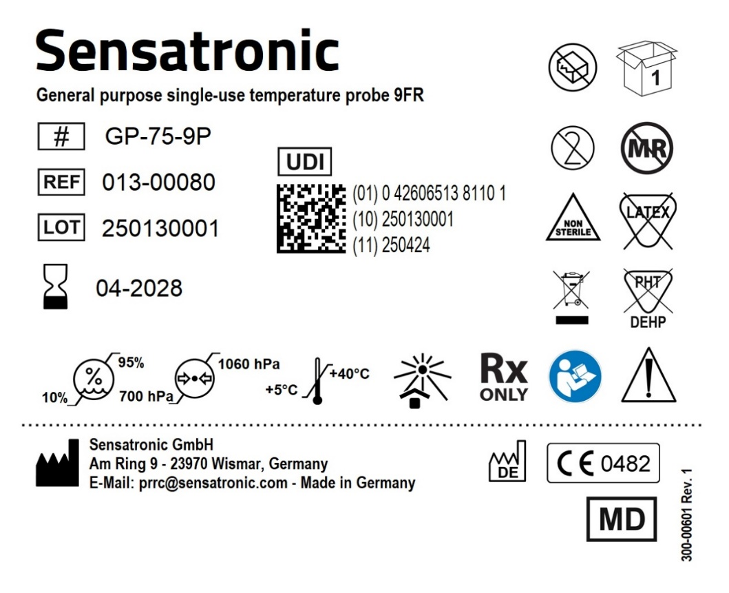
REF number/type | Description | Labelling
REF:013-00080 Type: GP-75-9P | General purpose probe, single-use, non-sterile, 9 FR, Molex connector | Pouch label (direct printing):

Slide 11

REF number/type | Description | Labelling
REF: 013-00081 Type: GP-75-12P | General purpose probe, single-use, non-sterile, 12 FR, Molex connector | Box label:

Slide 12
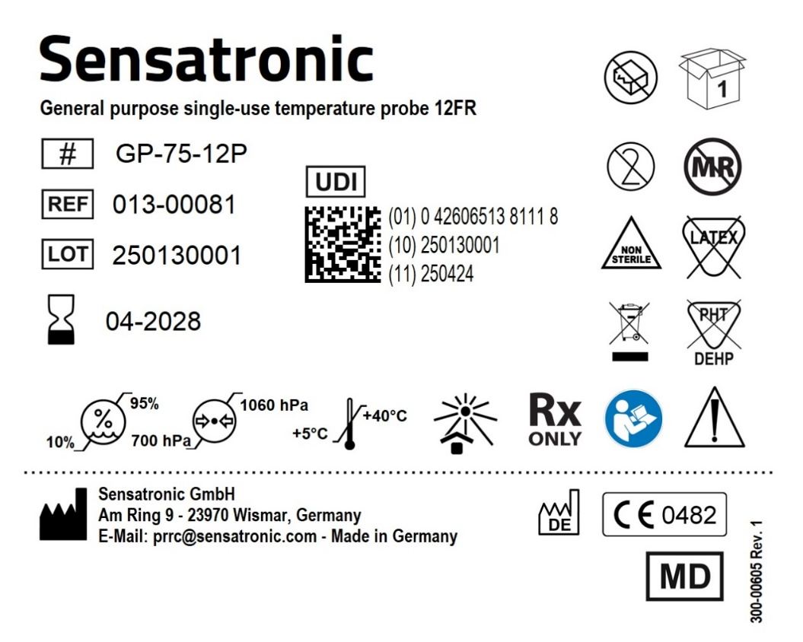
REF number/type | Description | Labelling
REF: 013-00081 Type: GP-75-12P | General purpose probe, single-use, non-sterile, 12 FR, Molex connector | Pouch label (direct printing):

Slide 13
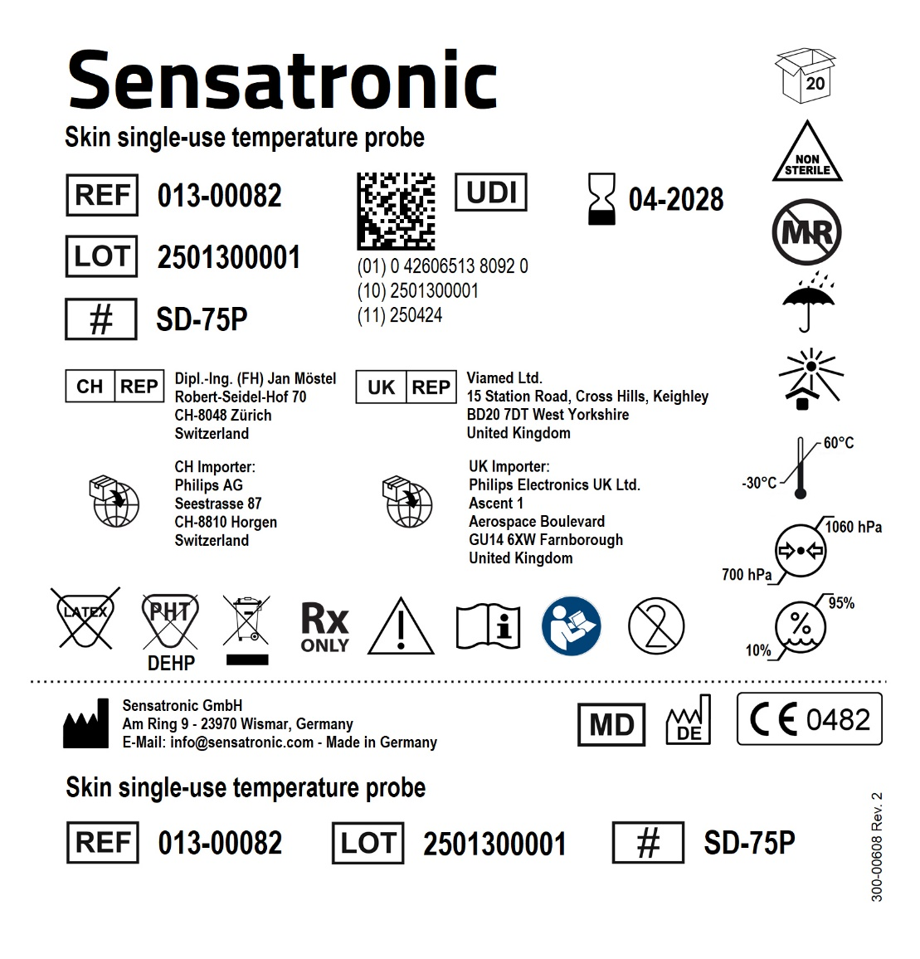
REF number/type | Description | Labelling
REF: 013-00082 Type: SD-75P | Skin probe, single-use, non-sterile, Molex connector | Box label:

Slide 14
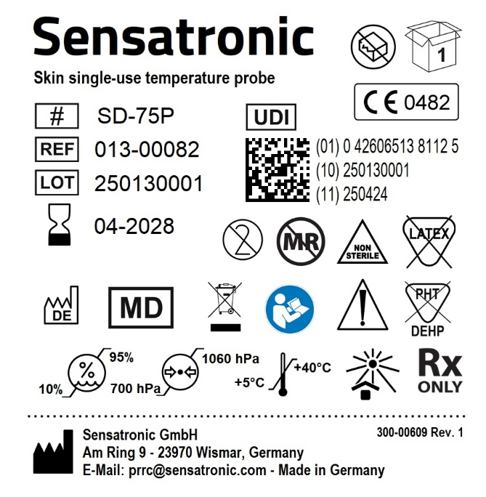
REF number/type | Description | Labelling
REF: 013-00082 Type: SD-75P | Skin probe, single-use, non-sterile, Molex connector | Pouch label (direct printing):

Slide 15
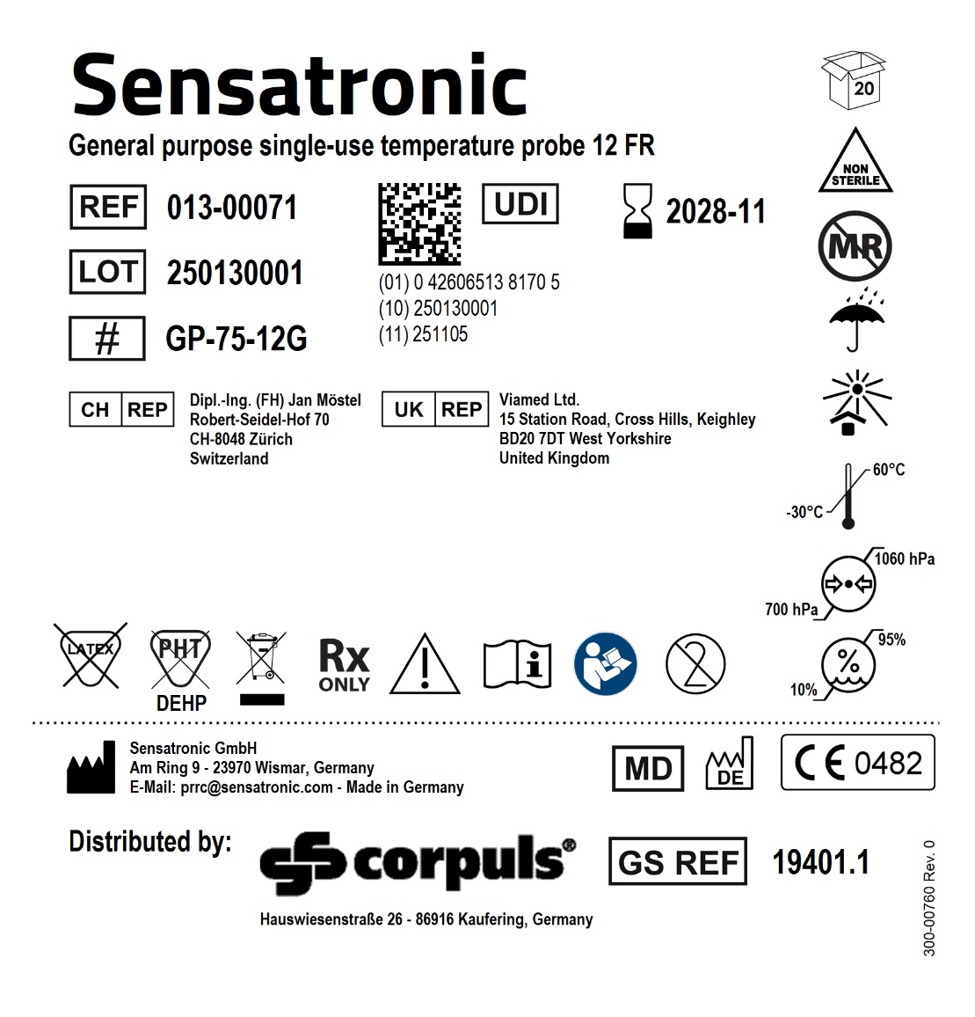
REF number/type | Description | Labelling
REF: 013-00071 Type: GP-75-12G | General purpose temperature probe, single-use, non-sterile, 12 FR, Molex connector | Box label:

Slide 16
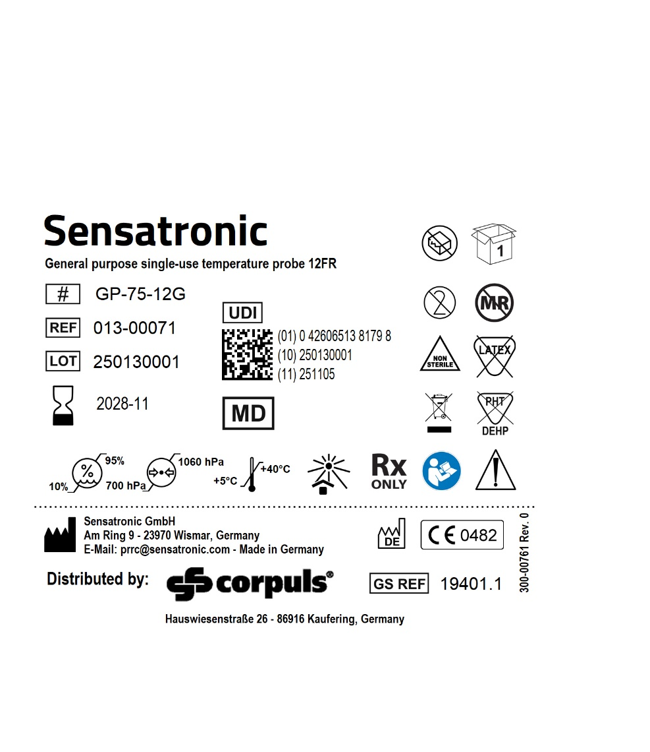
REF number/type | Description | Labelling
REF: 013-00071 Type: GP-75-12G | General purpose temperature probe, single-use, non-sterile, 12 FR, Molex connector | Pouch label (direct printing):

Slide 17
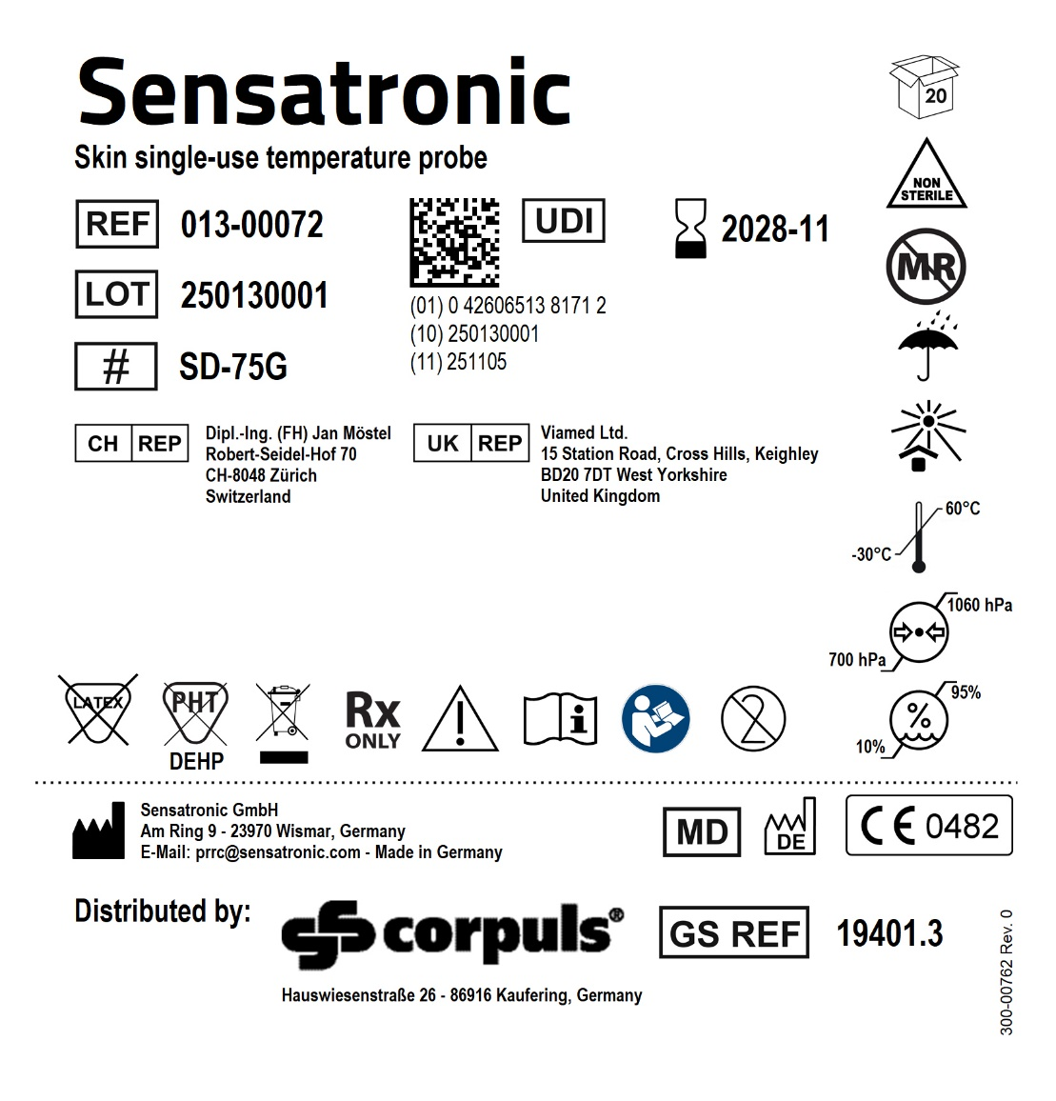
REF number/type | Description | Labelling
REF: 013-00072 Type: SD-75G | Skin temperature probe, single-use, non-sterile, Molex connector | Box label:

Slide 18
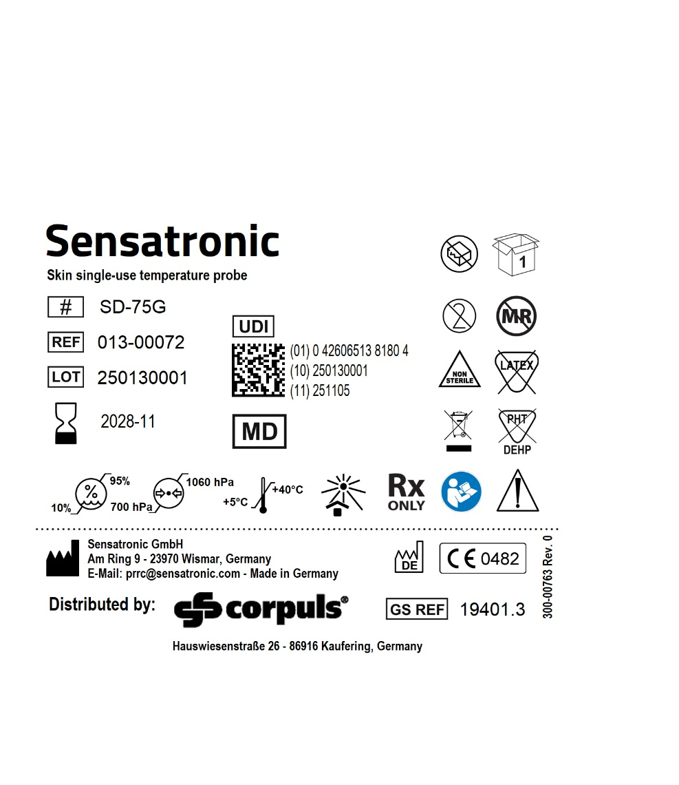
REF number/type | Description | Labelling
REF: 013-00072 Type: SD-75G | Skin temperature probe, single-use, non-sterile, Molex connector | Pouch label (direct printing):

Slide 19
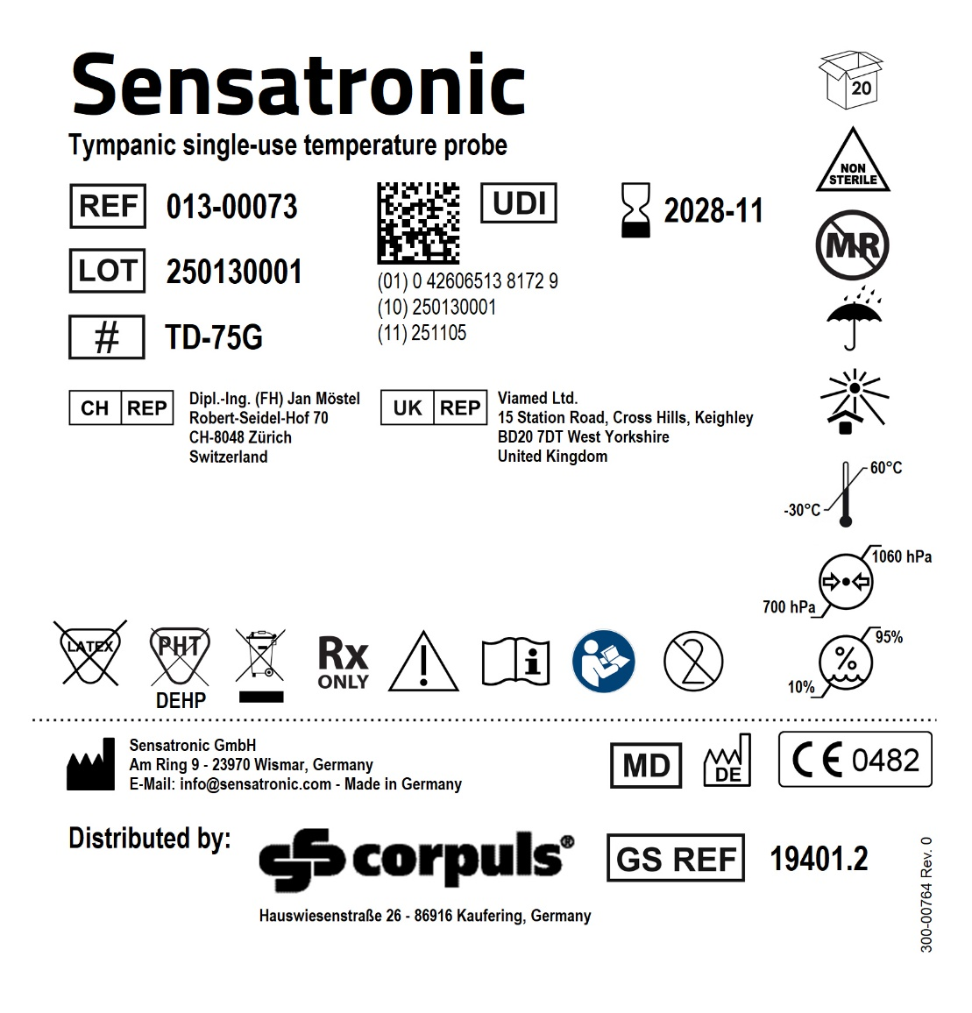
REF number/type | Description | Labelling
REF: 013-00073 Type: TD-75G | Tympanic temperature probe, single-use, non-sterile, Molex connector | Box label:

Slide 20
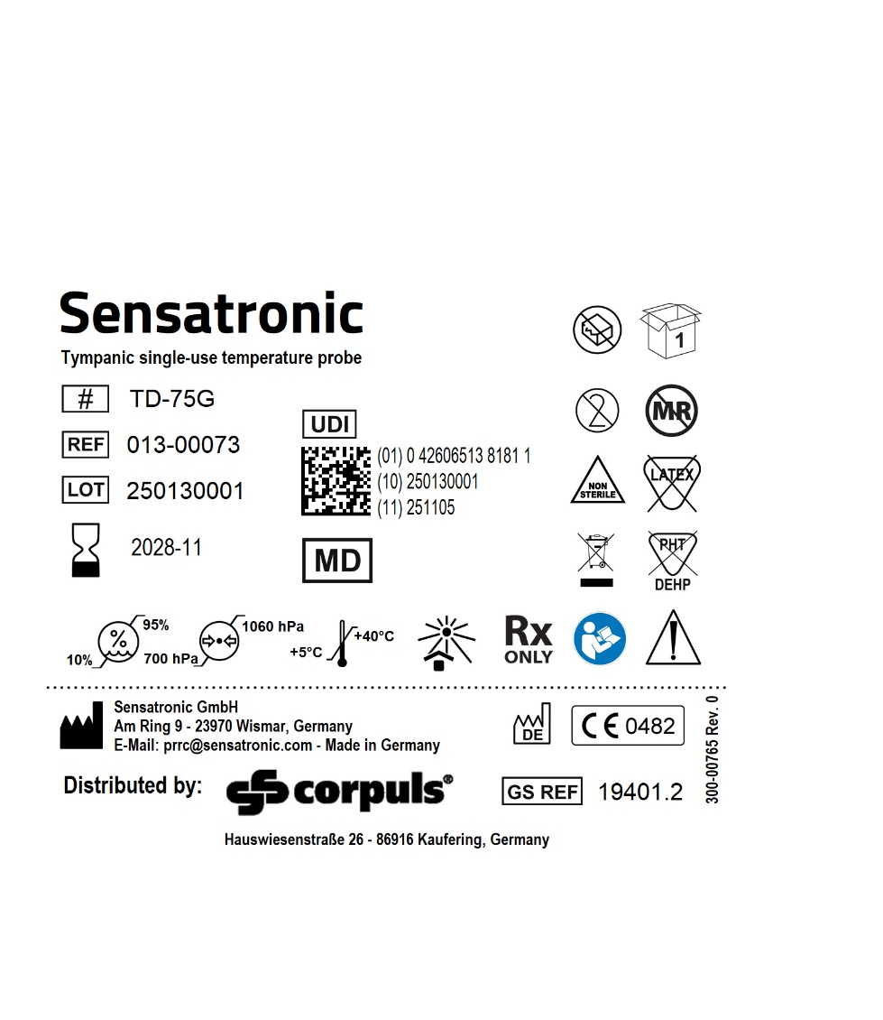
REF number/type | Description | Labelling
REF: 013-00073 Type: TD-75G | Tympanic temperature probe, single-use, non-sterile, Molex connector | Pouch label (direct printing):

Slide 21
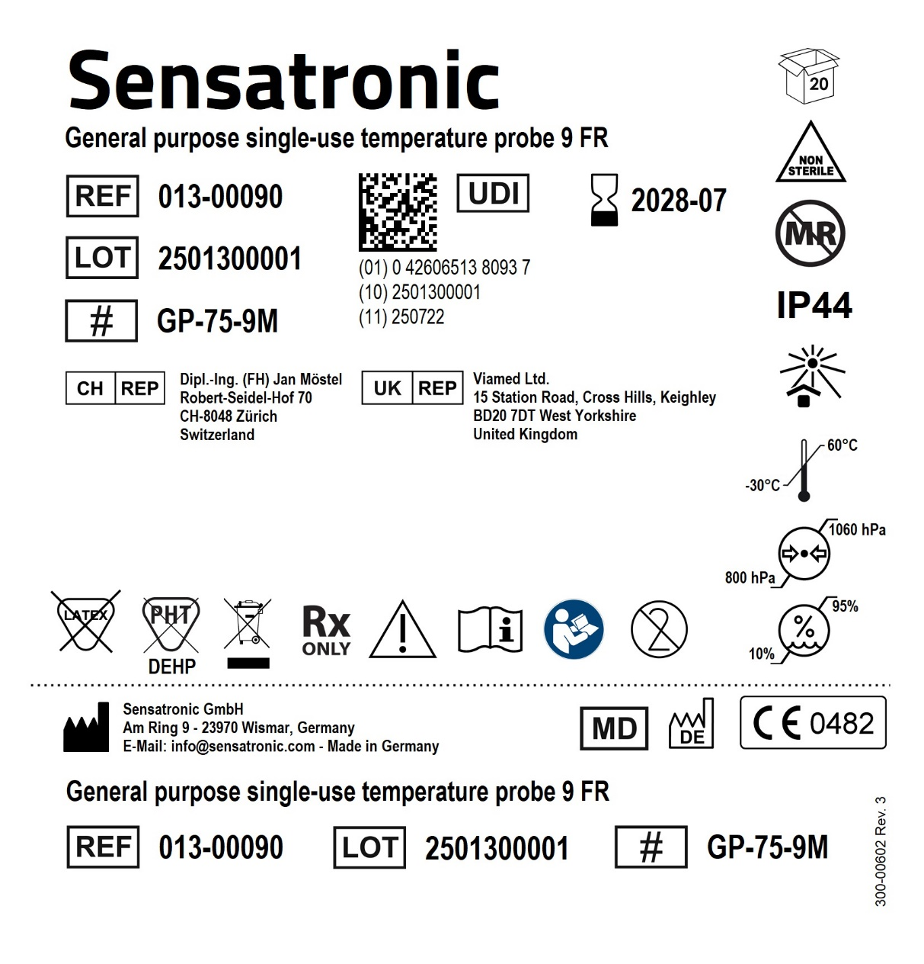
REF number/type | Description | Labelling
REF: 013-00090 Type: GP-75-9M | General purpose temperature probe, single-use, non-sterile, 9 FR, Molex connector | Box label:

Slide 22
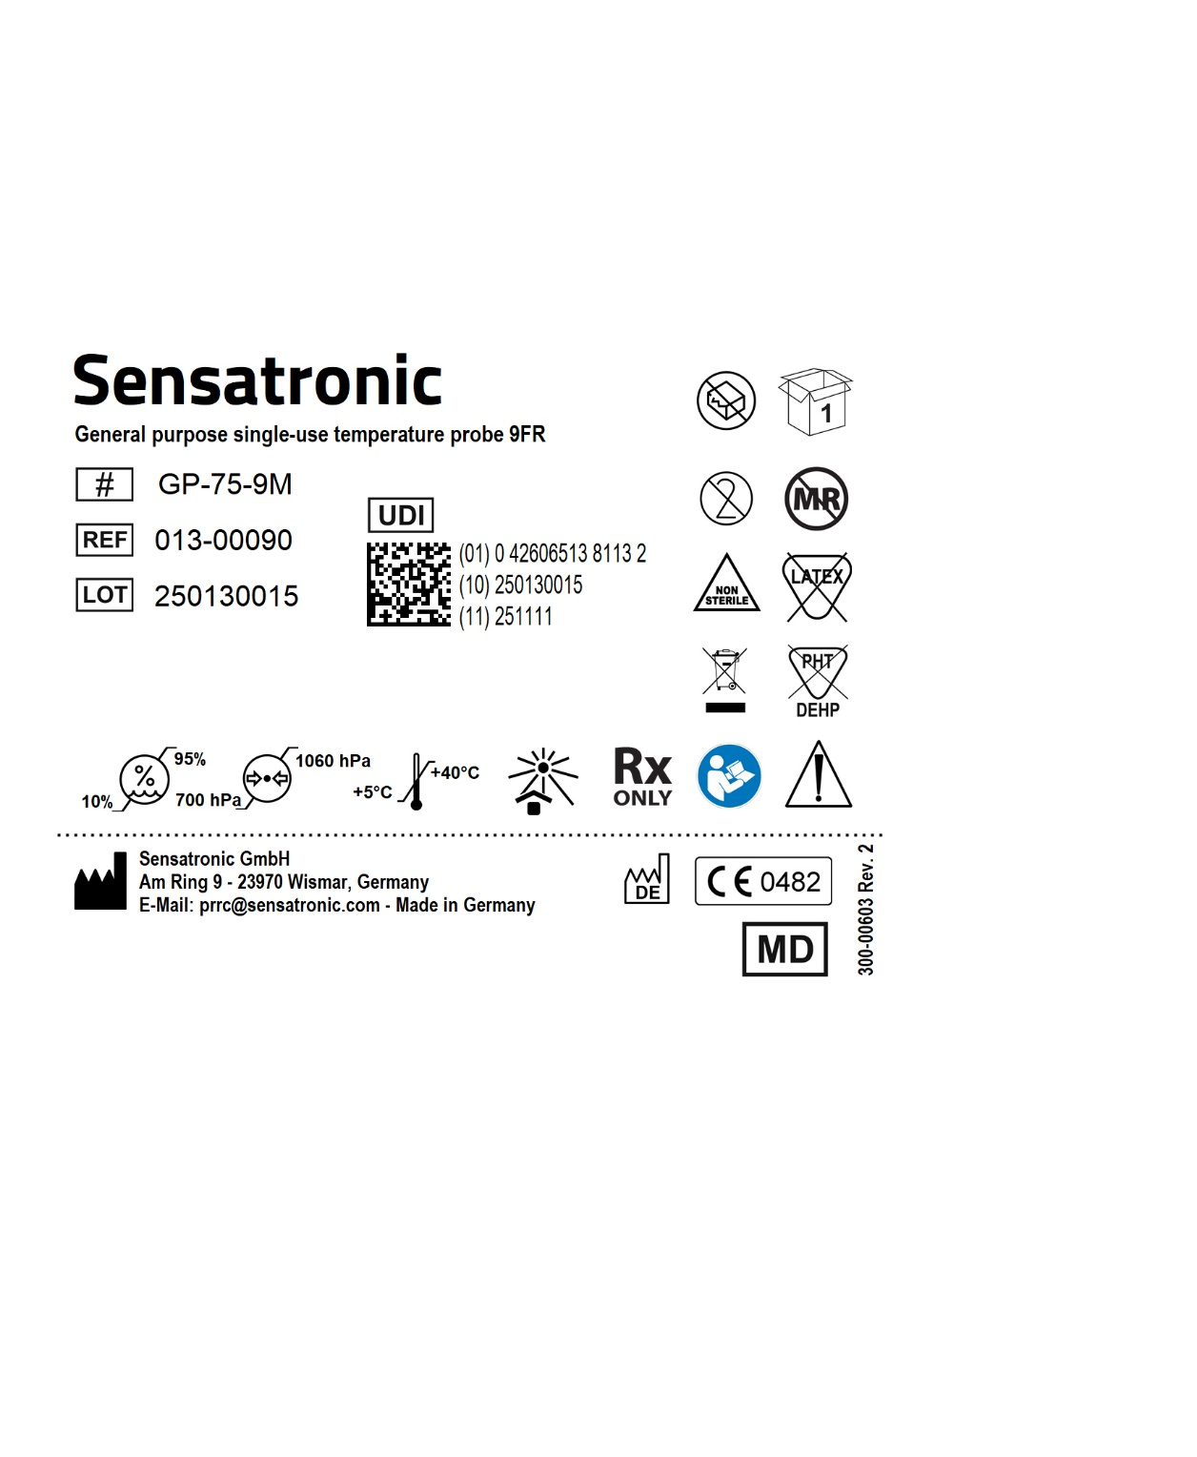
REF number/type | Description | Labelling
REF: 013-00090 Type: GP-75-9M | General purpose temperature probe, single-use, non-sterile, 9 FR, Molex connector | Pouch label (direct printing):

Slide 23

REF number/type | Description | Labelling
REF: 013-00091 Type: GP-75-12M | General purpose temperature probe, single-use, non-sterile, 12 FR, Molex connector | Box label:

Slide 24

REF number/type | Description | Labelling
REF: 013-00091 Type: GP-75-12M | General purpose temperature probe, single-use, non-sterile, 12 FR, Molex connector | Pouch label (direct printing):

Slide 25
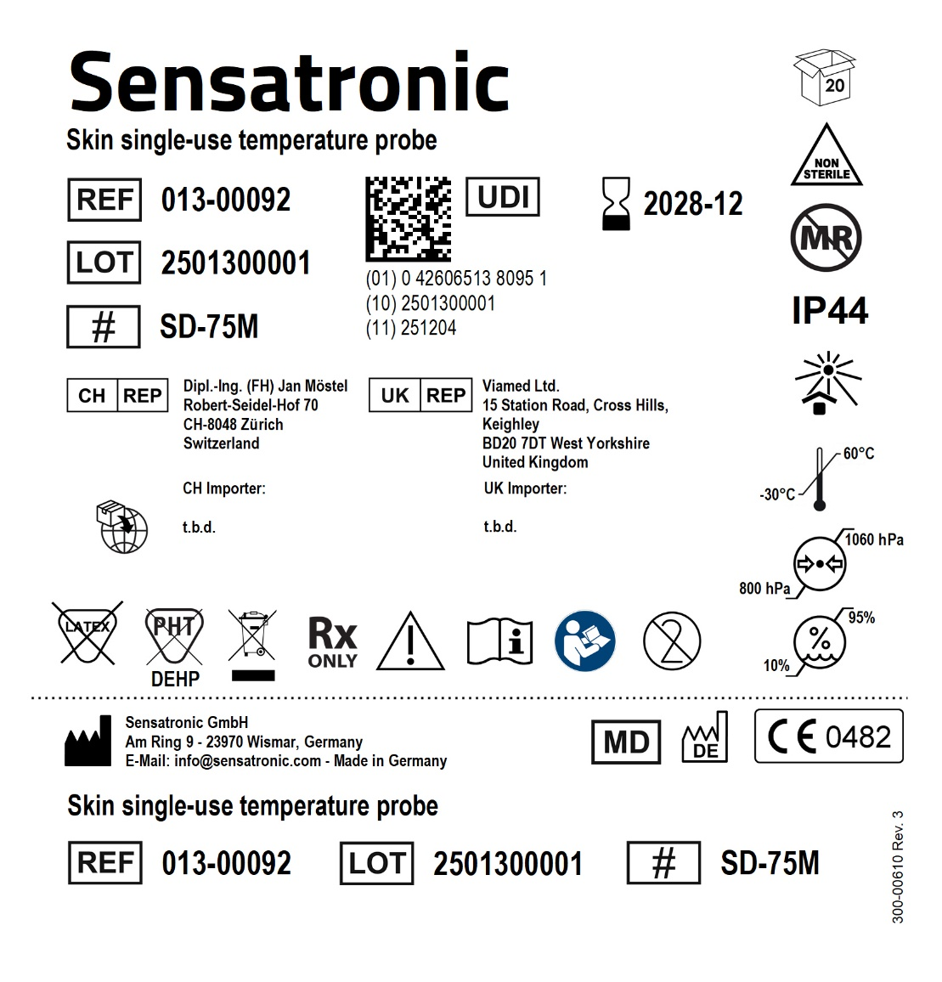
REF number/type | Description | Labelling
REF: 013-00092 Type: SD-75M | Skin temperature probe, single-use, non-sterile, Molex connector | Box label:

Slide 26
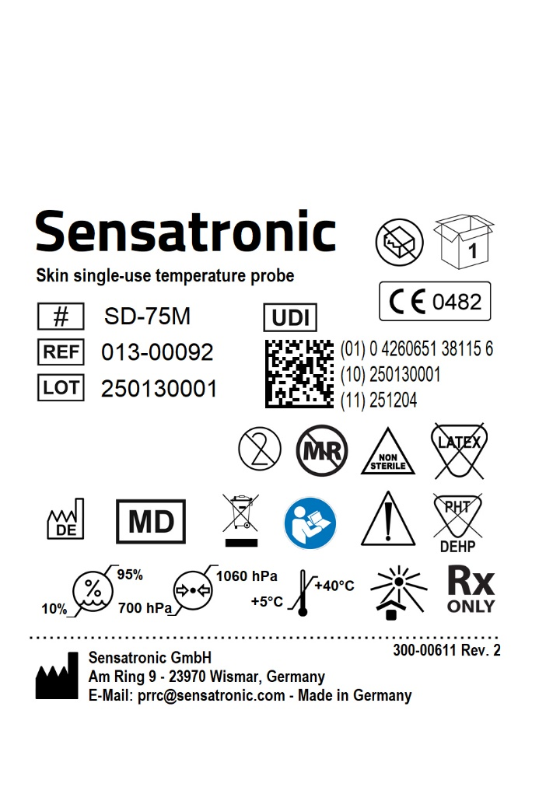
REF number/type | Description | Labelling
REF: 013-00092 Type: SD-75M | Skin temperature probe, single-use, non-sterile, Molex connector | Pouch label (direct printing):

Slide 27
REF number/type | Description | Labelling
REF: 013-00093 Type: TD-75M | Tympanic temperature probe, single-use, non-sterile, Molex connector | Box label:

Slide 28
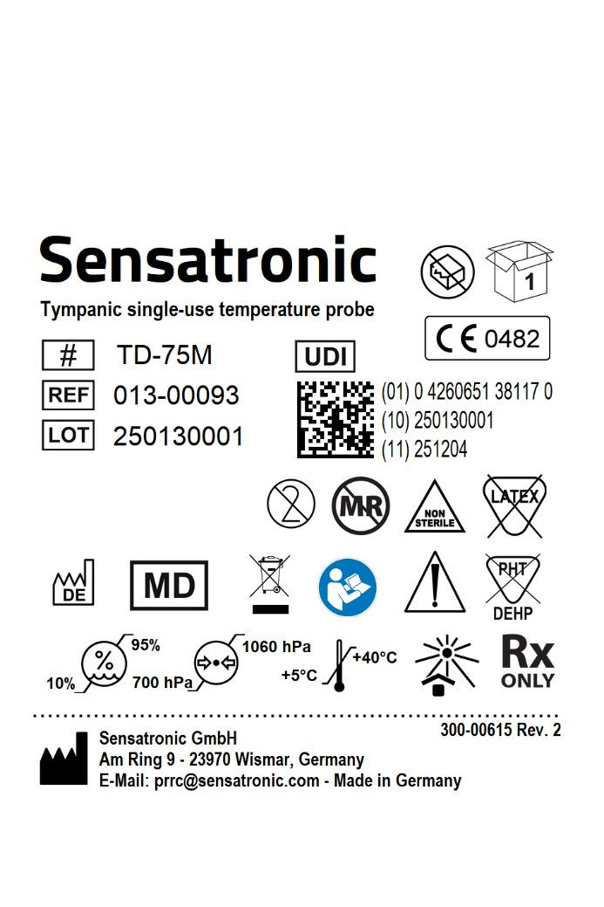
REF number/type | Description | Labelling
REF: 013-00093 Type: TD-75M | Tympanic temperature probe, single-use, non-sterile, Molex connector | Pouch label (direct printing):

Slide 29
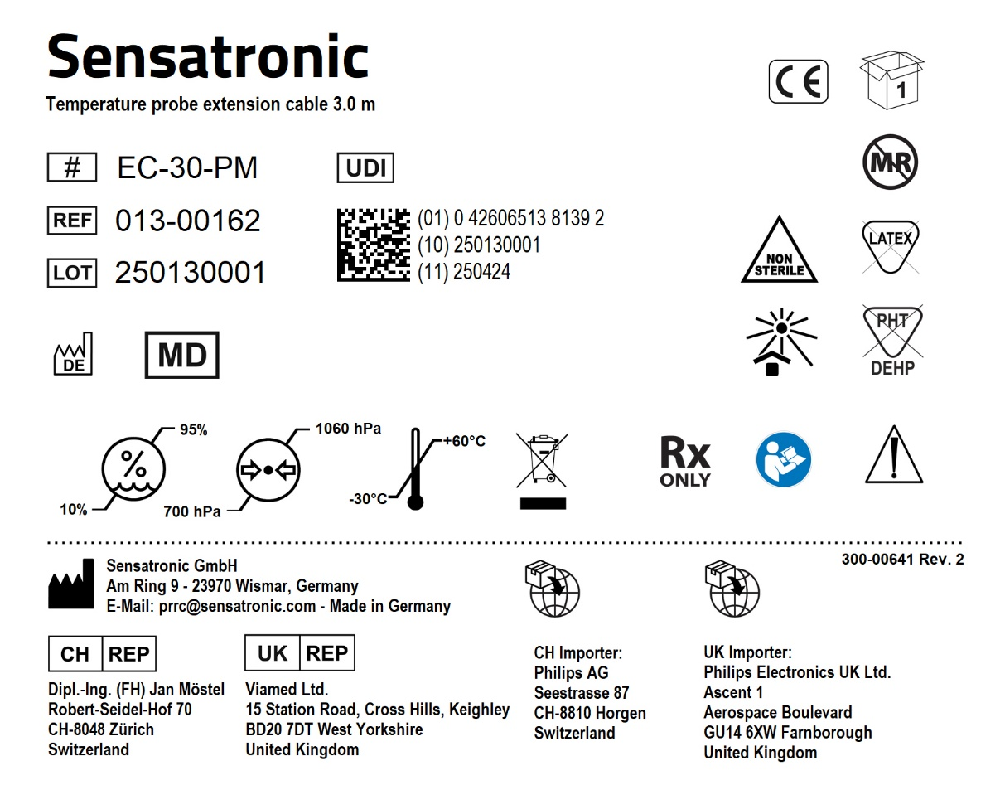
REF number/type | Description | Labelling
REF: 013-00162 Type: EC-30-PM | Extension cable for single-use probes, 3.0 m, Molex connector and Philips compatible monitor connector | Box label:

Slide 30
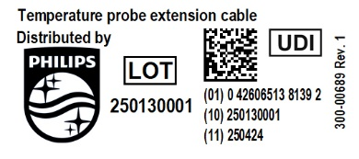
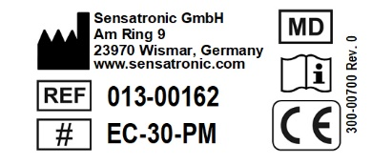
REF number/type | Description | Labelling
REF: 013-00162 Type: EC-30-PM | Extension cable for single-use probes, 3.0 m, Molex connector and Philips compatible monitor connector | Flag label (front): Flag label (back):

Slide 31
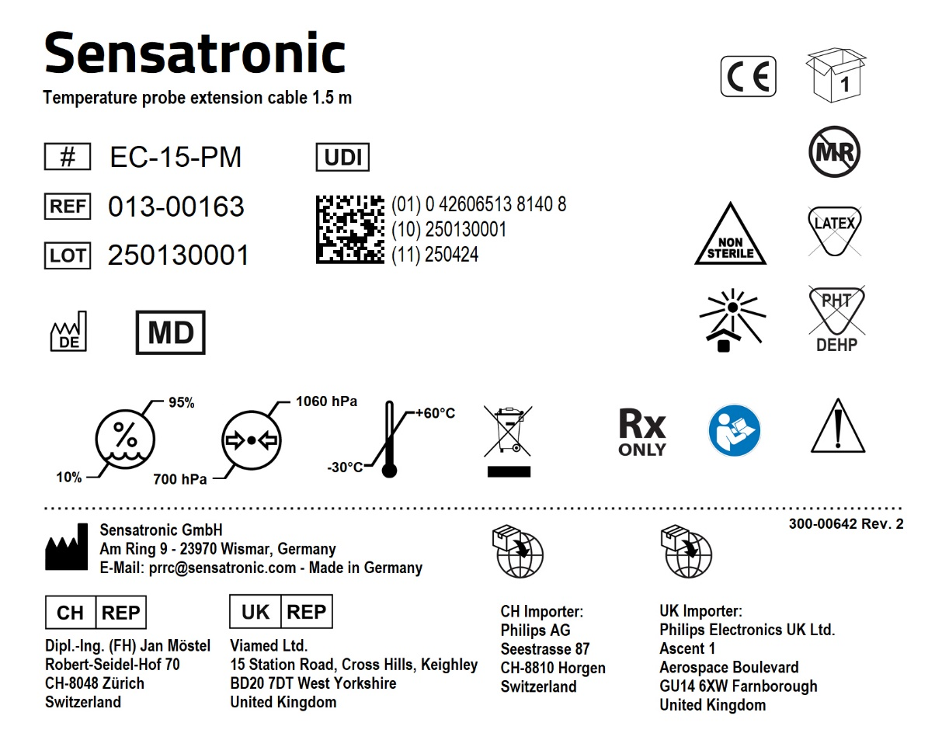
REF number/type | Description | Labelling
REF: 013-00163 Type: EC-15-PM | Extension cable for single-use probes, 1.5 m, Molex connector and Philips compatible monitor connector | Box label:

Slide 32
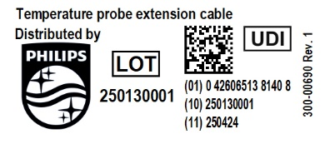
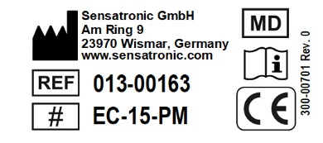
REF number/type | Description | Labelling
REF: 013-00163 Type: EC-15-PM | Extension cable for single-use probes, 1.5 m, Molex connector and Philips compatible monitor connector | Flag label (front): Flag label (back):

Slide 33
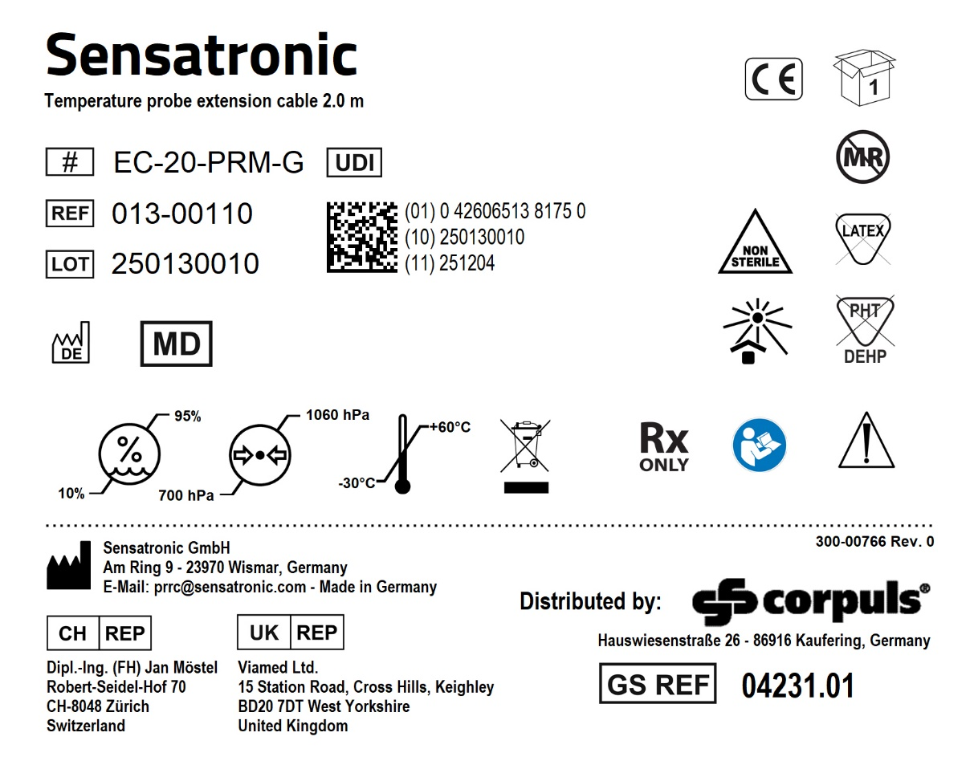
REF number/type | Description | Labelling
REF: 013-00110 Type: EC-20-PRM-G | Extension cable for single-use probes, 2.0 m, Molex connector and right-angled monitor connector | Box label:

Slide 34
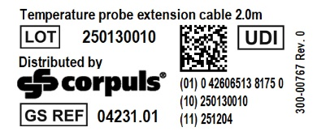
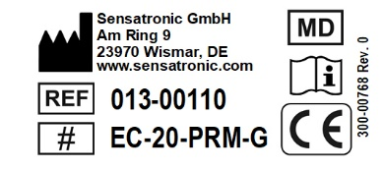
REF number/type | Description | Labelling
REF: 013-00110 Type: EC-20-PRM-G | Extension cable for single-use probes, 2.0 m, Molex connector and right-angled monitor connector | Flag label (front): Flag label (back):

