Slide 1
10835-DFM_20230213

Slide 2
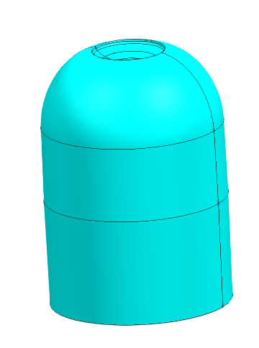
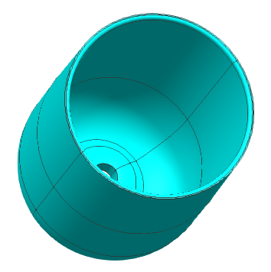
¢24.00X33.80MM
General Information
Project No. | 10835
Part name | CAP
Material | PP
Weight | 2.8g
Shrinkage | 1.016
Cavity | 1*2
Ejection | pin
Gate | SUB-Gate
Mold type | 2 plates
Surface finish | VDI21+ 600Grit
Cavity steel | 738H
Core steel | 738H

Slide 3
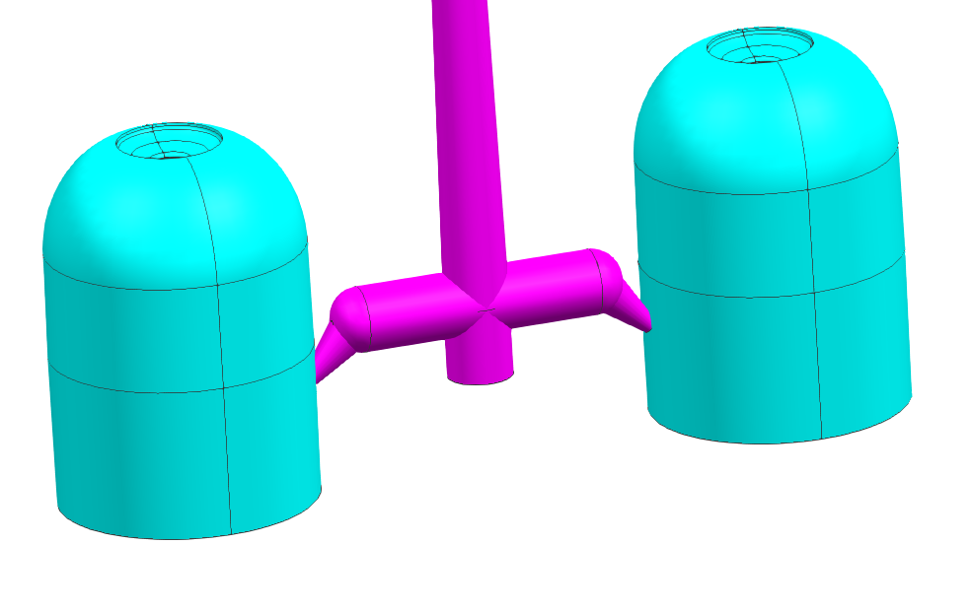
Gate
2 plates, SUB gate ¢1.2mm

Slide 4
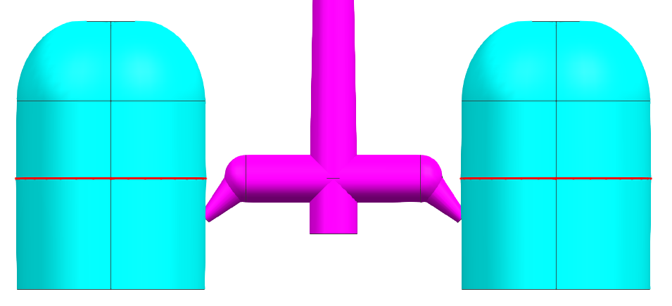
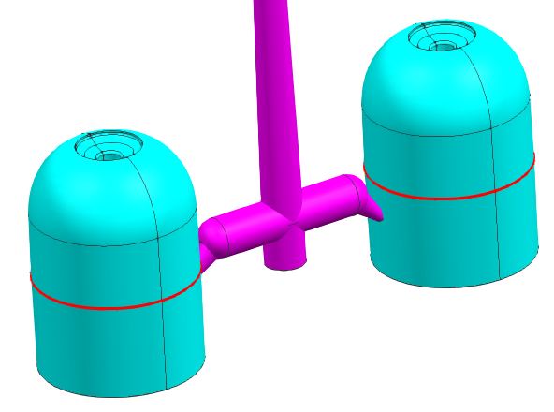
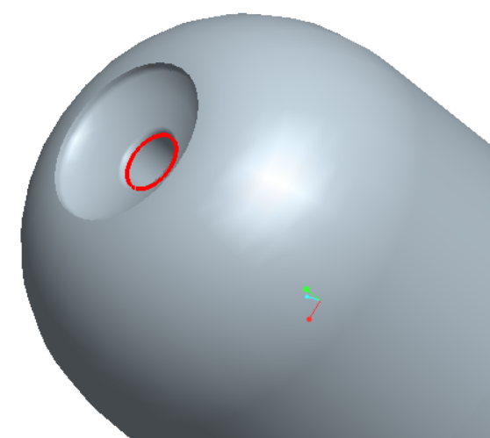
Parting line
CAV
CORE
CAV
CORE

Slide 5
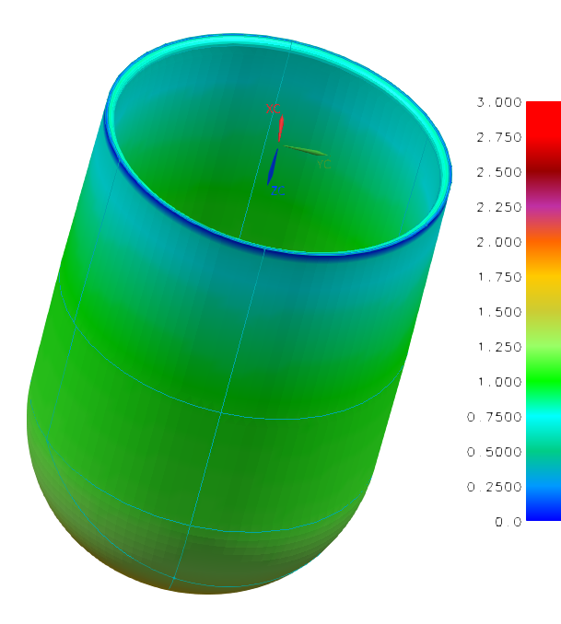
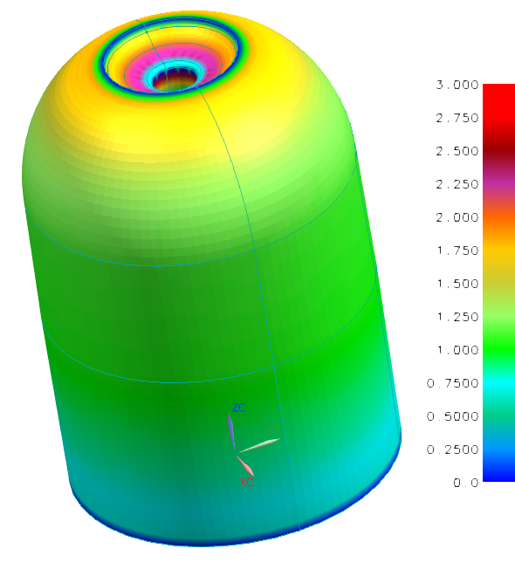

Wall Section
Wall section OK

Slide 6
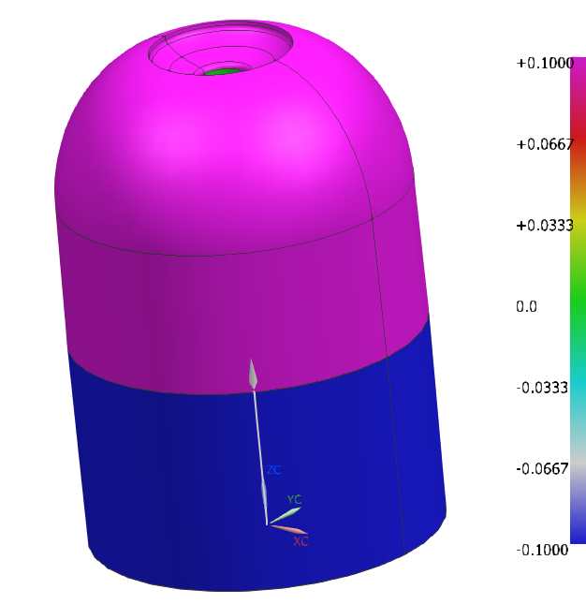
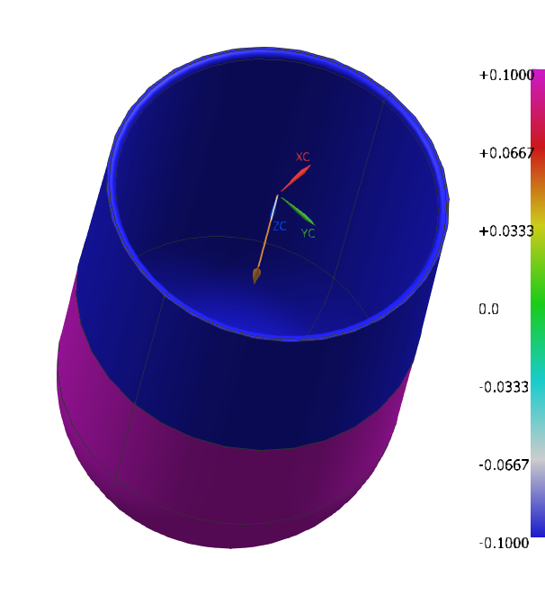
Draft analysis脱模角度分析
Draft OK

Slide 7
Finishing
Pink area is texture with VDI21, rest blue area is smooth polishing with 600grit, please confirm.

Slide 8
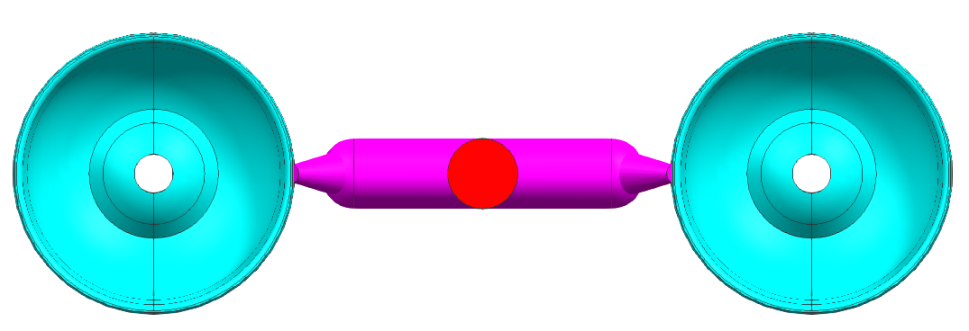
Ejector pin
Ejector pin

